Slide 1
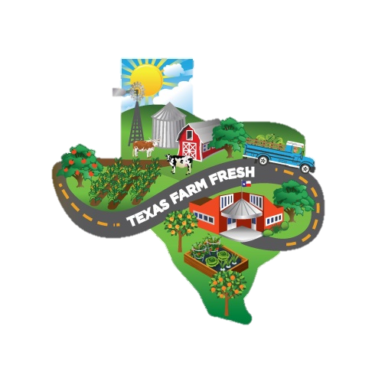
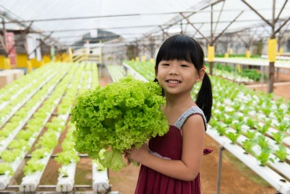
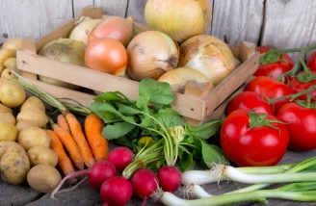
Summer Farm Fresh Challenge
Be Social Support
The Texas Department of Agriculture Farm Fresh Challenge has three parameters - Eat Local. Teach Local. and Be Social.
This Be Social Support tool provides sample posts and best practices to help you and your sites Be Social. Share at least one social media post on Facebook, Instagram or Twitter using #FarmFreshTexas to meet the Farm Fresh Challenge Be Social requirement.
Instructions: Copy and paste these sample posts into your social media platforms, newsletter and bulletin boards. Be sure to remove the text italicized in parentheses and fill in the appropriate information. Also add a comment or two to personalize your posts!
Target Audience: Families of program participants, and community partners
English* | Spanish* | Sample Image
(Contracting Entity Name) joined the @TexasDepartmentofAgriculture in the Farm Fresh Challenge. We partner with (Farm name) to serve more locally sourced food. Our participants will be enjoying fresh foods and learning about Texas agriculture! #FarmFreshTexas | (Contracting Entity Name) se unió a @TexasDepartmentofAgriculture en el desafío de la granja fresca. Nos asociamos con (nombre de la granja) para servir más alimentos de origen local. ¡Nuestros participantes disfrutarán de alimentos frescos y aprenderán sobre la agricultura de Texas! #FarmFreshTexas
(Contracting Entity Name) pledged to serve more local foods for TDA’s Summer Farm Fresh Challenge! #FarmFreshTexas | (Contracting Entity Name) se comprometió a servir más alimentos locales para el Summer Farm Fresh Challenge de TDA! #FarmFreshTexas
Fresh food should be integral to a child’s meal. We took the Farm Fresh Challenge to show our commitment to serving local ingredients in our meals and snacks. #FarmFreshTexas | La comida fresca debería ser una parte integral de la comida de un niño, así que tomamos el Farm Fresh Challenge para servir ingredientes locales en nuestras cafeterías #FarmFreshTexas
We serve local, (Farm name and /or ingredient) from (City), Texas #FarmFreshTexas | Servimos local de (Farm name) en (City), Texas #FarmFreshTexas | Share a picture of a Farm Fresh meal!
As part of the Farm Fresh Challenge, program participants learned about (fill in detail of Farm Fresh educational activity)! #FarmFreshTexas | Como parte del Farm Fresh Challenge, ¡los estudiantes aprendieron (details of educational activity)! #FarmFreshTexas | Share a picture that highlights your educational activity.
*All posts are designed to be used on Facebook, Instagram and Twitter.

Slide 2
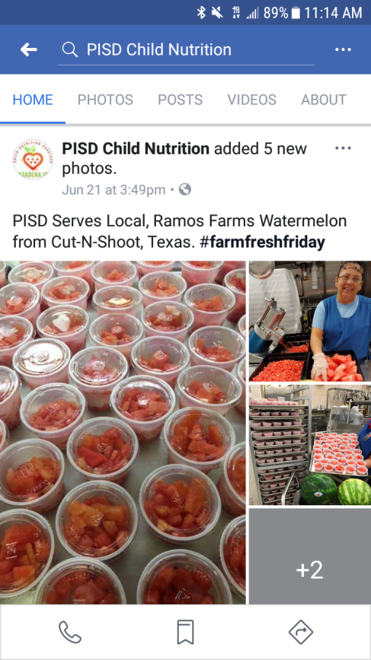
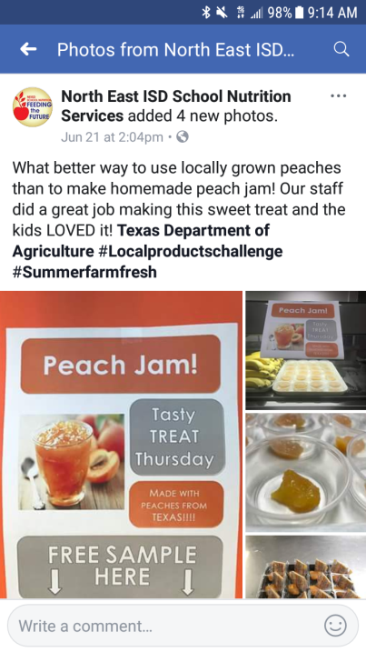
Examples
Social Media Best Practices
1. Consider your audience
Your audience includes family members, kids, local media, officials and community leaders. Tailor your language and make sure the message is easy to read.
2. Use social media tags and hashtags
Create a short link to a profile using the @ key on any of the three platforms. This will allow the tagged profile to add your post to its timeline and ultimately increase the posts visibility and longevity.
Consider tagging local news outlets, radio stations, and/or mayors.
Tag TDA on Facebook and Twitter
Facebook: Texas Department of Agriculture
Twitter: @TexasDeptofAg
Use #FarmFreshTexas
3. Add photos or videos
Use photos, videos or GIFs whenever possible. Facebook Video, Facebook Live and Instagram’s Boomerang offer fun ways to add multimedia to communication platforms. Keep videos under two minutes.
Make sure any media has the appropriate release form.
TDA has provided high quality images sized to fit Facebook, Instagram, and Twitter. You can also add these to your web pages and newsletters.
The suggested image size for most platforms is at least 800x800 pixels. Aim for 1200x630 for Facebook, 1080x1080 for Instagram, and 440x220 for Twitter.
4. Plan Posts
Plan your posts based on your sites activities and when you’ve planned a farm fresh meal or activity. Also consider the peak posting times below.
Peak Post Times for Each Platform
Facebook | Twitter | Instagram
3 pm Wednesday 1-4 pm Thursday and Friday Noon-1 pm Saturday and Sunday | Noon and 5-6 pm Wednesday Noon-3 pm and 5 pm Monday-Friday | 8-9 am and 5 pm Monday and Thursday for images 9 pm-8 am Monday-Sunday for videos

