Slide 1


Administrative Review (AR)
For
Contracting Entities
Review Attachments
Notes:
Welcome to The Texas Department of Agriculture’s Administrative Review in TX-UNPS, Specifically focusing on Review Attachments.

Slide 2

ICON | FUNCTION
 | ATTACHMENT: Select this icon beside the corresponding question to upload a file as an attachment.
 | ERROR: Indicates that a question is in is error. The error process is initiated once a user selects the Validate button at the bottom of the form page. The form will remain in an error status until all required questions have been answered
 | TOOL TIP: Hovering over the icon will briefly display additional information that may aid in answering the review question. The user can also click the icon to display the information in a popup.
!
?
WORDS | DEFINITION
VIEW | View only, no changes are possible
MODIFY | Edit, make changes
DETAIL | Opens selected parts of the review
AGENCY | Contracting Entity
Notes:
The following icons are used in the Administrative review module. Please take a few moments to familiarize yourself with them.
Throughout the AR module you will often see the word ‘AGENCY’ . Agency means Contracting Entity.

Slide 3
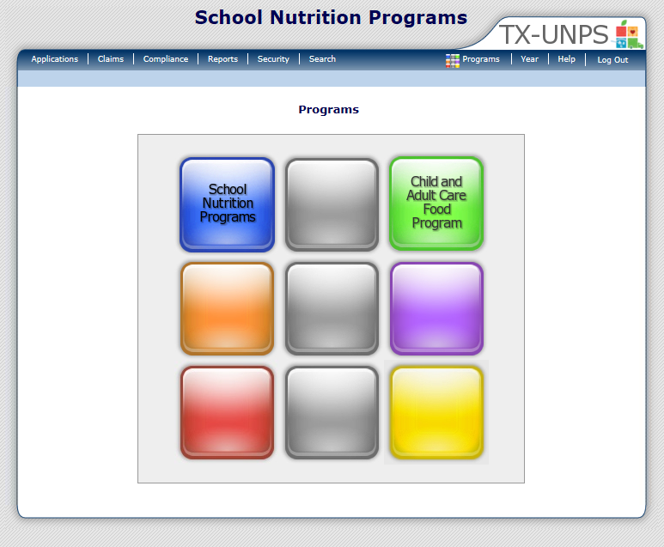
Notes:
After you have logged into the system, click on ‘COMPLIANCE ‘ on the blue navigation menu bar

Slide 4
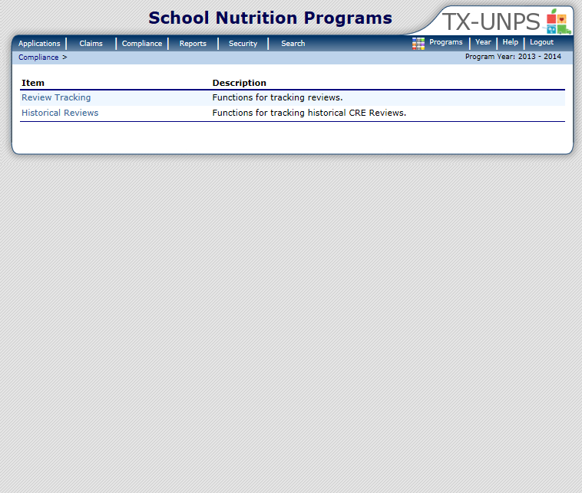
Notes:
Next, select ‘REVIEW TRACKING’

Slide 5
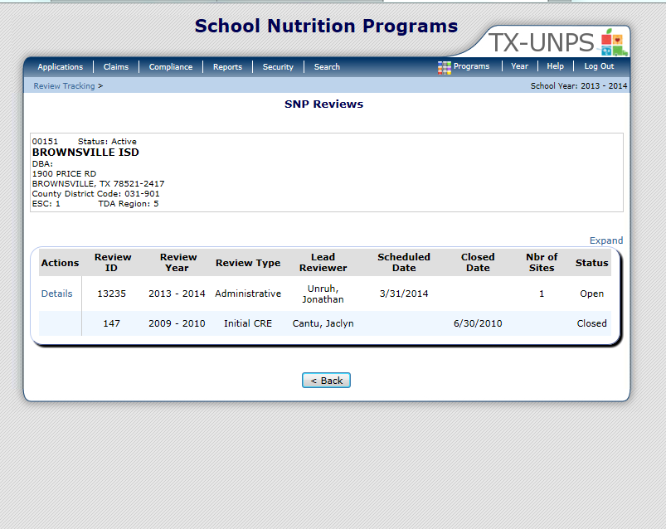
Notes:
This will open up the SNP Review screen
Only Reviews that have a status of Open are accessible. Click ‘DETAILS’

Slide 6
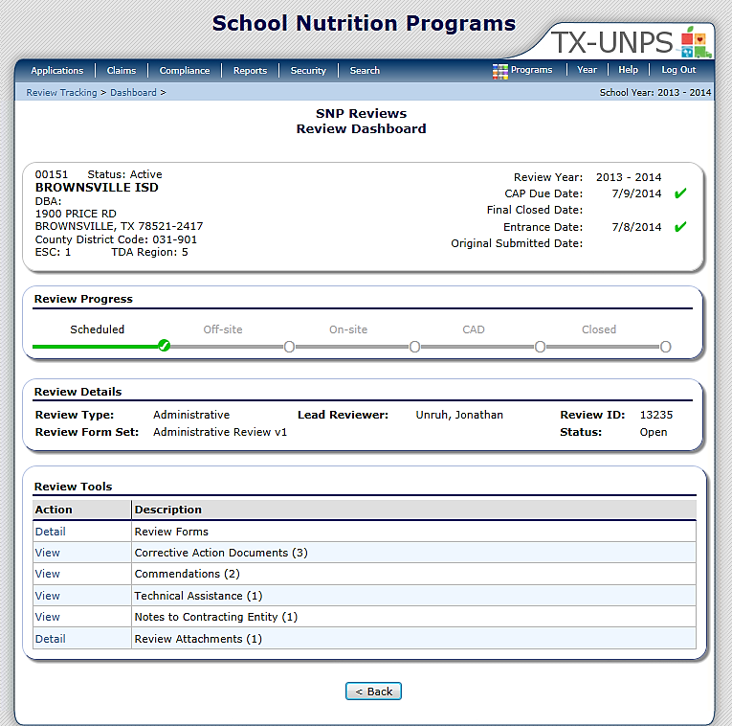
01234 Status: Active
ANYWHERE ISD
DBA:
1 Main ST
Anywhere, US 12345
County District Code : 123-456
ESC Region: 1
SCHOOL
INFORMATION:
IMPORTANT
DATES:
Notes:
The next screen is the Review Dashboard
The Review Dashboard serves as the launching point for all information pertaining to the review.
At the top of the page you will see a box that has basic information:
On the left is the school’s basic information (name, address and ESC region)
On the right are important dates (Review year, CAP due date, Final closed date, Entrance date and original submitted date).
Below this box is the REVIEW PROGRESS box. The review progress bar enables you to view the stage of the review at–a-glance. Each stage must be completed sequentially in order to progress through the review process
The last box contains the REVIEW TOOLS. This is where you will navigate to specific sections or modules of the review.

Slide 7

01234 Status: Active
ANYWHERE ISD
DBA:
1 Main ST
Anywhere, US 12345
County District Code : 123-456
ESC Region: 1
Notes:
You can access ‘REVIEW ATTACHMENTS’ from the review Dashboard. To open, select ‘DETAIL’

Slide 8
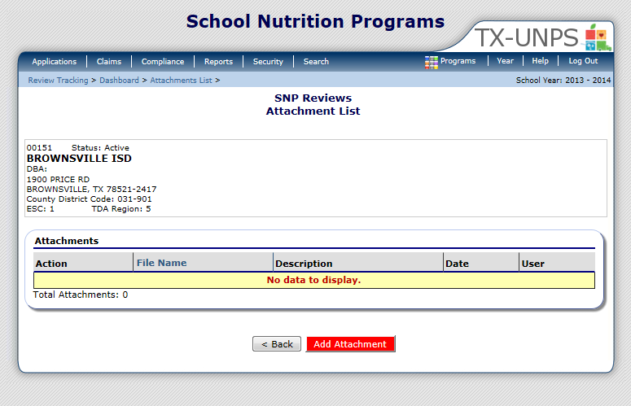
01234 Status: Active
ANYWHERE ISD
DBA:
1 Main ST
Anywhere, US 12345
County District Code : 123-456
ESC Region: 1
Notes:
To attach any supporting documentation you will do it From the Review Attachments module.
If no attachments have been upload you will see “No data to display.”
To attach or upload your document select ‘ADD ATTACHMENT’

Slide 9
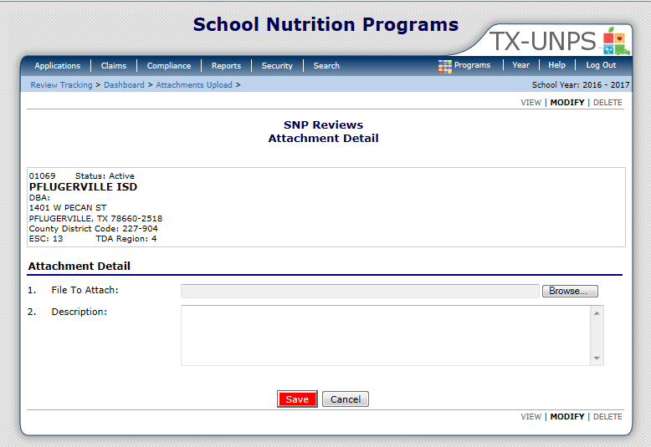
01234 Status: Active
ANYWHERE ISD
DBA:
1 Main ST
Anywhere, US 12345
County District Code : 123-456
ESC Region: 1
Notes:
The Attachment Detail screen will open.
First, select ‘BROWSE’.

Slide 10
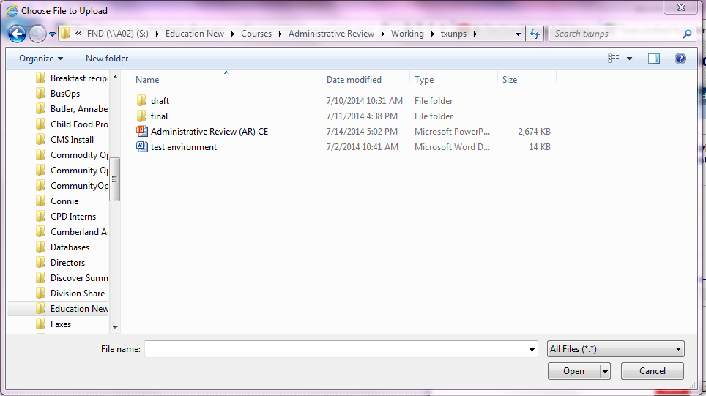
test environment
Notes:
This will open up a list of files on your computer that you can attach.
Select the file you that you want to attach and click ‘OPEN’.

Slide 11
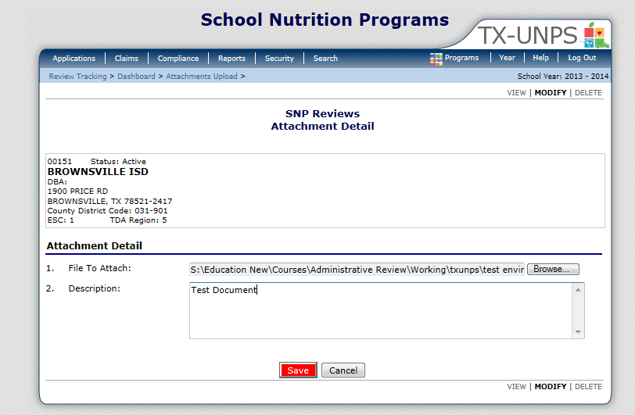
01234 Status: Active
ANYWHERE ISD
DBA:
1 Main ST
Anywhere, US 12345
County District Code : 123-456
ESC Region: 1
Notes:
You should now see the document you selected in the ‘File To Attach’ box:
Next;
Type a brief but detailed description of your file.
Select ‘SAVE’

Slide 12
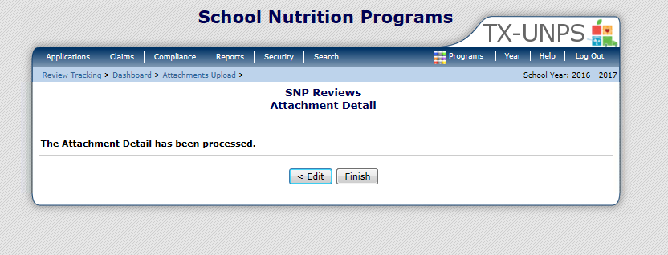
0
Notes:
If the document was successfully attached you will see the message letting you know it was processed.
Select, ‘FINISH’

Slide 13
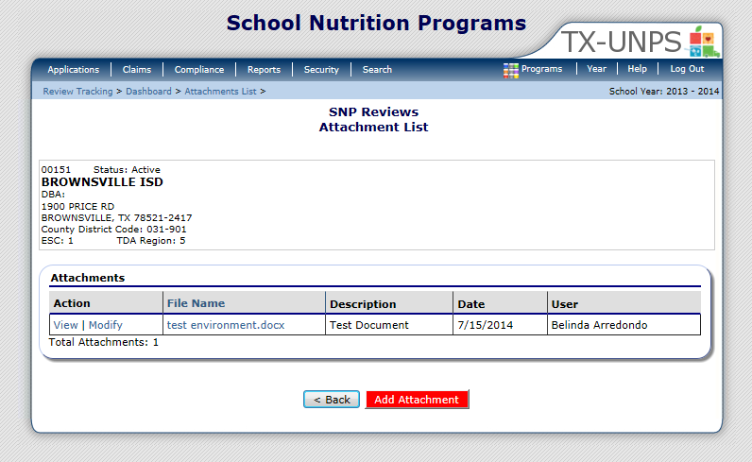
01234 Status: Active
ANYWHERE ISD
DBA:
1 Main ST
Anywhere, US 12345
County District Code : 123-456
ESC Region: 1
Notes:
After you have uploaded or attached your document, you should now see it listed on the Attachment List screen.
The Attachment List Screen allows you to view basic information about document: the file name, a brief description of the document, the date it was uploaded and the user who uploaded it.
This document allows you to view or modify the attachment detail screen.
To view the actual document click on the file name.
It also details the File Name, Description, Date it was added to TX-UNPS and the user who added it.

Slide 14

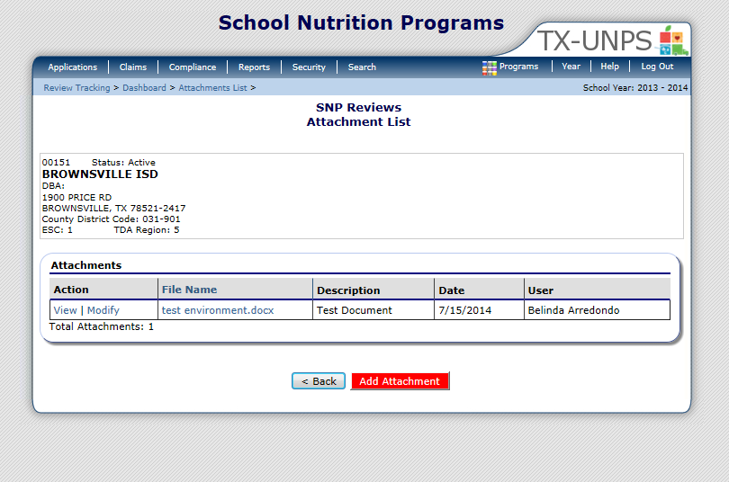
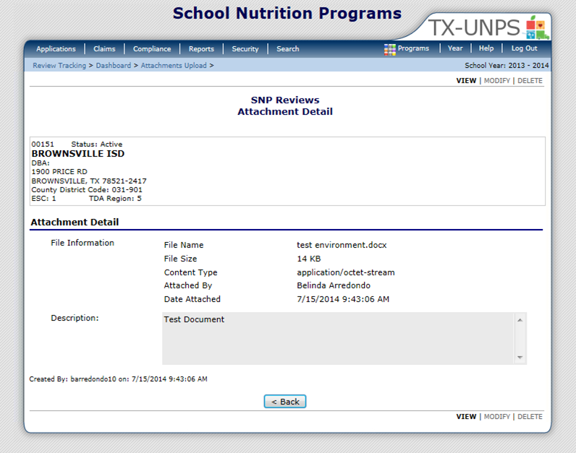
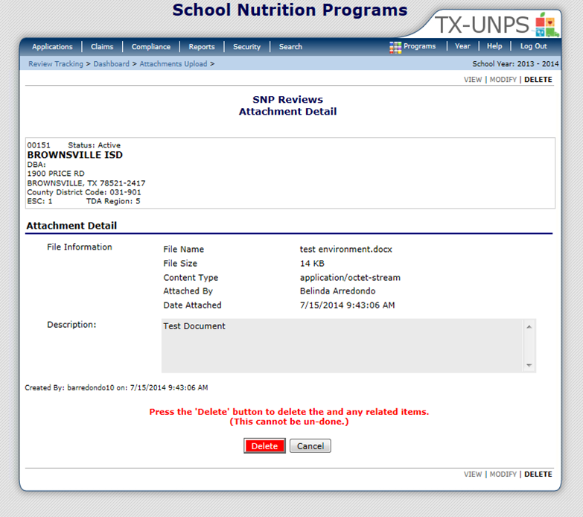
01234 Status: Active
ANYWHERE ISD
DBA:
1 Main ST
Anywhere, US 12345
County District Code : 123-456
ESC Region: 1
01234 Status: Active
ANYWHERE ISD
DBA:
1 Main ST
Anywhere, US 12345
County District Code : 123-456
ESC Region: 1
01234 Status: Active
ANYWHERE ISD
DBA:
1 Main ST
Anywhere, US 12345
County District Code : 123-456
ESC Region: 1
Notes:
If you need to delete an attachment
Click on view or modify next to the file you would like to remove
This will open up the Attachment Detail Screen
Next, click on DELETE in the lower right corner.
You will now see a Delete button and a warning message that once you delete the file it cannot be undone. In other words if you delete the wrong document you will have to upload/attach it again.
To Remove the document click on the ‘Delete” button
After selecting delete you will be brought back to the Attachment list screen and the document will no longer be listed there.

Slide 15
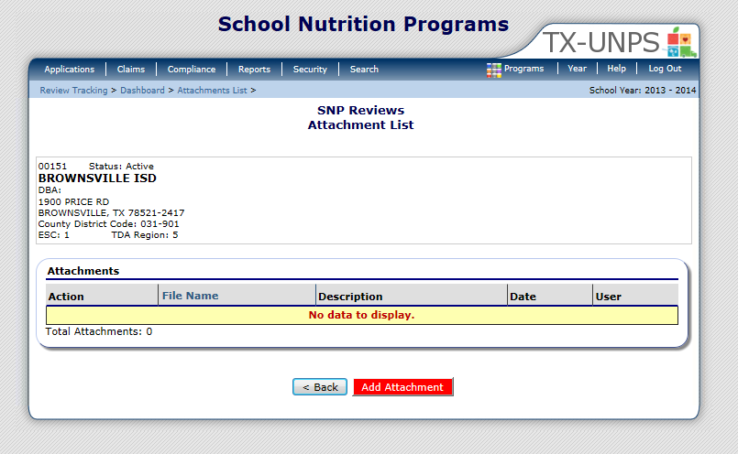
01234 Status: Active
ANYWHERE ISD
DBA:
1 Main ST
Anywhere, US 12345
County District Code : 123-456
ESC Region: 1
Notes:
After you delete the document you will be brought back to the Attachment List screen and the document will no longer be listed

Slide 16


In accordance with Federal civil rights law and U.S. Department of Agriculture (USDA) civil rights regulations and policies, the USDA, its Agencies, offices, and employees, and institutions participating in or administering USDA programs are prohibited from discriminating based on race, color, national origin, sex, disability, age, or reprisal or retaliation for prior civil rights activity in any program or activity conducted or funded by USDA.
Persons with disabilities who require alternative means of communication for program information (e.g. Braille, large print, audiotape, American Sign Language, etc.), should contact the Agency (State or local) where they applied for benefits. Individuals who are deaf, hard of hearing or have speech disabilities may contact USDA through the Federal Relay Service at (800) 877-8339. Additionally, program information may be made available in languages other than English.
To file a program complaint of discrimination, complete the USDA Program Discrimination Complaint Form, (AD-3027) found online at: How to File a Complaint, and at any USDA office, or write a letter addressed to USDA and provide in the letter all of the information requested in the form. To request a copy of the complaint form, call (866) 632-9992. Submit your completed form or letter to USDA by:
mail:
U.S. Department of Agriculture
Office of the Assistant Secretary for Civil Rights
1400 Independence Avenue, SW
Washington, D.C. 20250-9410;
fax: (202) 690-7442; or email: program.intake@usda.gov.
This institution is an equal opportunity provider.
TEXAS DEPARTMENT OF AGRICULTURE
COMMISSIONER SID MILLER
Food and Nutrition Division
National School Lunch Program
This product was funded by USDA.
This institution is an equal opportunity provider.
Updated 12/22/2020
www.SquareMeals.org

