Slide 1
Administrative Review Process in Alternative Meal Models
Nicole Notarianni,
Director of School Operations
Updated 06/2020
www.SquareMeals.org
Notes:
1st Cover Option

Slide 2
The Coronavirus or COVID-19 has forced our contracting entities (CEs) to think outside the box in order to continue to serve healthy, reimbursable meals to the schoolchildren of Texas.
TDA appreciates your questions, feedback and the multitude of ideas and suggestions that you have provided.
“You are braver than you believe, and stronger than you seem, and smarter than you think”.
Christopher Robin

Slide 3
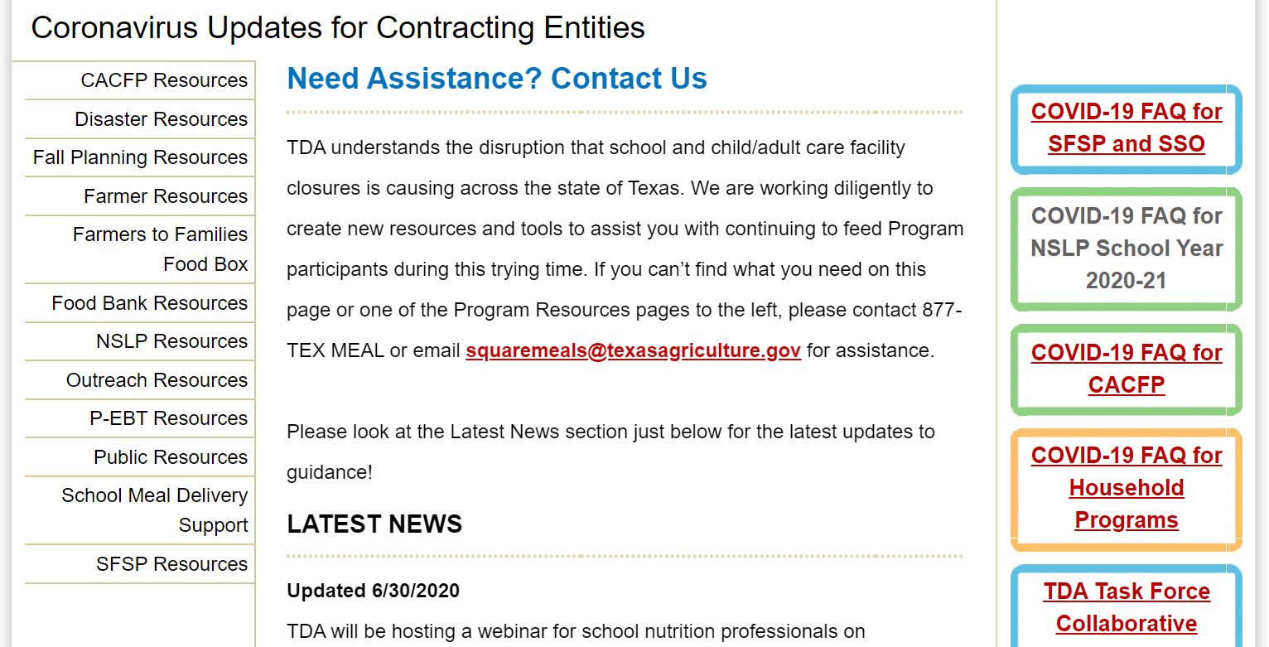
Resources
www.squaremeals.org homepage, click on this icon
Food and Nutrition has numerous resources available regarding child nutrition operations, including resources for operating during the COVID-19 public emergency.
Resources available on www.squaremeals.org or by clicking the link below.
https://squaremeals.org/FandNResources/CoronavirusUpdateforContractingEntities/FallPlanningResources.aspx
The material being presented is to assist and support CEs as they operate alternative meal service models. The material is not all-inclusive. It is the CE’s responsibility to operate the programs in compliance with all Federal and State policy, rules and regulation.

Slide 4
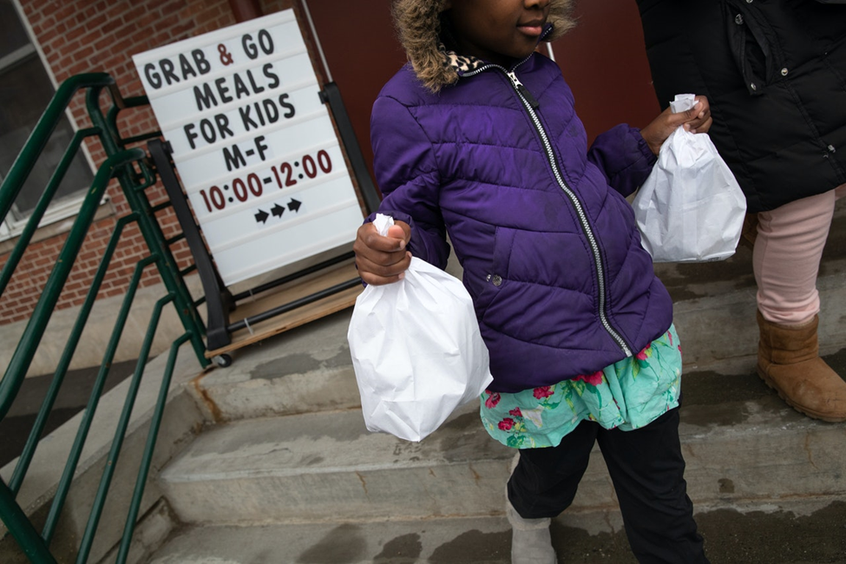
Each contracting entity (CE) has the ﬂexibility to determine the model that provides the best ﬁt for their operations.

Slide 5
01
TDA expects to see multiple meal service models during ARs in School Year 20-21
Socially Distant
Cafeteria
Meals are served to students in the cafeteria with additional safety, distancing and sanitation practices implemented.
Meals in the Classroom
Meals are served to students in the classroom.
Mobile Cafeterias
Meal are served on mobile food carts located throughout and school’s campus.
Off-Site Meals
Students that elect to continue distance learning are provided meals through delivery or a grab-and-go models.

Slide 6
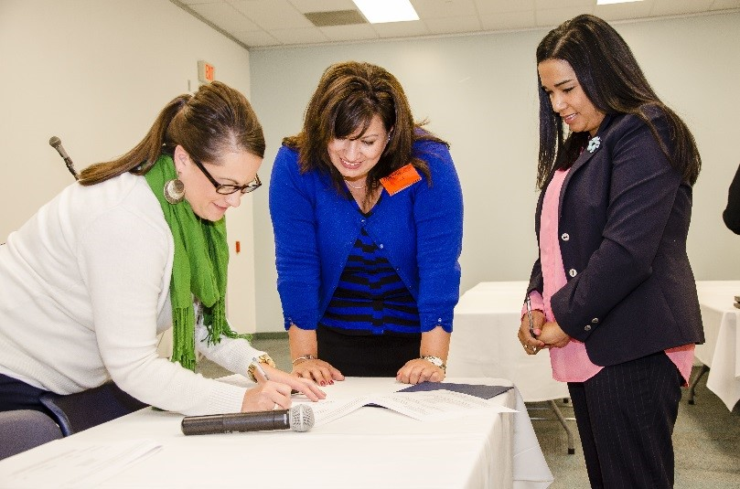
How will Administrative Reviews (ARs) be conducted in School Year 2020 – 2021?

Slide 7
ARs in School Year 2020-2021
School Year 20-21 is Year 2 of the Administrative Review (AR) four-year cycle.
TDA School Operations plans to conduct ARs as in previous years or virtually (if allowable). At the beginning of the AR off-site process, your AR Specialist will ask about your policies regarding visitors.
If visitors, including governmental agencies, are not allowed on any campus, the AR Specialist will notify you that the on-site portion of the AR will be conducted virtually. Virtually means through videoconferencing (i.e., Zoom, TEAMs, etc.) or by conference call. The AR Specialist will provide instructions if the AR becomes a virtual review.
As in previous years, TDA will practice collaborative compliance during the AR’s as possible.

Slide 8
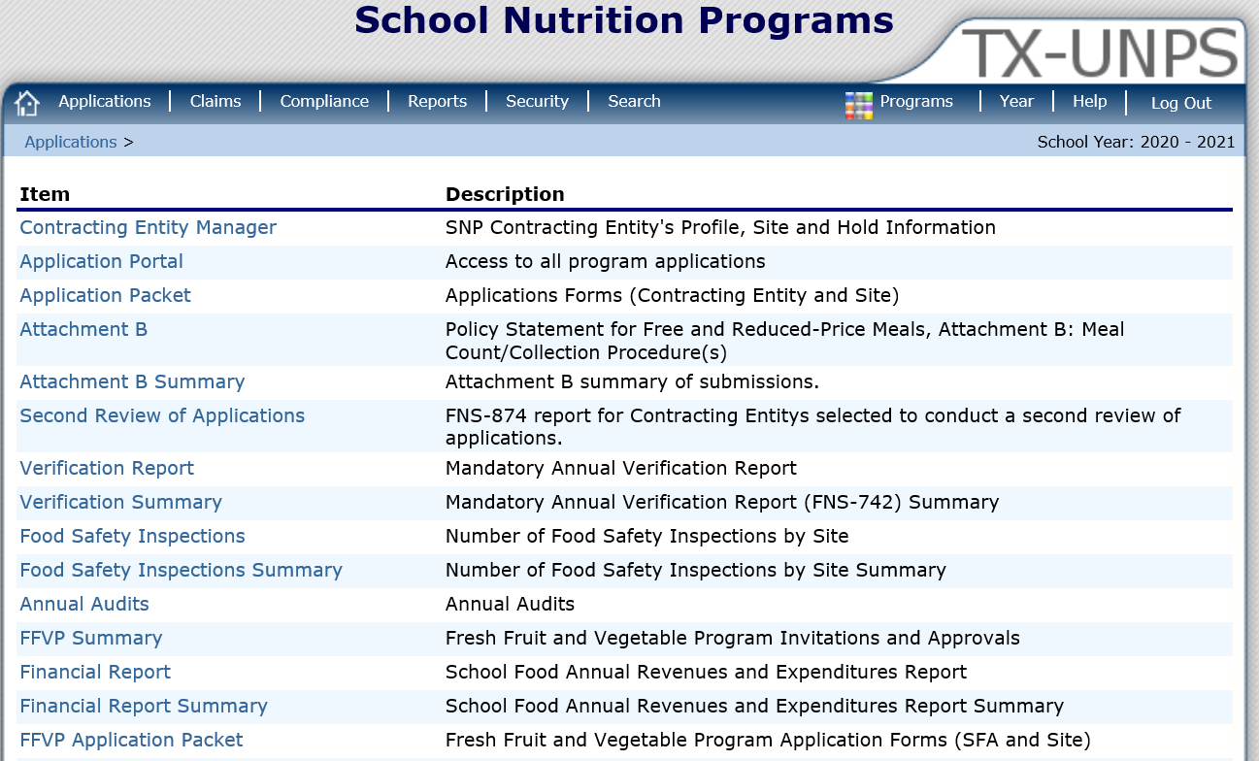
Keep Information Updated in
TX-UNPS

Slide 9
Contracting Entity Information in TX-UNPS
CEs are responsible to keep all information in TX-UNPS up-to-date.
During this time as situations are quickly changing, it is even more important that the information in TX-UNPS is current and correct.

Slide 10
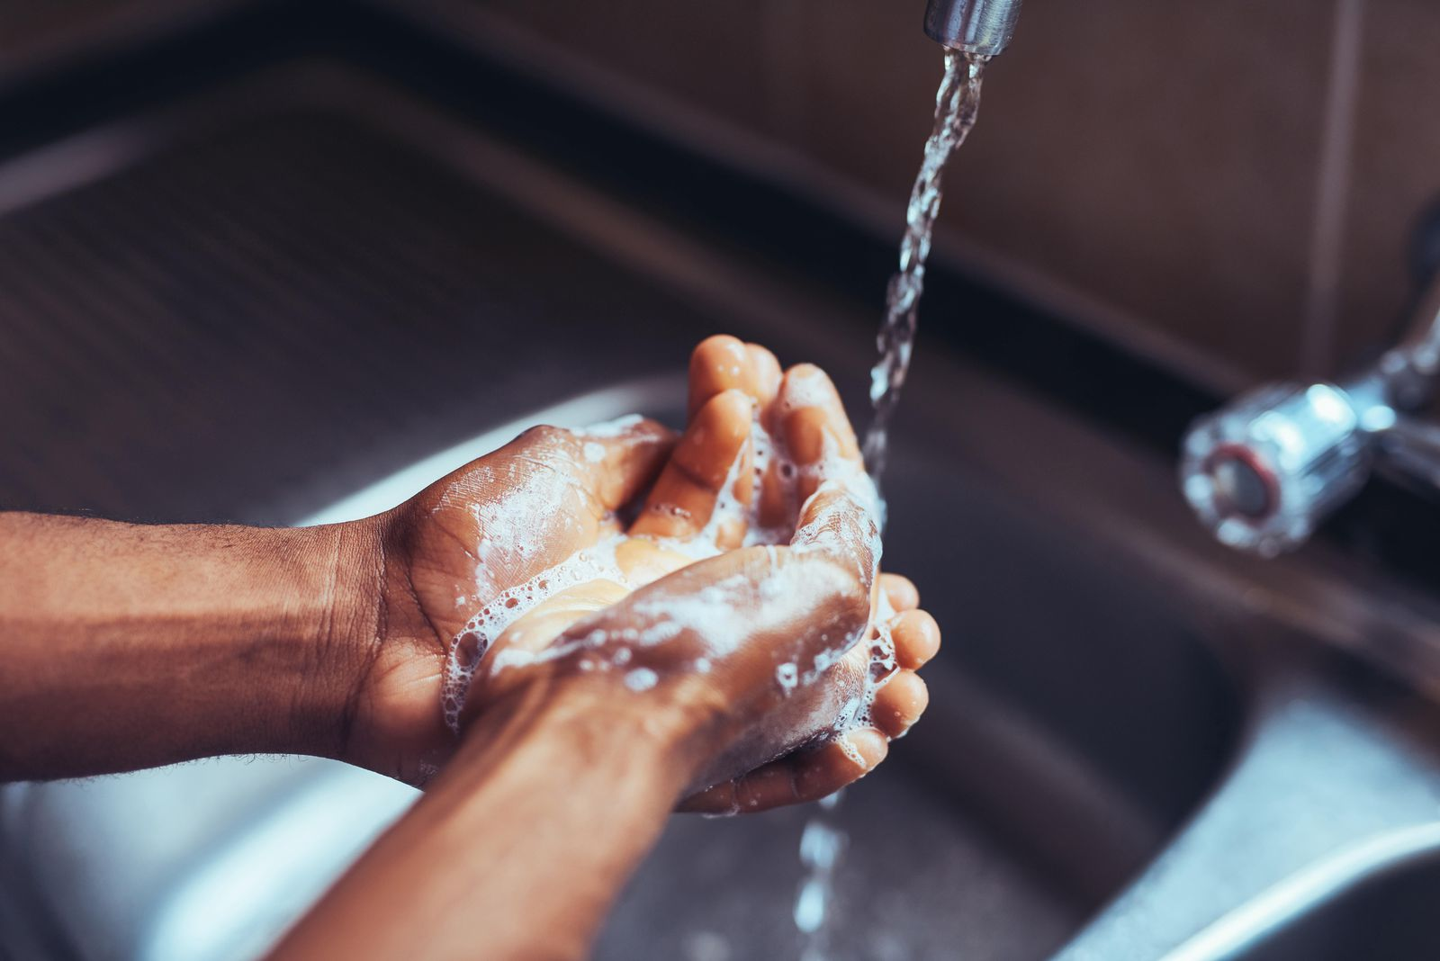
Food Safety and Sanitation

Slide 11
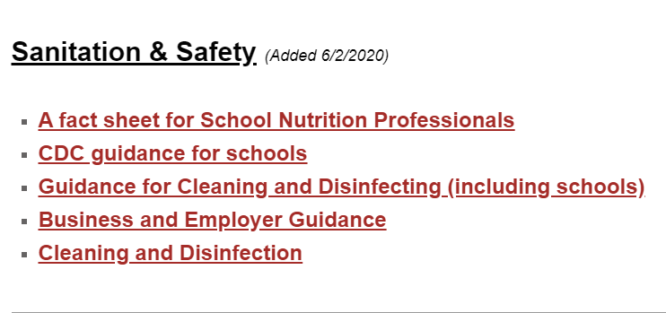
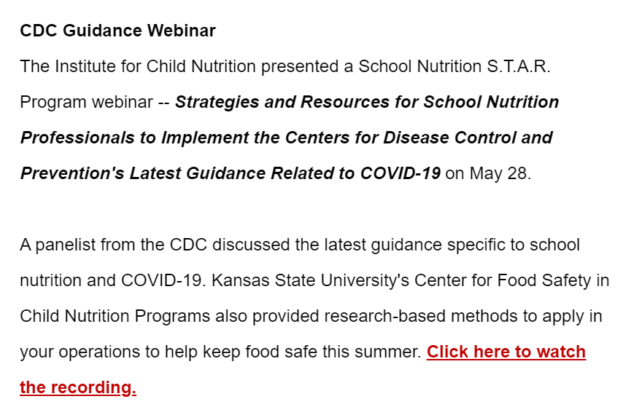
Food Safety Resources
For More information, visit:
https://squaremeals.org/FandNResources/CoronavirusUpdateforContractingEntities.aspx

Slide 12
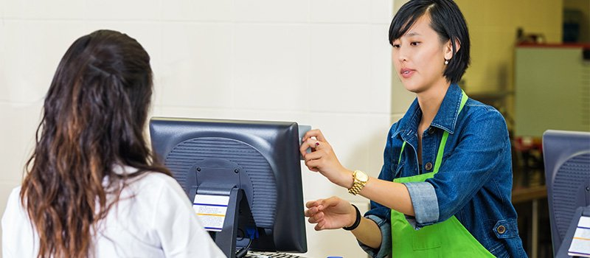
Meal Counting and Claiming

Slide 13
Meal Counting and Claiming
Maintain accurate and legible meal count records, Accuclaim/edit check, and any additional supporting documentation to support their claim for reimbursement. This includes both electronic and manual systems.
Have a method to count each meal served to each child as the meals are served or distributed (point-of-service).
Ensure that only one meal for each meal type is claimed for each child each day.
Count the individual meals served to each child or picked up for each child.

Slide 14
Meal Counting and Claiming
Ensure the Attachment B in TX-UNPS reflects the meal counting and claiming method(s).
Recommend developing a QAQC process of counts each day, week and month.
Need a back-up counting and claiming system.
It is recommended that the CE practices their counting and claiming systems before implementing them. Do a dry run with staff so that staff understand the process and to ensure there aren’t any issues identified that would impact accurate counting and claiming.

Slide 15
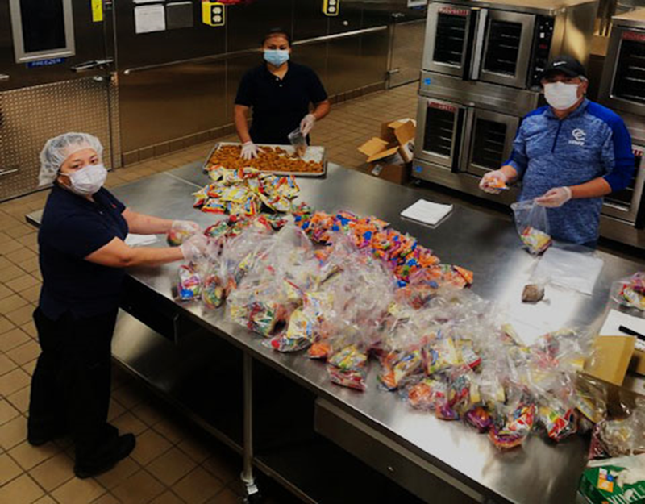
Meal Service

Slide 16
Meal Service
All meals offered/served must meet all meal pattern requirements for all School Nutrition Programs that you operate.
Meal preparation and meal service practices must meet all applicable State and local food safety standards.
If you have an approved waiver, you must ensure that supporting documentation for the waiver is retained, including documentation showing that the CE has actively attempted to purchase the necessary items to comply with the meal pattern requirements.
In instances where a meal pattern waiver has been granted, the CE must document this information on the food production record.

Slide 17
Meal Service
Documentation and recordkeeping requirements must be followed during the COVID-19 public health emergency. Detailed recordkeeping is critical including food production records.
CEs must retain food production records that demonstrate compliance with the meal pattern and the quantity of food prepared.
Documentation includes all supporting documentation including Child Nutrition (CN) labels, nutrition fact labels, product formulation statements, manufacturer specifications, etc. If substitutions are made, the CE must document the use of the substitute and why.

Slide 18
Meal Service
The Age/Grade Group waiver that CEs indicated on the School COVID-19 Intake form completed when the SSO/SFSP COVID-19 feeding began ends on August 31, 2020.
Beginning when the CE begins operating the NSLP/SBP (first day of school), the CE must follow all required NSLP and SBP age/grade groups. There is no waiver available (except for RCCIs).
USDA provided a waiver of Offer vs. Serve requirements in the School Nutrition Program. Therefore, Offer vs. serve is no longer a requirement in high school sites. High schools utilizing straight serve must ensure that the required serving of each component is provided to each student for the meal to be reimbursable. A variety of milk is still a requirement.

Slide 19
Meal Service
Meal Service Accommodations
CEs are required to provide meal modifications for students with a medical statement. When planning a non-congregate meal service, program operators should consider how individuals who require meal modifications will be identified and served.
To the extent reasonable, CEs must provide the requested meal modifications when supported by a medical statement. If the CE cannot make the modification (e.g., the needed substitute is not on hand or available), the CE must clearly document why it could not make the requested meal modification. This will be reviewed during an AR.
TDA encourages CEs to work with their ESC child nutrition specialist to address specific concerns or to identify alternative methods to provide meal accommodations during this challenging time.

Slide 20
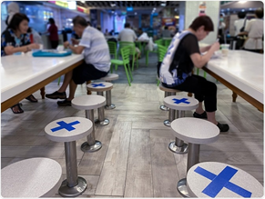
01
SOCIALLY DISTANT
CAFETERIA

Slide 21
Socially Distant Cafeteria
Considerations for choosing the Socially Distant Cafeteria model of meal service:
Meals are served to students in the cafeteria with additional safety, distancing and sanitation practices implemented.
Increased safety and sanitation practices will require additional standard operating procedures and staff training.
Breakfast and lunch serving times may need to change to allow for fewer students in the cafeteria at one time.
Serving lines and times may be longer based on the number of lunch periods and students allowed to be served at once.

Slide 22
Socially Distant Cafeteria
Compliance
If there are multiple serving lines, ensure that each line meets the meal pattern and nutrient standard requirements for the day and week.
Sneeze guards are required on all lines. Serving line, utensils and trays must be sanitized between each meal period. If you use a salad bar and/or students have access to serving utensils, how will the CE ensure food safety and sanitation.
If the CE elects to utilize share tables, they must be operated in accordance with the local/county/state health and food safety requirements. Might not be allowed.
CEs must still follow civil rights requirements in the cafeteria under the Socially Distant Cafeteria model.

Slide 23
Socially Distant Cafeteria
Compliance
How will the CE ensure safety and sanitation at bulk condiment and water stations.
The CE must have an adequate counting and claiming system and have a method to ensure that each student receives one meal per meal service only.
The CE must release a media release informing households and the public of their use of the Social Distant Cafeteria meal service model.
CEs maintain all waiver documentation for each COVID-19 waiver they applied and were approved/denied.

Slide 24
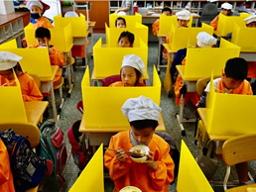
02
MEALS IN
THE CLASSROOM

Slide 25
Meals in the Classroom
Considerations for choosing the Meals in the Classroom model of meal service:
Teachers and classroom aids may need additional training. Mealtimes may be longer since they are incorporated in the classroom.
Al la carte sales and paid meals may be impacted.
Additional transportation equipment such as carts and coolers will need to be planned for and procured. Menus may need to change for this delivery model. Procurement considerations with point of sale system.
Does the POS count and roll up to the claim correctly?
Manufacturers and food distributors are projecting a shortage of individually wrapped products. CN staff may have to individually wrap food items.
Increased safety and sanitation practices will require additional materials and staff training.

Slide 26
Meals in the Classroom
Compliance
The CE must have a process as to how meals will be accurately counted and claimed.
Child nutrition staff and teachers must be trained on the Meals in the Classroom counting procedure prior to conducting any child nutrition tasks. This includes Civil Rights training.
Manual Counting Procedures: CE can count meals using a roster and then entered into an electronic POS system, which will then be used for the claim. How will CEs ensure the accuracy of the manual meal counts?
Electronic POS systems: The CE must have a back-up system in case their electronic POS system goes down.

Slide 27
Meals in the Classroom
Compliance
Maintain accurate and legible meal count records, Accuclaim/edit check, and any additional supporting documentation to support their claim for reimbursement. This includes both electronic and manual systems.
Ensure all meals served meet the meal pattern requirements. If the CE is unable to obtain a food item/component due to supply chain issues or availability, they must maintain all documents supporting the waiver.
Ensure meals are recorded on the food production records on the day of service.
Ensure each teacher/staff member handing out the meals is educated on the day’s menu for each meal and what constitutes a reimbursable meal.
The option of utilizing Offer vs. Serve or Straight Serve is correctly documented on the food production records.

Slide 28
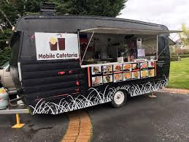
03
MOBILE
CAFETERIAS

Slide 29
Mobile Cafeterias
CEs choosing the Mobile Cafeteria meal service model should consider:
Meal planning and additional equipment procurement (such as carts and coolers) require significant planning time before implementation.
Increased safety and sanitation practices will require additional materials and staff training.
Manufacturers and food distributors are projecting a shortage of individually wrapped products. Sufficient child nutrition staff or other resources may need to be in place to individually wrap items.
May allow for longer mealtimes compared to other models.

Slide 30
Mobile Cafeterias
Compliance
The CE must develop procedures for adequate counting and claiming of reimbursable meals.
The CE must meet all local, county and/or state food safety requirements.
If the mobile cafeteria is considered a site under the CE, the CE and site applications and the Attachment B must be updated and current in TX-UNPS.
If the CE purchases additional equipment, the CE must follow all required procurement processes and maintain documentation to support each purpose.

Slide 31
Mobile Cafeterias
Compliance
How will the CE ensure logistics with the mobile cafeteria for varying mealtimes within a school and among the schools in the CE?
CEs must keep in mind that a mobile cafeteria may be considered its own line when meeting meal pattern requirements and nutrition standards.
Consider the amount of preparation space and/or storage space the mobile cafeteria has to determine the number of meals the mobile cafeteria can accommodate.
Consider special dietary meals availability at mobile cafeterias.

Slide 32
Mobile Cafeterias
Compliance
It is recommended that the CE practices their counting and claiming systems before implementing them. Do a dry run with staff so that staff understand the process and to ensure there aren’t any issues identified that would impact accurate counting and claiming.

Slide 33
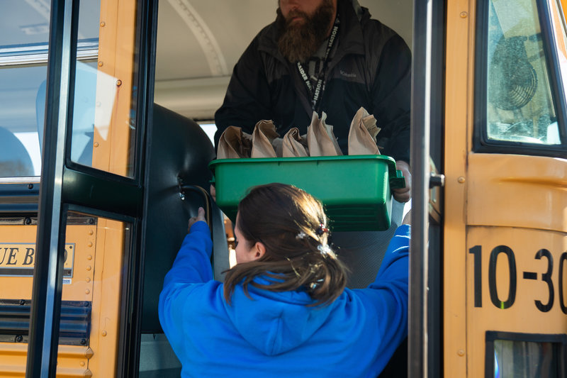
04
OFF-SITE
MEALS

Slide 34
Off-Site Meals
Considerations for choosing the Off-Site Meals model of meal service:
Manufacturers and food distributors are projecting a shortage of individually wrapped products. Sufficient child nutrition staff or other resources may need to be in place to individually wrap items.
Food safety concerns with timing of meals getting to a house and into a cooling system.
Compliance
Meal preparation and meal service practices must meet all applicable State and local food safety standards.
Meals must be recorded as counted on the day of intended consumption to prevent duplicate claiming and edit check errors.
If a CE is providing multiple meals at one time, the CE must provide instructions on how to safely store and reheat meals (if applicable). Remember the Non-discrimination Statement!
If the CE purchases additional equipment, the CE must follow all required procurement processes and maintain documentation to support each purpose.

Slide 35
Off-Site Meals
Compliance
Food production records (FPRs) must be completed daily. If a school serves multiple meals at one time, food production records must be completed in full for each meal served for each day of meals served.
Example:
If a CE serves five (5) days of breakfast and five (5) days of lunch meals to each student on a Monday, the CE must have food production records completed for each meal for each day of the week.

Slide 36
Contact Us
TDA F&N School Operations Assistant Directors
Mary Gomez-Kokkinos
Mary.Gomez-Kokkinos@TexasAgriculture.gov
Adriana Diaz
Adriana.Diaz@TexasAgriculture.gov
Sarah Carlson
Sarah.Carlson@TexasAgriculture.gov

Slide 37
Updated 06/2020
www.SquareMeals.org

