Slide 1
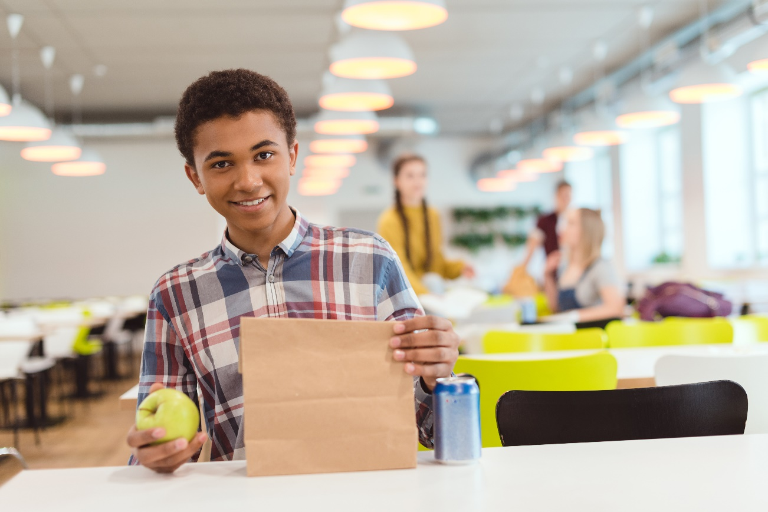
Processing Bulk Food to IW
Updated 07/2020
www.SquareMeals.org
Notes:
1st Cover Option

Slide 2
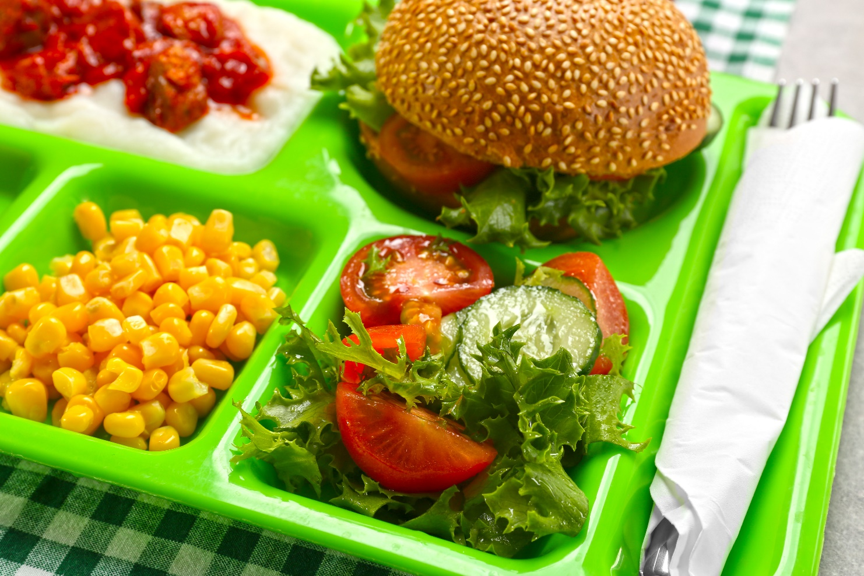
Miranda Rhodes RDN, LDN,
School Nutrition Supervisor,
Temple ISD
01
Fatima Tai, MS, RD, LD
Nutrition Coordinator, Little Elm ISD
02
Moderated by Krystle Haney, Special Programs Specialist
03
Presenters

Slide 3
Making IW Food from Bulk
Miranda Rhodes RDN,LDN

Slide 4
Development/ Making a Plan!

Slide 5
Menu
What do you already have planned?
How many Cycles? Consider one or two weeks.
How many Menus? Consider to adopt one or two for all grade levels make sure they meet at the higher creditable amount.
Temple: Breakfast is a one week cycle, one menu. Lunch is a two week cycle, one menu to meet all grade levels.
What food items are on hand already? Ex:#10 cans, cases frozen food, bags of dry goods?
Do you have all backdoor, central warehouse ,or both?
Temple: Central Warehouse = pallets of bulk food
Training staff; this might be a new method?
Temple: Training for managers follow up site visit!
Consider: Staffing

Slide 6
Recipes
How does your existing recipe Yield?
Fruit: juice vs no juice
Temple: Pineapple Tidbits with no juice equals three #10 cans and yields 50 1/2 cup servings vs. with Juice equals two #10 cans and yields 50 1/2 cup servings.
How does your existing recipe instructions read?
Packaging: Open vs Closed ( Ivex vs squat cups)
Congregated meals vs non congregated
Temple: Update recipe/instructions to read “ place in 6 oz squat cup”, replacing “place in ivex”
Help eliminate confusion to staff!

Slide 7
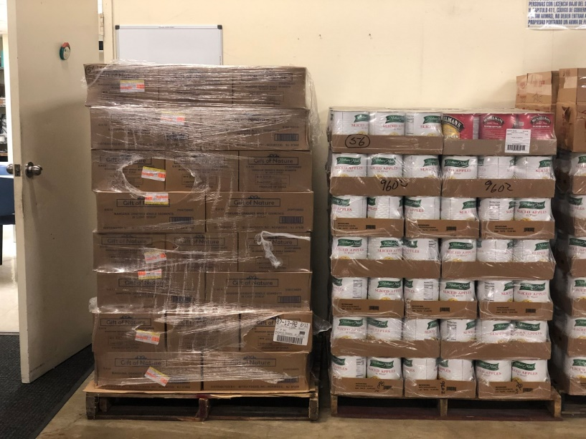
Central Warehouse

Slide 8
Packaging/ Making our own IW !

Slide 9
Packaging Cont.
Cups are good for sides
6oz squat cup can fruits
8oz squat cup mash potatoes w/ gravy, corn, green beans,
Labatt Item#7326051, 7325798
Lids
Non-Vented or Vented
Tip: Non-vented good for anything that might sweat or have liquid
Labatt Item#7305059, 7302003
Bowls are good for liquids or home dish entrees
8oz black bowl: spaghetti, bake beef mac, soup, chicken spaghetti
Labatt Item#9400522, 6814060

Slide 10
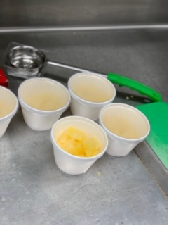
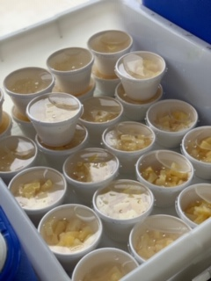
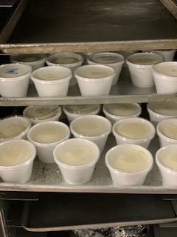
PACKAGING Cont.

Slide 11
Packaging cont.
Foil Wraps/ Foil Sheets good for entrees
Hamburger patties, Chicken patties, Steak fingers, Chicken Nuggets, Pancake on a Stick, Sausage Koalche
Labatt Item #2007219, 7055575, 2007218, 6844000, 49415
Bags are good for sides and complete packaging.
Paper( lunch bag)
Consider if the bag will rip due to weight
Plastic ( saddle bag, cookie, sandwich)
Labatt Item#7713259, 7035033, 9689258, 7035629

Slide 12
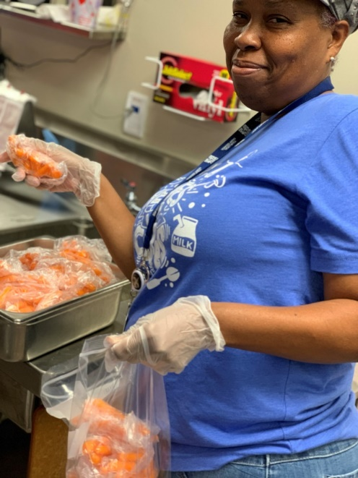
Packaging

Slide 13
Distribution/Storing for Service
How to distribute IW meals items?
Outside, Inside or both
Carts or portable table
How to store IW meal items? HACCP considerations…….
Coolers, Bus Bens, Cambro
Depending on location of service in relation to kitchen, you might be able to batch cook or batch prep

Slide 14
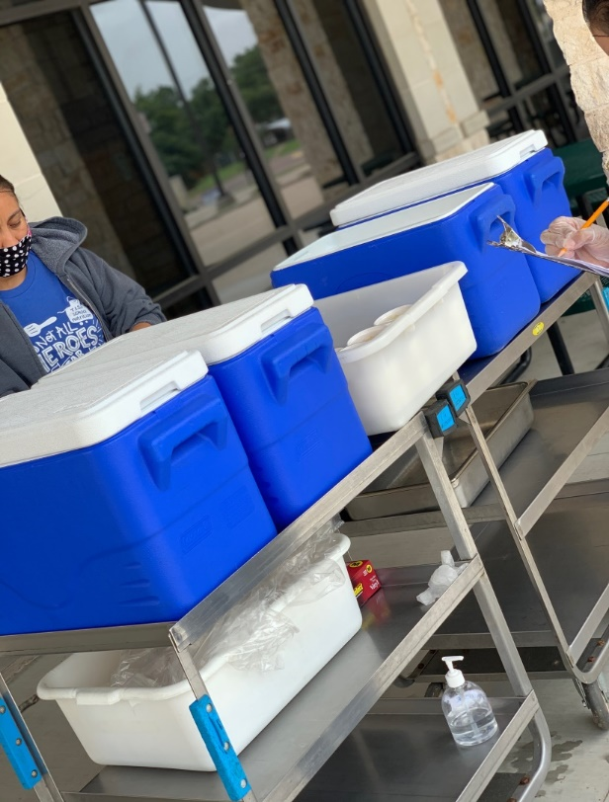
Curbside Service

Slide 15
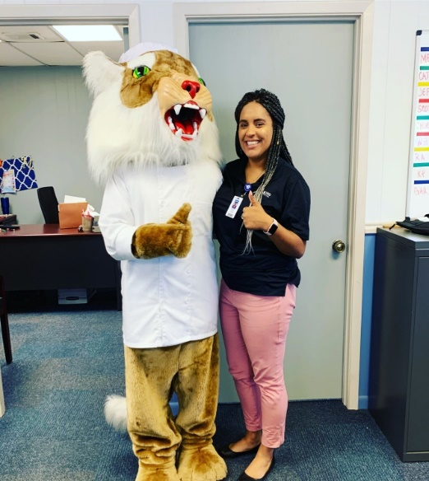
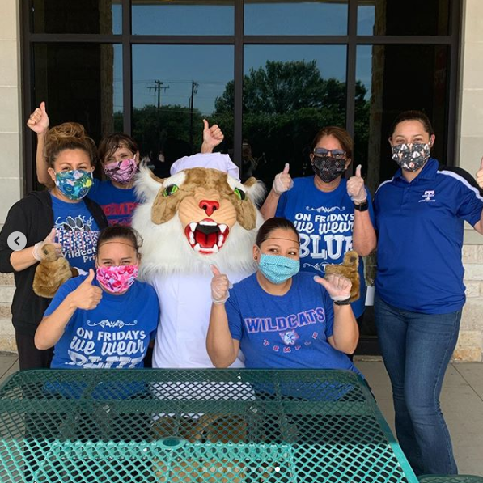
Contact Information
Miranda.Rhodes@tisd.org
(254) 215-6533

Slide 16
Miranda Rhodes, RDN, LDN,
School Nutrition Supervisor,
Temple ISD
01
Fatima Tai, MS, RD, LD
Nutrition Coordinator, Little Elm ISD
02
Moderated by Krystle Haney, Special Programs Specialist
03
Presenters

Slide 17
Bulk Item Usage
Little Elm ISD
Notes:
We are no different than any other school district that went through this and is going through this. We wanted to keep it as simple as possible; At Little Elm, we started right after Spring Break and had only 4 days to plan.
We tried to order individually wrapped items, but as well know they were not always available. These are the things we took into consideration when choosing to individually wrap bulk items.

Slide 18
Topics:
Things to Consider
Products to choose
Packaging
Marketing
Fall Planning
Notes:
The objective is to share what we are doing -- It took us about 1-2 weeks to have a process in place that worked for us. Again, our goal was to keep it simple maintaining safety of all our staff and students. We wanted to limit the time of our staff in the kitchen and have a simple process in place.

Slide 19
Things to Consider
Delivery Day
Vendor availability
Number of meals
Staff (limited due to social distancing)
Preparation Time (while social distancing)
Transportation
Capability of the student/families
Notes:
Few things we took into consideration before making menu choices include the following:
Delivery Day
Receive the delivery to give enough time to individually wrap the items. For example, we received the delivery on Wednesday and started wrapping the products on Thursday and Friday. It took us a full day to individually wrap items.
Number of meals
How many meal service do you have? Are you serving meals for the entire week on 1 day? At Little Elm ISD, we distributed 5 breakfast and 5 lunch on Monday. At one point we distributed more than 2000 meals in one day (total of 6 sites)
Staff (limited due to social distancing)
Social distancing means less staff in the kitchen at one time which would mean longer time to prepare
Received help from the maintenance department on the day of meal distribution to help with transportation of grab and go meals from the kitchen to the distribution site
Preparation Time (while social distancing)
Transportation: Will you need to transfer those meals to an off site location?
Capability of the student/families
Will the students be able to heat up the item at home if required?
What is the majority age group you are serving? If the parents are working, will the kid be able to warm up the food if it is required?
Equipped with microwave/oven

Slide 20
Product To Choose
How did we choose the item
Items that are on the bid
Items that would meet at least 2 food components
Meat/Meat Alternate & Grain
Open Site: Meet the meal pattern for highest grade level
Vendor availability
Notes:
How did we choose the item
Even though procurement process allows for off bid items during emergency feeding, we preferred to choose items from the awarded bid. If the item is not on the awarded bid, district must get Emergency Purchasing Approval from TDA to make purchases for foods that are not on any awarded bids.
Items that would meet at least 2 food components to make it easier for service - less items in a grab and go bag; not as heavy.
Meat/Meat Alternate & Grain
All our sites were open Site which means to meet the meal pattern for highest grade level (9 -12 Grades). Our goal was to choose entree items that provide 2 grains and 2 meat/meat alternate, so we are closer to meeting the requirements.
Vendor availability: there were many times we did not receive the items we ordered, and we would have to work with a substitute item so flexibility is very important.

Slide 21
Packaging
How did we individually wrap the item
Aluminum foil: safe for conventional oven and not for microwave oven
Ziplock bags
Specific product instructions vs General food safety instructions
Notes:
We individually wrapped frozen entrees. We did not cook the items before wrapping them. The reason we chose to do it this way is that all our items are fully pre cooked frozen entrees and they require reheating at the appropriate internal temperature. It would be time consuming and labor intense to cook and then wrap. We wanted to limit the time of our staff in the kitchen and have a simple process in place. This may not work for everyone but it worked for us at Little Elm. The children were given instructions on how to heat the food at home before consuming.
At first we started off providing specific item instructions, for example - bean and cheese burrito and mini burger instructions. Then we switched to general reheating instructions to avoid printing multiple items specific instructions for each campus.

Slide 22
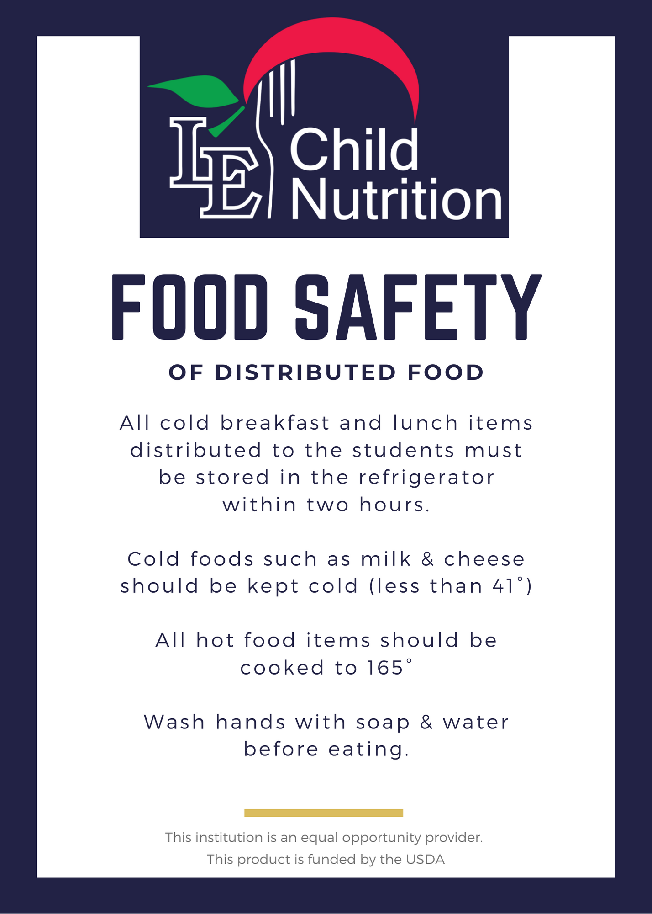
Notes:
We used various methods to ensure that students and parents were aware that some items served required heating.
Print out instructions and hand to put in meal bags
English/Spanish: consider the population at the site you are serving
Facebook
District Website

Slide 23
Fall Planning
In School Learning
Current Plan: Place entrees directly on to the tray without individually wrapping the item
Students will use their campus-issued student ID card or student barcode on the Focus Mobile app, to make purchases without having to use the touchpads.
Online Learning
Come through the line in the cafeteria
Notes:
So how are we planning for the fall? There are a lot of unknowns and things are changing very fluidly that it is hard to know exactly what route we will take but this is our plan as of today:
In School Learning
Current Plan: Place entrees directly on to the tray without individually wrapping the item
Students will use their campus-issued student ID card or student barcode on the Focus Mobile app, to make purchases without having to use the touchpads.
Online Learning
Come through the line in the cafeteria

Slide 24
Questions?

Slide 25
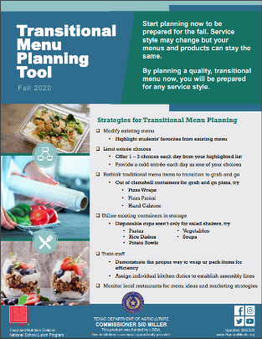
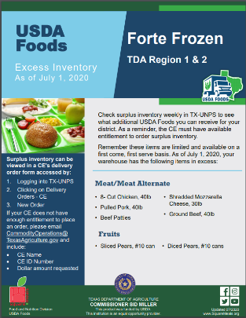
Additional Resources
Transitional Menu Planning Tool
Includes menu planning strategies, example menus, packaging options, and service styles
Available at squaremeals.org/fallplanningresources
USDA Foods Flyers
By region
Showcasing items in high supply at TDA contracted warehouse
Available at - https://squaremeals.org/Programs/FoodDistributionProgramforCNPrograms/USDAFoodsOfferedforNSLP.aspx

Slide 26
Additional Resources
2020 National School Lunch Program Equipment Assistance Grants for School Food Authorities
Kitchen equipment assistance grant
Application Period – July 8 – August 16, 2020
More information at - https://squaremeals.org/Programs/NationalSchoolLunchProgram/EquipmentGrant.aspx
Webinar Recording, PowerPoint and other fall planning resources
Available at www.squaremeals.org/fallplanningresources

Slide 27
Questions?

Slide 28
CONTACT US
Fatima Tai, MS, RD, LD ftai@leisd.ws
Miranda Rhodes, RDN, LDN, miranda.rhodes@tisd.org
Krystle Haney, Krystle.Haney@TexasAgriculture.gov

Slide 29
Updated 06/2020
www.SquareMeals.org

