Slide 1
EMERGENCY OPERATING COST AND FOOD DISTRIBUTION PAYMENTS
Gwendolyn McDade
Administrator
Notes:
2nd Cover Option

Slide 2
SCHOOL FOOD AUTHORITY (SFA) PAYMENTS
Emergency Operating Costs Grant Payments
Food Distribution Payments

Slide 3
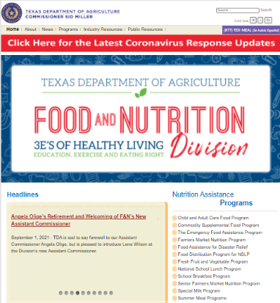
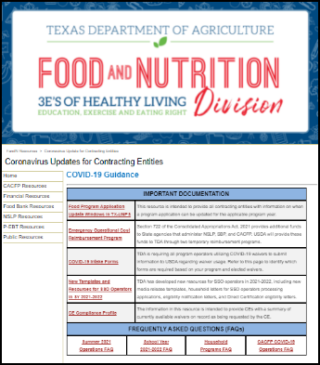
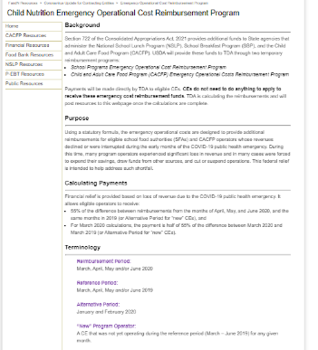
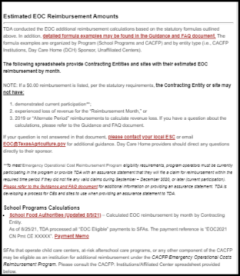
EOC PAYMENTS
To identify amounts being paid
Description on payment: EOC 2021 CN Pmt CE #####
SQUARE MEALS HOME PAGE
EMERGENCY OPERATING COST REIMBURSEMENT
GO TO BOTTOM OF PAGE
ESTIMATED REIMBURSEMENT AMOUNT - SFA UPDATED 8/09/2021

Slide 4
RETURN PAYMENTS
7 CEs have been requested to return payments because they no longer have current agreements in the program.

Slide 5
DESCRIPTION OF EOC PAYMENT
EOC 2021 CN PMT CE -XXXXX

Slide 6
ACCOUNTS TO UTILIZE
01
USDA does require breakout of these funds by NSLP and SBP
02
Must use Child Nutrition Fund – Fund 240
5921 - School Breakfast Program
5922 - National School Lunch
Object codes 7952 and 7953 are only used when a district uses an enterprise fund to account for food services.
Use account 5939 for At Risk payments from EOC.

Slide 7
FOOD DISTRIBUTION PAYMENTS
01
Represent storage and distribution reimbursements
02
Paid based on available budget

Slide 8
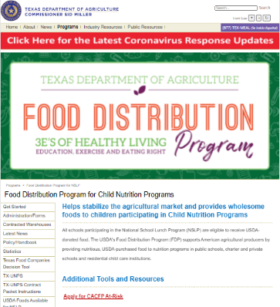
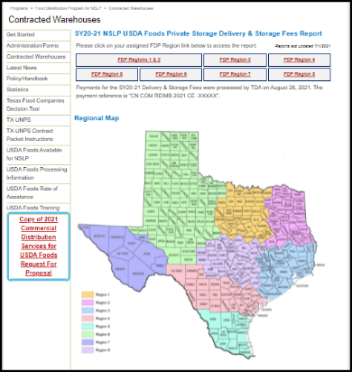
LOCATION OF AMOUNTS
SQUARE MEALS HOME PAGE
FOOD DISTRIBUTION PROGRAM FOR NSLP
CONTRACTED WAREHOUSE
CLICK ON REGION ON SPREADSHEET

Slide 9
DESCRIPTION OF FOOD DISTRIBUTION PAYMENT
CN COM REIMB 2021 CE -XXXXX

Slide 10
AMOUNT OF REIMBURSEMENT
Total of delivery fee paid and private storage fee paid

Slide 11
CODING OF FOOD DISTRIBUTION PAYMENTS
5939 – Federal revenue distributed by State agencies other than TEA
7954 – Enterprise Funds – USDA Commodities

Slide 13
CONTACT US
1700 North Congress Avenue, 10th Floor
Austin, Texas 78701
www.SquareMeals.org
SquareMeals@TexasAgriculture.gov
(877) TEX MEAL

Slide 14
Questions?

