Slide 1
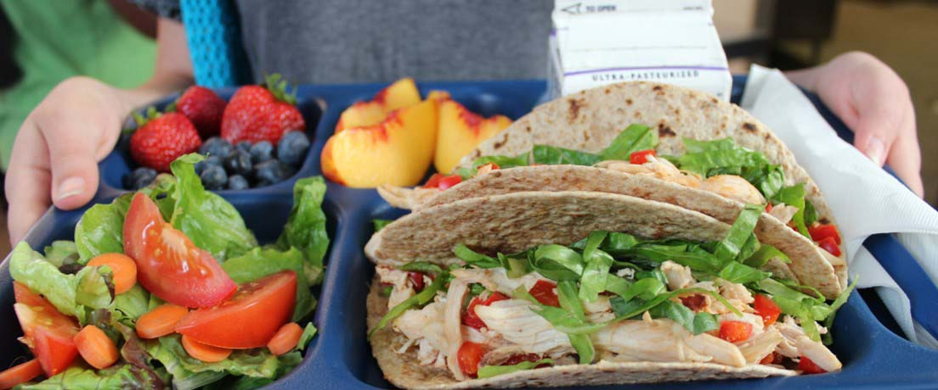
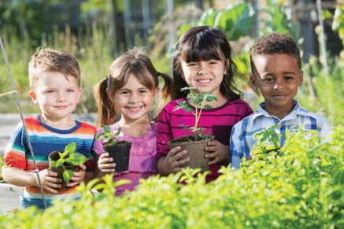
Fall Meal Promotion Webinar
Kellen Cantrell
Outreach Marketing Specialist
Texas Department of Agriculture - Food and Nutrition Division
09/2020

Slide 2
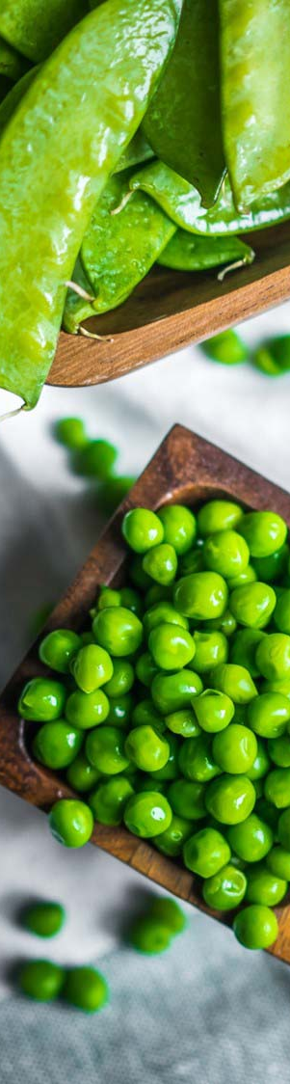
Promotion
Marketing
Outreach
Resources
Strategies
Best Practices
Notes:
If you would like to move the photo within the frame, click on Picture Format > Crop and then move the image to show the area of the photo desired.

Slide 3
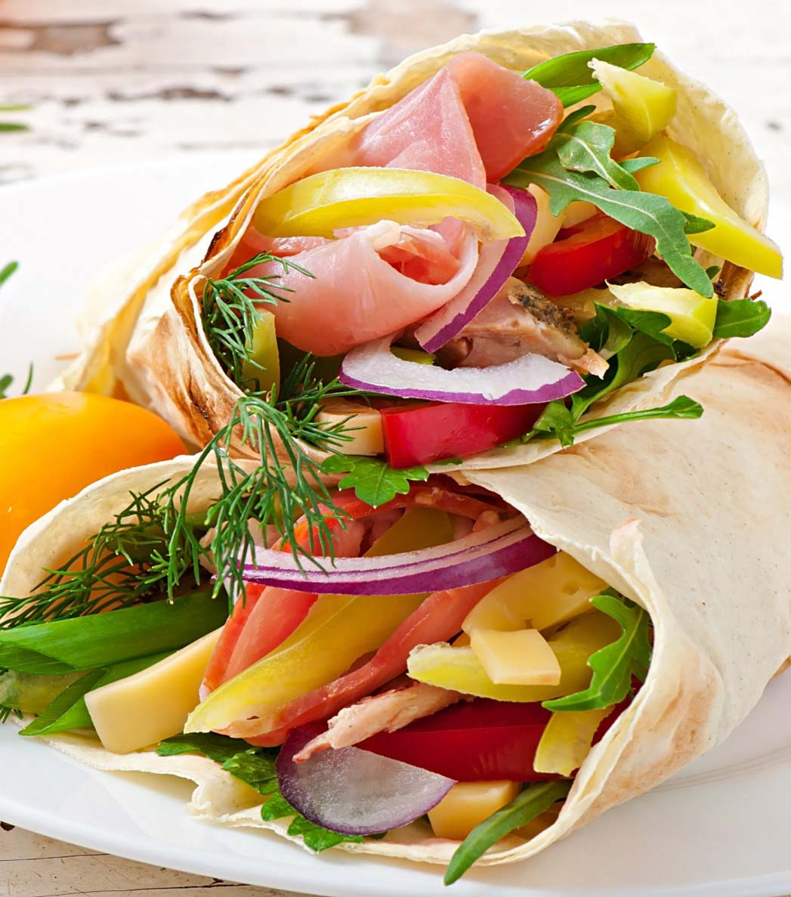
Fall Meal Promotion Resources
Fall Planning → Fall Meal Promotion
www.SquareMeals.org/FallResources
Promotion Resources and Graphics***
Sanitation and Safety
Planning Tools Archive
Additional Resources and Guidance
Virtual Training Series

Slide 4
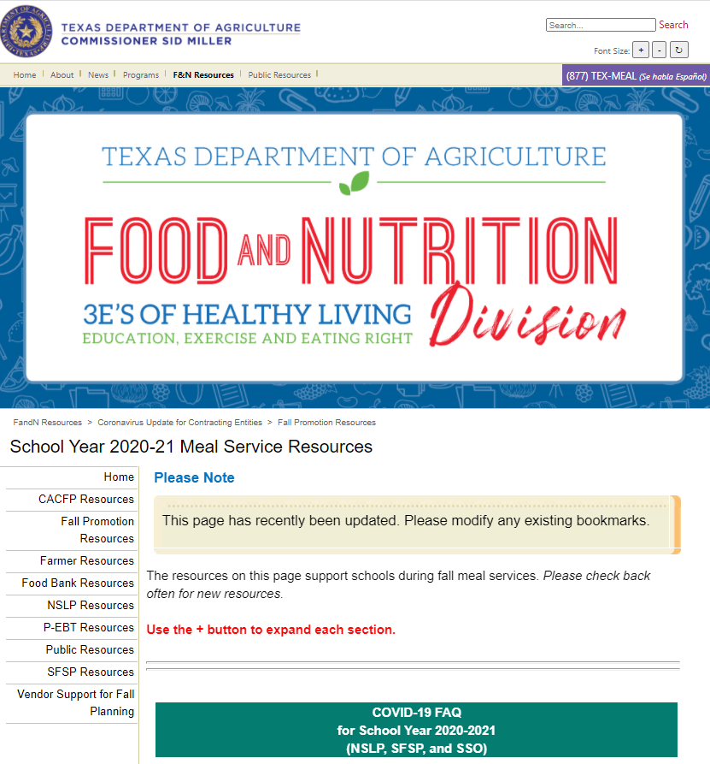

Slide 5
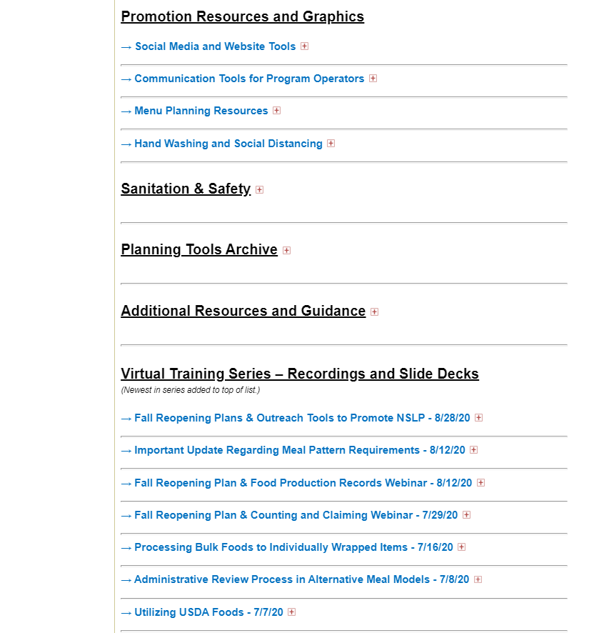

Slide 6
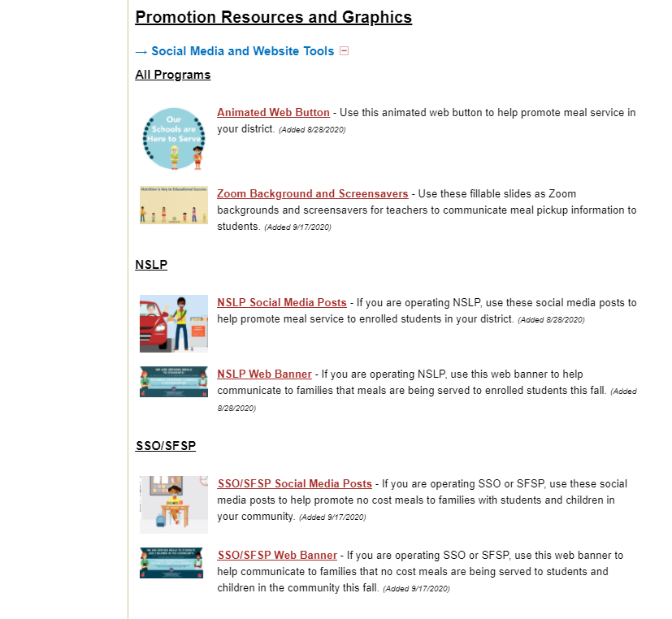

Slide 7
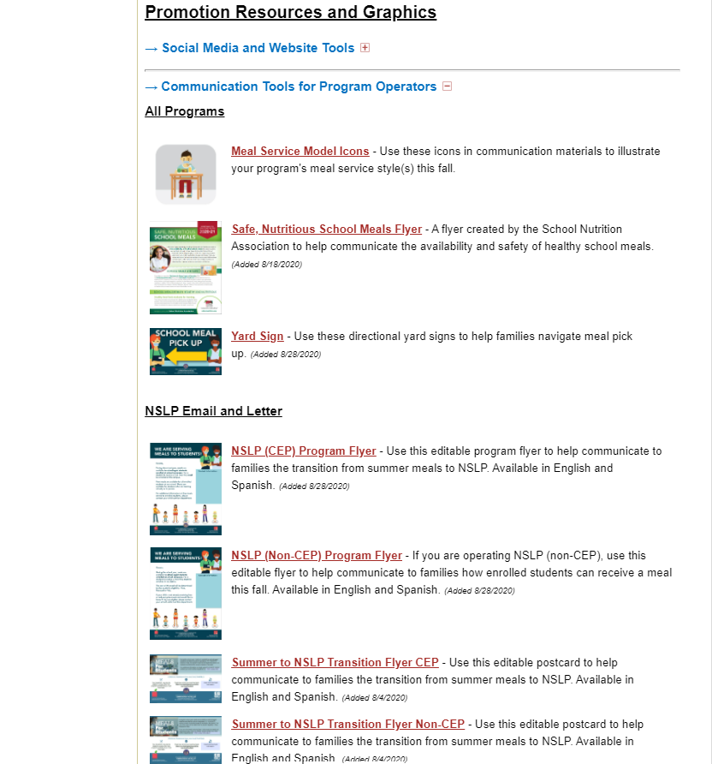
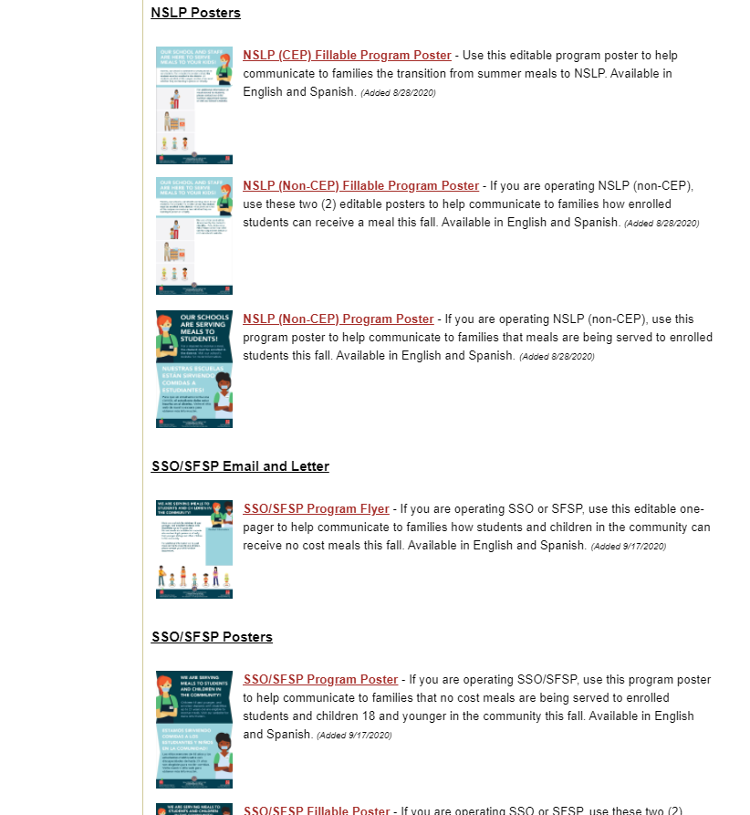

Slide 8
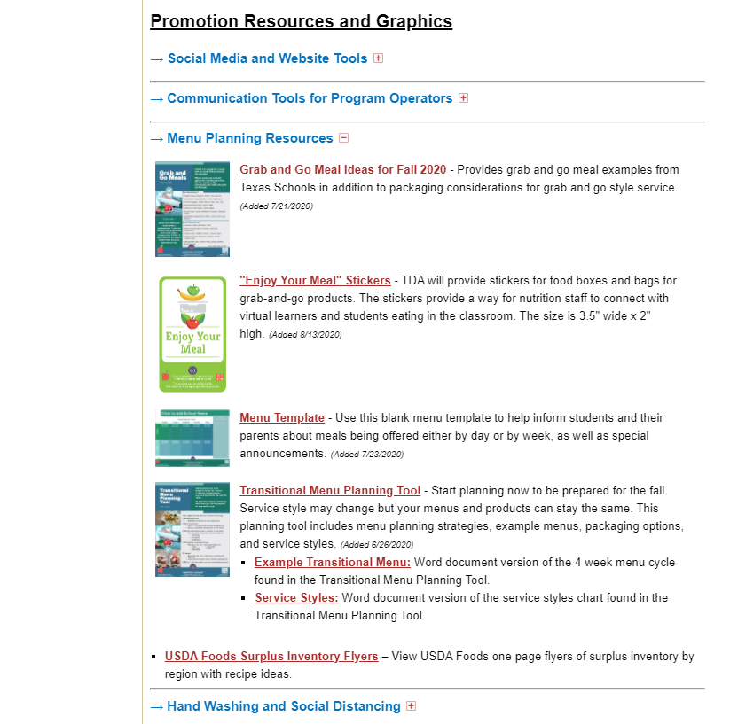

Slide 9
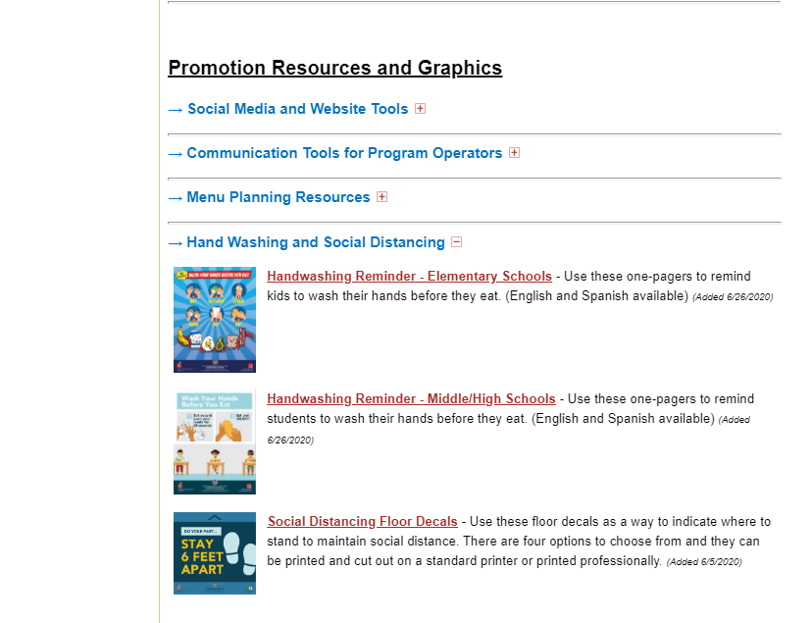

Slide 10
Marketing Strategies
Website
Social Media
Direct Messaging

Slide 11
Website
Utilize your homepage
Website Banner
Website Button
Clear Concise Information

Slide 12
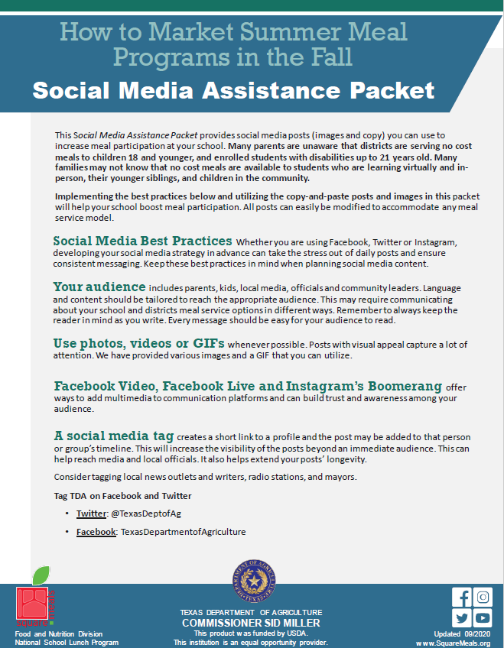
Social Media
Share content in real time
Connect with different audiences
Post photos
Connect with those who may not already know about meal service
A social media strategy can give structure to daily posts and ensure consistent messaging

Slide 13
Direct Messaging
Teachers and schools have opportunities to directly connect with parents and students through school-based apps such as Class Dojo, Seesaw and Remind, text messaging services, or robo calls. Info flyers or graphics can be utilized to enhance direct messages visually.

Slide 14
Best Practices
Utilize social media
Know your audience
Use visuals
Multimedia
Social media tags

Slide 15
Social Media
Use Facebook, Twitter or Instagram to increase meal participation
Make your post’s purpose to increase awareness
Social Media Support Packet

Slide 16
Know Your Audience
Parents, kids, local media, officials and community leaders.
Language and content should be tailored to reach the appropriate audience.
Communicate about meal service options in different ways.

Slide 17
Use Visuals
Posts with visual appeal capture a lot of attention
Utilize TDA provided GIFs and images

Slide 18
Multimedia
Facebook Video
Facebook Live
Instagram’s Boomerang

Slide 19
Social Media Tags
Increase the visibility of the posts beyond an immediate audience
Help reach media and local officials.
Extend your posts’ longevity.
Consider tagging local news outlets and writers, radio stations, and mayors.
Tag TDA on Facebook and Twitter
Twitter: @TexasDeptofAg
Facebook: TexasDepartmentofAgriculture

Slide 20
09/2020
Notes:
Easily change photo. Please click on the small icon in the center of the holder and choose an image on your computer.
When you add the image, you may need to send it to back (Right click on the image > Send to Back).
If you would like to move the photo within the frame, click on Picture Format > Crop and then move the image to show the area of the photo desired.

Slide 21
Questions?

Slide 22
CONTACT US
1700 N. Congress Ave. Austin, TX 78701
www.SquareMeals.org
Outreach@TexasAgriculture.gov
512-463-0754

