Slide 1
Functional Forecasting
in Menu Planning
Updated 11/2020

Slide 2
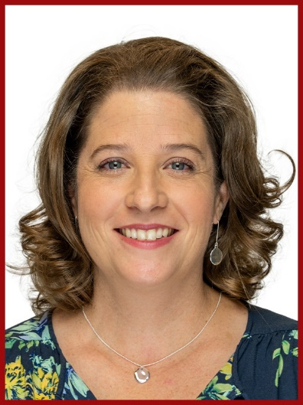
Presenters
Alexa Carrier M.S., R.D.
Child Nutrition Program Specialist, ESC 4
Kelly Waldron
Child Nutrition Program Chef & Specialist, ESC 13
Notes:
Alexa Carrier M.S., R.D., Child Nutrition Program Specialist with ESC 4 in Houston.
Registered Dietician for 19 years.
10 years in Child Nutrition
5 years in Higher Education
Kelly Waldron, Chef and Program Specialist with ESC 13 in Austin.
10 years in Child Nutrition
15 years in Culinary Field

Slide 3
Acknowledgement Statement
You understand and acknowledge that:
the training you are about to take does not cover the entire scope of the program; and that
you are responsible for knowing and understanding all handbooks, manuals, alerts. Notices and guidance, as well as any other forms of communication that provide further guidance, clarification, or instruction on operating the program.
Notes:
The information that we will review today represents a portion of the Food and Nutrition programs, but not the full scope of the program.
As a reminder, TDA and USDA share information regarding the program through posted Handbooks, Manuals, Alerts, Notices, and Additional Guidance.
As always, if you seek further clarification or instruction on any area of the program, please seek assistance from you local ESC.

Slide 4
Course Objectives
Define forecasting
Identify stakeholders
Factors affecting forecasting
Tools needed for accurate forecasting
Recap of the procurement timeline
Notes:
NOTE:
participants should be actively participating in the training.
please notice the yellow boxes throughout the training to indicated questions/answers for the chat
As a reminder, when chatting, select ALL ATTENDEES, not just PANELIST

Slide 5
What are the steps in the forecasting process?
(take a few minutes)
Notes:
Ask the group to list as many steps as they can think of that are in the forecasting process for a few minutes.
Ask the group to write in the chat their ideas?
Ask – Are any of you following a forecasting process? (possibly a POLL)

Slide 6
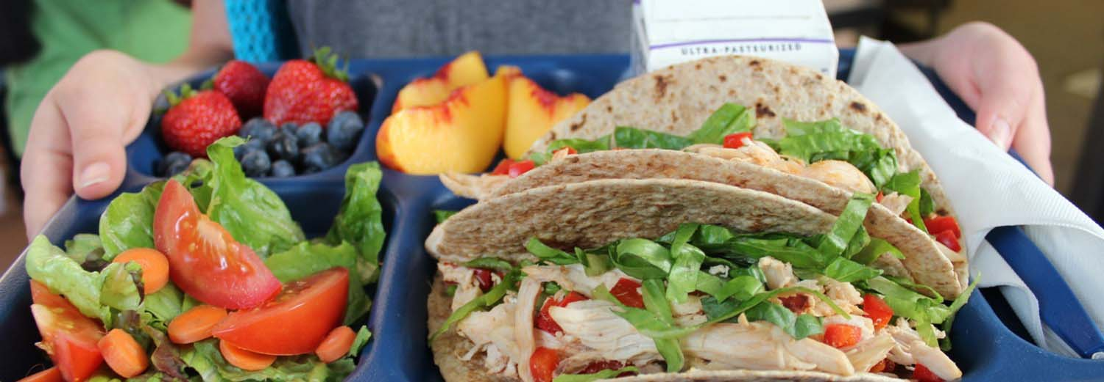
What is
Forecasting?
Forecasting is the process of analyzing current and historical data to determine future trends
Predicting and estimating for the coming year
Assessing needs for procurement activities
Notes:
So what exactly is forecasting?
Forecasting is the process of analyzing current and historical data to determine future trends.
Forecasting involves predicting and estimating the goods, products, and/or services needed in specified areas for the coming year.
Assessing needs by reviewing current procurement activities.
As we saw with the previous session on Food Cost:
The pre-cost is directly driven by your ability to forecast correctly.
Understanding your food cost will help you when determining changes in your cycle menu for the next year and how you may decide to use USDA foods or change bid specifications.

Slide 7
Forecasting will drive your procurement processes, including:
Creating requests for shipment of USDA Foods
Writing bid specifications
Determining order delivery schedules
Managing and maintaining appropriate inventory levels
Maintaining appropriate food cost
What is Forecasting?
Notes:
Forecasting is vital to the SNP so that amounts and types of foods that will need to be purchased can be determined.
Forecasting of items and amounts needed will drive your procurement processes including:
Creating requests for shipment of USDA foods
Writing bid specifications
Determining order delivery schedules
Determining most appropriate procurement guidelines to follow for specific items
Managing and maintaining appropriate inventory levels
Maintaining appropriate food cost
Forecasting allows for procurement plans to evolve each fiscal year.

Slide 8
Steps of Procurement
Cycle Menu
Forecast Needs
Evaluate
Receive Product
Allocate USDA foods/Create Specs/ Write Bid
Solicit, Evaluate, Award
Notes:
How does forecasting impact Procurement?
With out forecasting, you may end up developing a menu that is not well accepted.
Unfortunately you would allocate USDA foods and write bid specifications on items that end up with a low return.
If you have a low return/participation, then the budget allowances you are counting on to drive your overall budget will not be used.
In the end, you will not receive the full potential of your cycle menu and its connection to the budget.

Slide 9
Stakeholders
Who is involved and what is their role?
01
02
03
04
STUDENTS
SITES
BUSINESS OFFICE
SUPPLIERS
Student preferences should drive all menu choices
Site capabilities and constraints drive forecasting options
District business office determines annual budget for food purchases
Products purchased will determine supply chain
Notes:
All food purchases made by a school district are driven by the menu items that are served. Student preference should always drive these decisions because no matter how good or economical a product is if the student does not eat it, it becomes waste which is now lost revenue to the school district.
2. Site operators and site capabilities must be considered when determining the menu and thus the food items purchased. Examples: do we have the skill and equipment to scratch cook items? Do we have adequate storage space in the freezers, refrigerators and dry storage? Your storage space will drive delivery dates and food options to be purchased.
a. these factors also need to be considered when the menu is created so that the days offerings can be executed efficiently
b. What is your scheduled lunch time?
c. Do Principals control these or other aspects of the food service operations on your campuses?
3. The allowed budget for the operation will drive decisions for purchases. No district has an unlimited budget for food and waste of items can be detrimental to the SNP budget
4. Suppliers that are available to deliver to your operation will affect pricing, delivery schedules and selections available for purchase.

Slide 10
Steps in Forecasting
What data do I need?
Cycle Menu
Food Production Records
Usage Reports
Inventory Reports
USDA Foods availability
Notes:
BRIEF:
***possible examples
The first step in forecasting should be creating a cycle menu. Based on the items on the cycle menu you can create ways to document the amounts of the food items used when serving that cycle menu.
Food production records provide documentation of exactly what was used at each meal and should be used as a management tool to adjust preparation amounts and track actual usage of food at each site.
Usage reports are vital in tracking amounts used over a specific period.
Maintaining inventory reports is another important step in tracking usage of items in your operation. Inventory should be counted on a regular basis and should be used to inform your ordering decisions. Maintaining inventory is also a vital tool in estimating plate cost.
Being aware of what food items are available to you through the USDA foods (commodity) program is vital to getting the most value for your commodity dollar. Remember that your USDA foods entitlement dollars are a very important part of your food budget.

Slide 11
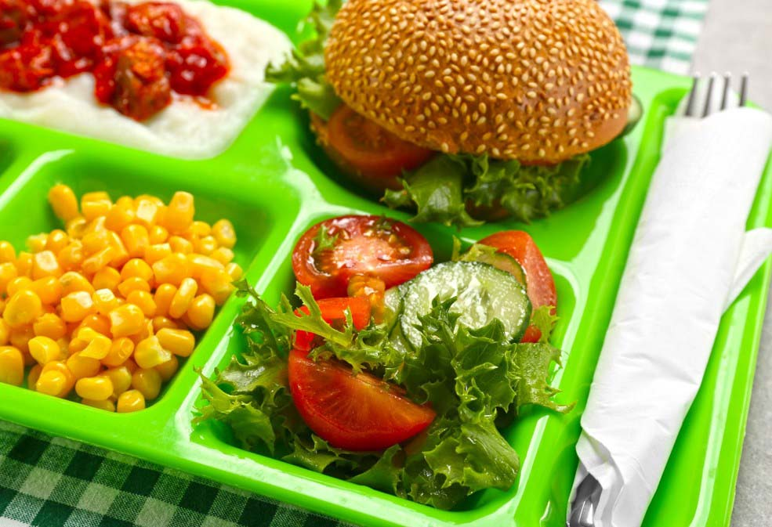
Cycle Menu
Why is it important?
Controls costs
Boosts participation
Improves efficiency
Reduces waste
Assists in meeting regulations
Chat: How do you overcome lack of variety? Any fan favorites?
Notes:
***How many of you are using a cycle menu? RAISE YOUR HAND….
Controls costs because a specific menu rotation means you will always know which products you need and how much you will need
Boosts participation by:
incorporating variety and creativity,
keeps popular student items in rotation,
allows students to know what will be served ahead of time which makes them more likely to participate in your program.
Improves efficiency- When staff prepares the same menu items multiple times, they become more efficient, recognize opportunities to trouble shoot issues
Provides the menu planner with feedback on combinations that do or do not work within your operation.
Reduces Waste- cycle menus build regular customers and aids in calculating how much food needs to be in stock and prepare for each time the menu day/item is prepared.
Meet Regulations- A cycle menu improves regulatory compliance by assuring all requirements are met daily and weekly and aids in determining an appropriate substitution if needed.
ASK AUDIENCE FOR EXAMPLES-OR PROVIDE THE ONES BELOW.
Examples:
We need to substitute for an entrée that meets 2 grains, 2 meat meat/alternate, we know this because our pre-planned cycle menu was developed to meet the daily and weekly requirements
Substitute a vegetable from the same vegetable subgroup.
The middle School has sweet potato fries on the menu on Tuesday to meet the red/orange vegetable requirement for the week. The sweet potato fries were not delivered Monday. Name a vegetable that could be substituted for this on Tuesday. What else can you do to assure the item is met if you currently have no red/orange vegetable to substitute? Serve another vegetable and develop a plan to have your red/orange vegetable later in the week.

Slide 12
Student input
“What they want VS. What we think they want”
The first and most vital step in determining purchases. Know your customers’ preferences
Taste tests
Student surveys
Plate waste observations
Food trends
The customer’s perception is your reality. –Kate Zabriskie
Chat: Any other suggestions?
Notes:
Before the menu is built, before any food is purchased, you should collect as much data as possible on what the students in your district want to see on the menu.
Keep in mind this may differ greatly from elementary to high school age students and you should take that into account.
Students will voice their opinions if given the opportunity and even if they are not ! It is better to be proactive because they will certainly tell others their opinions of the food.
Tastings….Give the students an opportunity to taste and give input before.
Observe plate waste at meals. Then analyze and compare-was the food prepared correctly? Did your supplier substitute a product that is now unacceptable? Is staff holding food at correct temperatures? All these are factors in acceptance of your menu items.
Food in the trash is money out of your budget, unhappy hungry students and possibly upset parents.
Know the hottest food trends for students-spicy, ethnic dishes, GRAB AND GO. Look at what you see in the public and modify to work with your operation.

Slide 13
Site Capability Considerations
Crucial Areas to Consider
Storage available
Staff capabilities
Student population
Equipment available
Does the site have adequate dry and cold storage
Does the site have enough staff and adequate training?
The number and type of students to be served must be considered
Equipment to prepare foods drives menu choices
Chat: Do you expect any of these to impact
your menu moving forward? Solutions?
Notes:
Storage: the amount and types of storage capabilities a site has will determine how often they will need deliveries.
Example: If the site has very little cold storage for milk, then deliveries will need to be scheduled more frequently. This will affect the bid specifications, and possibly the end cost to the district.
Staff capabilities- staff employed at the site must have the skill sets needed to prepare menu items. Additionally, total number of staff at the site will affect what items can be produced. Training can be provided to develop skill sets needed, but equipment available will also play into this equation.
Students to be served/Campus schedule/Principals' preferences- total numbers to be served with in the allotted time can be a leading factor in what foods are prepared. Large campus numbers that need to be served in a short period of time will be a large factor in your planning of menu items so that the needs and time constraints can be met. The type of student will also drive the menu choices.
Example: items menued may differ greatly at your Pre-K campus vs. your high school campus. Pickle Example.
Equipment available for production drives menu choices. If you do not have a hot hold cabinet, then everything needs to be cooked for on time service. Batch cooking, holding capabilities…
Ask for Examples from audience.

Slide 14
The simplest definition of a budget is “telling your money where to go”
- Tsh Oxenreider
Budget
Pre-determined by revenue available
Driven by total reimbursement and USDA Foods allocations
Includes expenses other than food items
Notes:
The total reimbursement from the previous school year will be the main source of revenue for most school districts.
The reimbursement received from TDA (via USDA) drives the SNP operations. Because these monies are federal dollars, they come with constraints on what the money can be spent on. Food is considered an allowable expense for these federal funds.
A la Carte sales are another source of funding for schools. Tracking food usage for a la carte sales is important so that calculations can be made to assure that all a la carte expenses are covered by revenues from those sales and not from the pool of federal reimbursement.
Keep in mind that strategically planning the use of your USDA foods entitlement is a big boost to the amount of funds that you have available to you to cover the cost of your food purchases.

Slide 15
USDA Foods
Preparing for SY 21-22
Conduct Cost Comparisons
Prepare Cycle Menus for SY 21-22
Notes:
Now we are going to shift our focus specifically to USDA Foods and how we can help to maximize their value in our operations. As we are now in the fall and quickly moving towards January and February when the USDA Annual Surveys will open, now is the time to review Cycle Menus. Alexa spoke in depth about the importance of Cycle Menus and the impact they have on your operation. Just as ordering commercially, your Cycle Menu should drive your USDA Foods requests. It is important to have a cycle menu in place and a strategy to maximize your Entitlement when surveys open.
We will discuss this more in depth in later slides, but conducting a cost comparison of USDA Foods (brown box, processed, dod fresh, and f2s) with commercial equivalents can help drive decisions regarding how to best utilize your Entitlement. It is not a one-size-fits-all approach, each CE is different and will have their own plan and strategy.

Slide 16
Calculating Entitlement
Entitlement $ =
Total Lunches Served (previous school year for NSLP)
x
Commodity Rate of Assistance (.3619)
Example: 250,601 TLS x .3619 = $90,692 Entitlement
Notes:
Review how to calculate Entitlement.
For next school year, SY 21-22 (surveys that will be opened in January), Entitlement will be calculated based on SY 18-19 TLS.
We don’t have guidance from USDA on how Entitlement will be calculated for SY 22-23.
Entitlement does not roll over at the local level. If you are unable to utilize food, communicate with TDA and co-op coordinators. The goal is to have inventory utilized, instead of sitting in storage. Also just to quickly review, Entitlement can be utilized for Regular USDA Foods “Brown Box”, Bulk items diverted for processing, DoD Fresh produce and Farm to School items.

Slide 17
USDA Foods Considerations
Know products available
Be aware of delivery capabilities
Consider Processing vs. Brown Box
Use of DoD Fresh
Plan for unexpected changes
Notes:
Be prudent in your selections of USDA foods to assure you are getting items you will utilize. Be aware of the constraints that may be set on USDA foods such as delivery schedules, paying for the storage of food items that cannot be shipped to you from the warehouse in the allotted timelines.
Some districts may benefit from ready-to-use end products from diversion/processing. In some cases, diversion/processing can be a cost savings to the sponsor for high quality products. Just like Direct Delivery, do your homework for diversion/processing and see what is the better deal. Sometimes diversion/processing can be more expensive than purchasing commercially if you factor in the processing charge, service fees, and any delivery charges.
The DoD Fresh Fruit and Vegetable program is another great option to supplement your produce ordering. Just remember that USDA foods have to be 100% domestically produced or grown, so produce through this program is seasonal. For example, don’t expect grapes to be available during the winter. During the summer and fall they are available from California but during the winter they are more than likely coming from Central or South America and wouldn’t be offered. This would fit into your forecasting planning.
USDA foods deliveries and availability must be monitored throughout the school year. Issues can arise that make an allocated food product unavailable. Plan to bid items as well as request allocations from USDA foods so that you have alternatives and can serve your menu as planned.
Watch for “bonus foods” to supplement your menu needs. This is like getting free groceries!
Bottom line, check USDA foods availability frequently and be aware of your balances. This must be managed just like inventory.

Slide 18
Tools for tracking usage
01
Food production records
Provides a historical record of what and how much was prepared. Tracks leftovers and waste.
02
Point of sale counts
Tracks total daily participation
May include features for tracking specific food items
03
Inventory reports/counts
Provides a record of what is used
Should be utilized to drive ordering for each site
Notes:
Food production records are vital in SNP’s to support compliance to meal pattern requirements but are also a very important tool for tracking amounts served/used in each meal service. The information collected from the food production records should be consolidated and recorded to build usage reports for each day of your cycle menu.
Review of food production records can assure that staff is preparing adequate food without “over-preparing” and creating waste. Food production record information collected and consolidated month to month will provide an estimate of total usage for each specific menu/recipe items. And that information can also be used to build a history that can drive delivery schedules and food orders.
Point of sale counts- can provide the staff with total number of reimbursable meals and a la carte sales for each day. Total reimbursable meals and a la carte items sold should be identified on the production record and serve as a guide for how many servings should be prepared the next time the same menu from the cycle is served.
Inventory reports/counts- it is vital to maintain inventory counts for specific periods in time. Most beneficial inventory counts will follow your order schedule so that you are aware of what you have on your pantry shelves and prevent over ordering and having excess product on the shelves.

Slide 19
USDA Foods Considerations
Be aware of delivery fees and case minimums
Stay on top of allocations and contracted warehouse storage
Chat: Do you know how to find delivery and storage fees for USDA Foods?
Notes:
USDA Foods Storage and Delivery fees can impact your budget. It’s important to be aware of your CEs own case ordering minimums and per case delivery fees and plan deliveries to maximize the delivery. Keep in mind that the delivery minimums are per drop site, not per CE. So this means that if your CE is within a 100 mile radius of the Ideal City, the case minimum will be 20 cases per drop site. If your CE is farther than 100 miles of the Ideal City, the case minimum per drop will be 40. In looking at delivery fees, note that if the CE does not meet the minimum, the price per case delivery fee would apply.

Slide 20
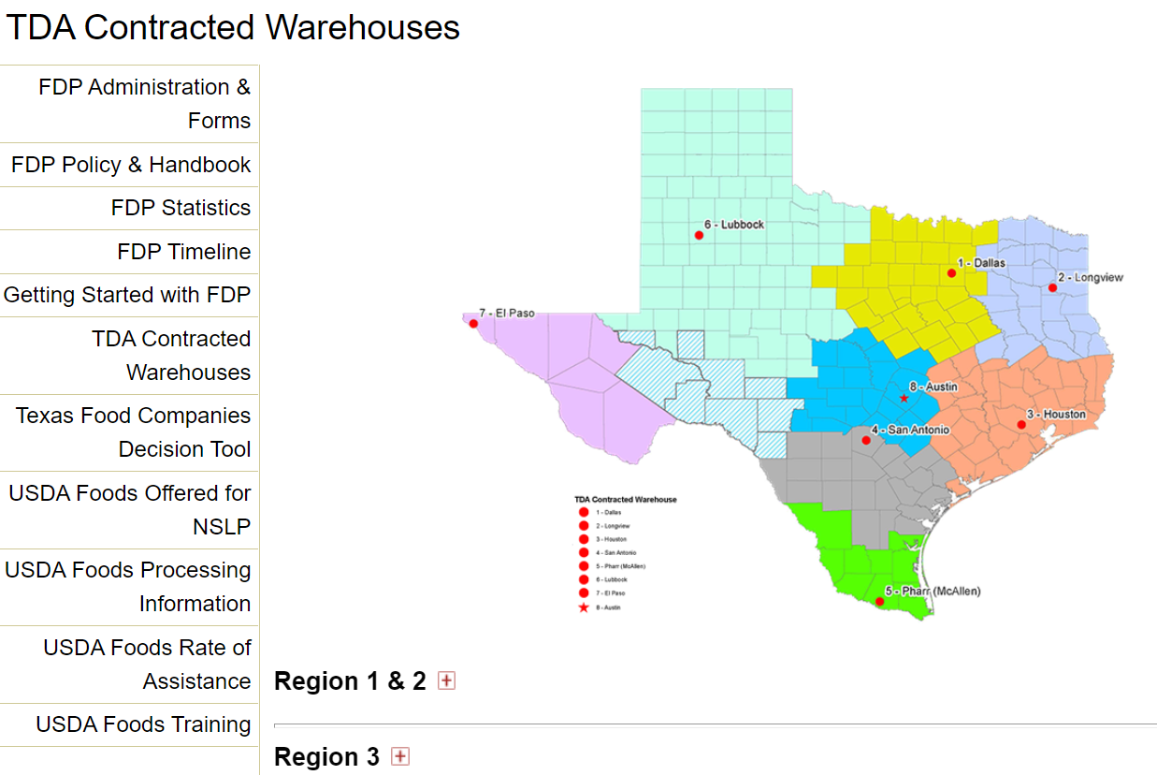
Notes:
For those that may need a refresher on how to find delivery and storage fees, we’ll navigate over to squaremeals to review how to find this information. Keep in mind that these fees are negotiated per warehouse and will vary based on which contracted warehouse the CE is using.

Slide 21
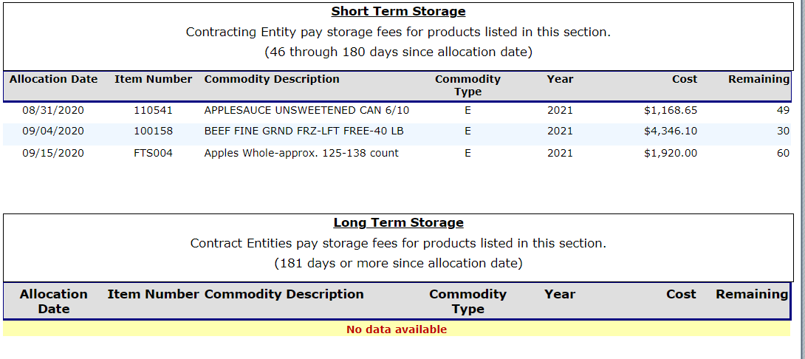
Notes:
In addition to being conscious of delivery fees, it is essential to keep track of what USDA Foods have been allocated to your CE by reviewing the Weekly Commodity Bulletin. This can be accessed through TX-UNPS in the FDP module under Reports. Just a reminder that when a CE completes the Annual Surveys in January/February for the following year, this is helping to inform TDA about intended demand for particular foods across the state. When you see that a particular item has been “allocated” to your CE in the warehouse, it means that It has been assigned in the warehouse to you. From the date of allocation, the CE has 45 days of free storage. From the 46th day, CEs begin to pay a per-case storage fee when items move into Short Term Storage. Rates vary depending on the type of storage. CEs should strive to receive inventory from the contracted warehouse before items move into Short Term storage to avoid paying storage fees.
The Weekly commodity bulletin is also where CEs keep track of remaining Entitlement.

Slide 22
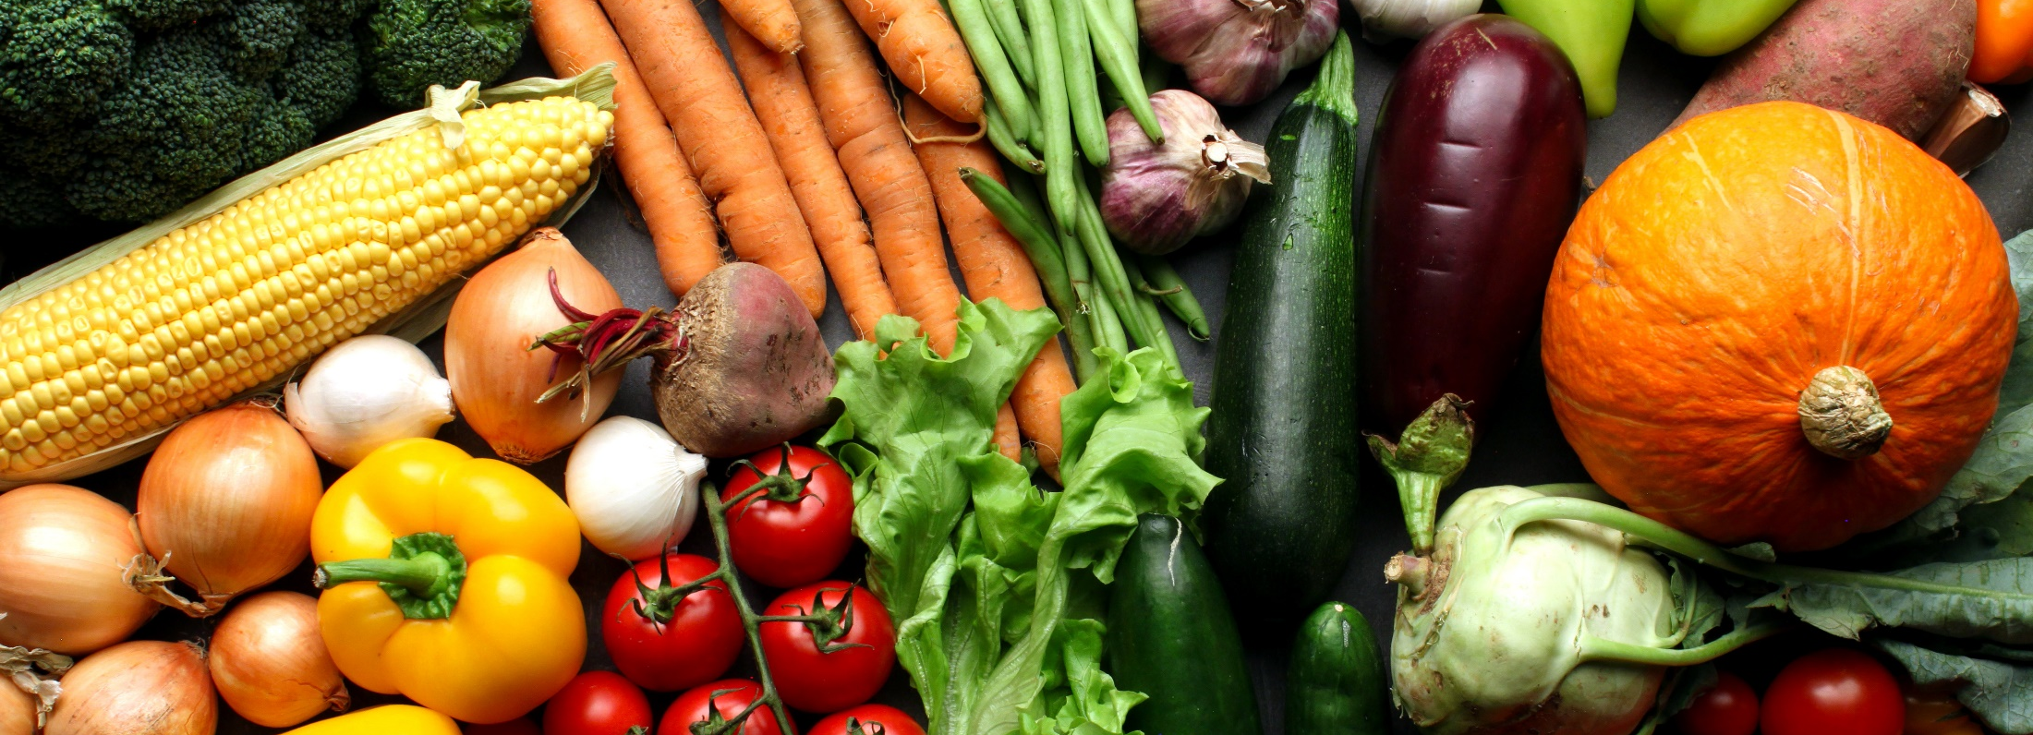
Setting par levels
Important inventory practice
Par level:
The expected minimum inventory
quantity required to ensure
supply needs are met
“By failing to prepare, you are preparing to fail.”
-Benjamin Franklin
Notes:
PAR stands for Periodic Automatic Replenishment
This is the amount of product needed to fulfill menu requirements for one ordering period plus a small amount of safety stock.
Par levels will vary and are based on individual circumstances. Consider par levels to be the normal maximum amount of an item to keep on hand.
Par levels can be set after a few rotations (months) of cycle menu usage and review of inventory(s)
By analyzing the amount of items used month to month, you can establish a set amount that you know each site (and thus your entire operation) will need in order to have enough supplies on hand to serve the day’s menu.
Communicating these par levels to the managers (and following up on inventory and ordering) can aid in establishing amounts that need to be ordered so there is no “guessing game”.
Following par levels when ordering helps to avoid excess inventory on hand which can lead to possible food waste.

Slide 23
Activity
1
Par Levels
Notes:
For this activity, we will refer to the USDA Fact Sheet “Chicken Strips, Unseasoned” and the Par Level Activity worksheet.
I’ll show you the example of the Fact Sheet on the next slide and then the worksheet. Based on the information provided, please take about 5 minutes to calculate the appropriate Par Level for the Chicken Strips for this district. You can work on your own and after the 5 minutes, we’ll come back together to review the correct responses.
Walk through steps of questions with the audience, writing answers down on the Post it note activity page
Answer sheet for activity
fajita each
Calculate the following:
How many servings do one case of the chicken strip product provide? 320 servings
How many cases will ABC school need to create their 500 servings? _________1.6_cases or 46.9 pounds_______
Will there be additional unused servings from this case? ___Yes 180 1.5 oz servings or 13.125 pounds_______________________
If ABC School serves 500 servings chicken fajitas twice each 4-week cycle, how many cases of the USDA foods chicken strips will be used during the 4-week cycle? 3.2 or 96 pounds______________________
If ABC school serves this 4-week cycle 9 times in the school year, how many cases of the USDA foods chicken strips would the district expect to need for the entire school year? _28.8 or 29 cases ( 870 pounds)___________________
What PAR level should be set for this item if ABC school orders only one time per month? __________4 cases______
Bonus: What factor(s) could change the amount ordered during a month? _______________________________________________________________________

Slide 24
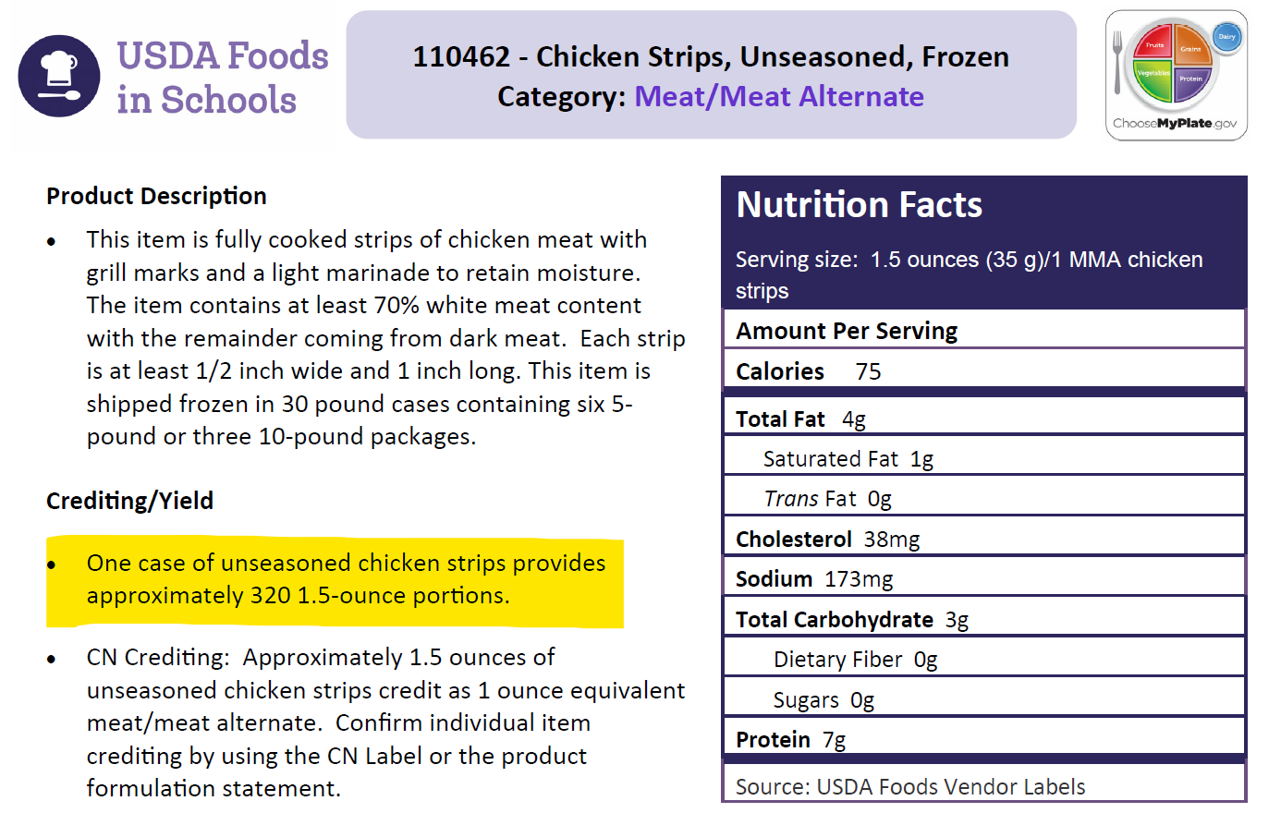
Activity
1
Please refer to the worksheet for Activity 1
Notes:
This is the USDA Foods Fact sheet that was posted in the course materials (see link in chat)

Slide 25
1 fajita provides one 1 oz. eq. WGR serving and 1.5 oz. meat/meat alternate
The recipe yields 100 servings
On Tuesday 2/11/2020 ABC school will need to make enough to feed 500 students 1 fajita each
Calculate the following:
How many servings do one case of the chicken strip product provide?
320
How many cases will ABC school need to create their 500 servings?
1.6 cases (46.9 lbs.)
Activity
1
Chat: What factors could affect how the par level is set?
Notes:
And this is an example of the questions on the worksheet. You can begin, and I will give the group a halfway mark.

Slide 26
Will there be additional unused servings from this case?
Yes--140 servings
If ABC School serves 500 servings chicken fajitas twice each 4-week cycle, how many cases of the USDA foods chicken strips will be used during the 4-week cycle?
3.2 cases
If ABC school serves this 4-week cycle 9 times in the school year, how many cases of the USDA foods chicken strips would the district expect to need for the entire school year?
28.8 rounded to 29 cases
Activity
1

Slide 27
Activity
1
What PAR level should be set for this item if ABC school orders only one time per month?
4 cases
Chat Responses: What factors could affect how the par level is set?
Notes:
Storage Space
Delivery Frequency
Vendor Minimum Thresholds
Value of the Product
Extended school closure or vacation

Slide 28
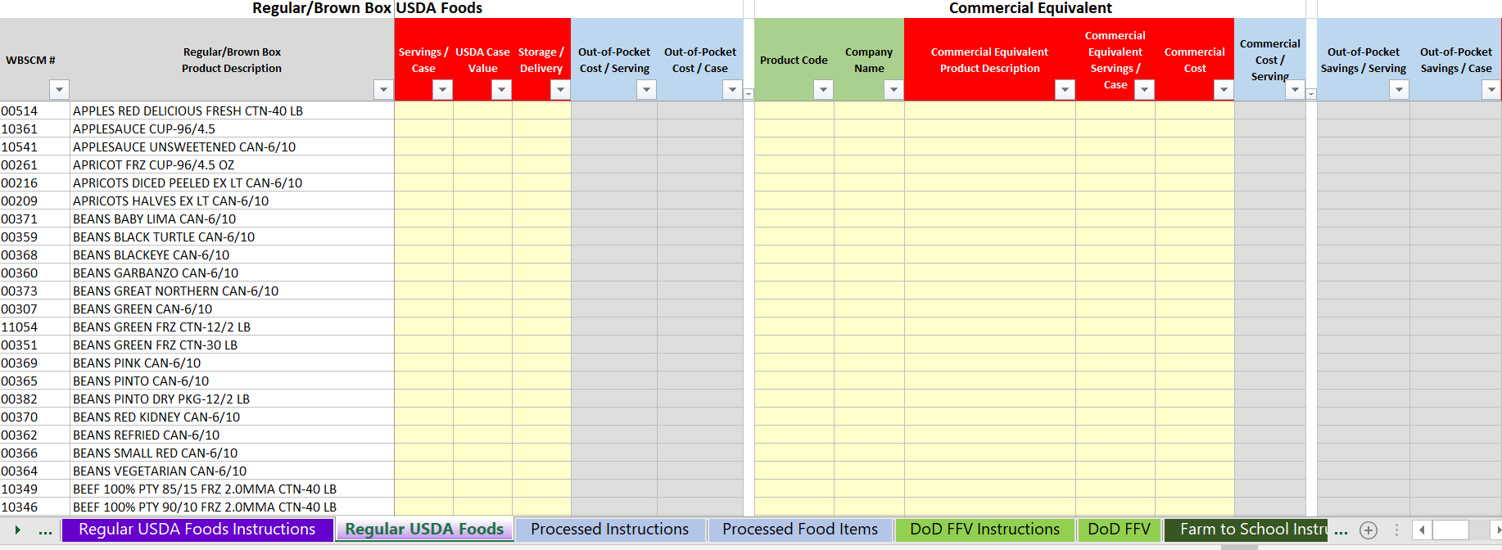
NEW!
USDA Foods Cost Analysis Worksheet
Notes:
We’ve discussed important factors to consider with regard to maximizing your Entitlement bucks. TDA has developed a new tool to assist CEs with decision making regarding whether it makes fiscal sense for them to utilize Entitlement and requesting particular items through USDA Foods, or whether a commercial item would be the better choice. In looking at the results as a whole, CEs can get a better picture of where the best use of their Entitlement will be and where it makes sense to purchase the items on the commercial market.

Slide 29
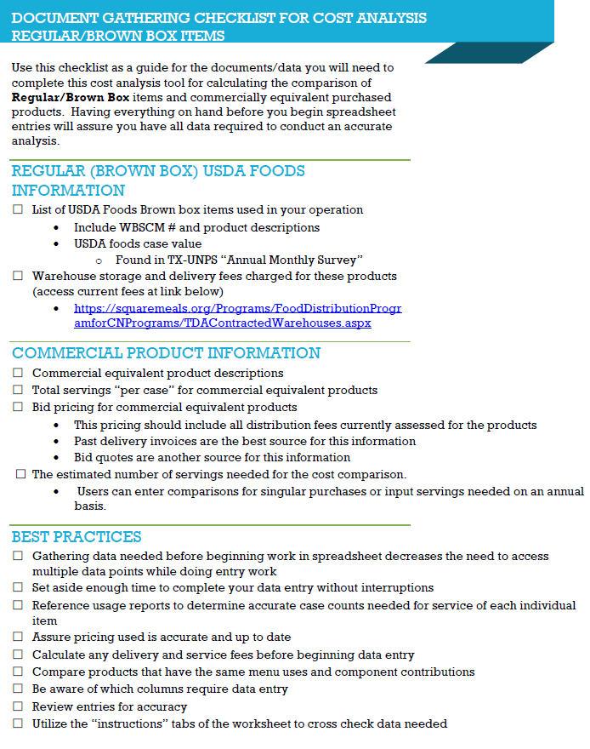
Preparation is Everything!
Document Checklists
squaremeals.org
Notes:
Before we navigate to squaremeals where the tool lives, I wanted to bring your attention to the Checklist resources that are available to help you in preparing all of the necessary data before you begin the worksheet. Each of the four types of USDA Foods has a checklist to help you in sourcing the necessary information. The checklists can be downloaded along with the Excel Analysis tool on squaremeals. Let’s navigate over to squaremeals.

Slide 30
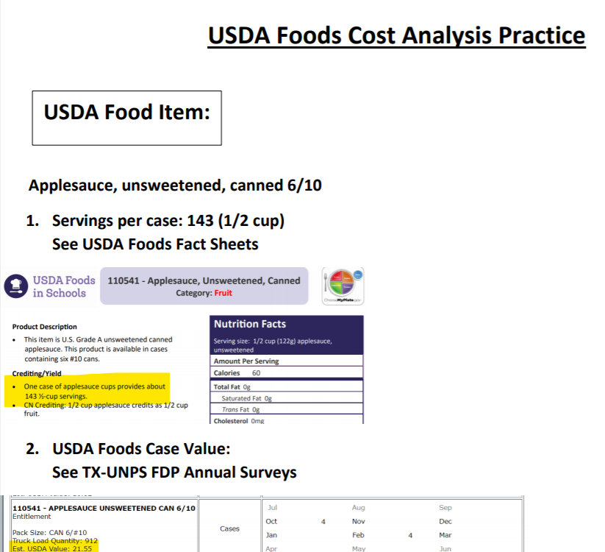
Activity
2
Please refer to the worksheet for Activity 2
Notes:
The objective of this activity is to demonstrate an example of organizing the necessary data and how to complete the tool.

Slide 31
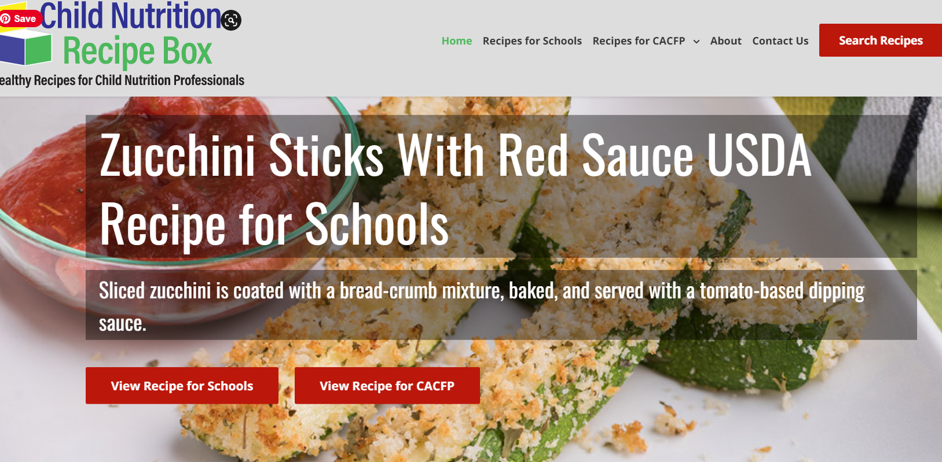
Recipe Resources
Chat: Where do you go to find recipes to utilize USDA Foods?
Notes:
We’ve discussed how to calculate Entitlement, the different ways it can be utilized, how to be vigilant about storage and delivery, preparing for best use of entitlement $, and the tool to help in comparing data to make appropriate spending decisions. Now we will spend a bit of time discussing the actual FOOD. This is certainly not an exhaustive list of USDA Foods recipe resources, but here are several that may provide inspiration for new menu ideas and new ways to utilize USDA Foods. In the chat, please feel free to share any resources you use for recipes.

Slide 32
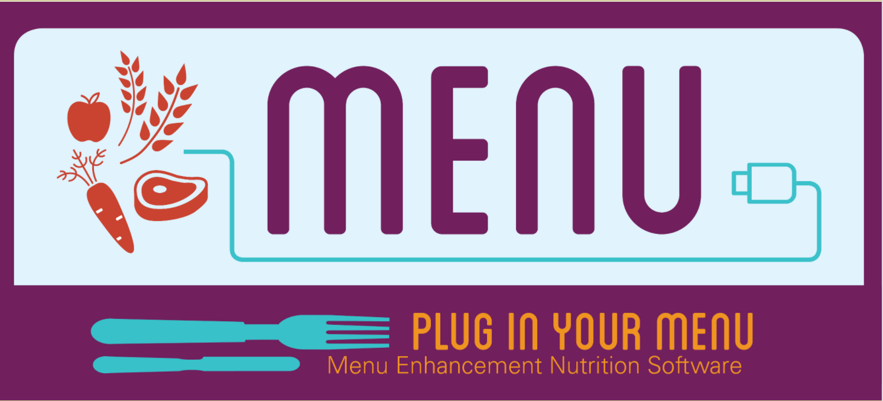
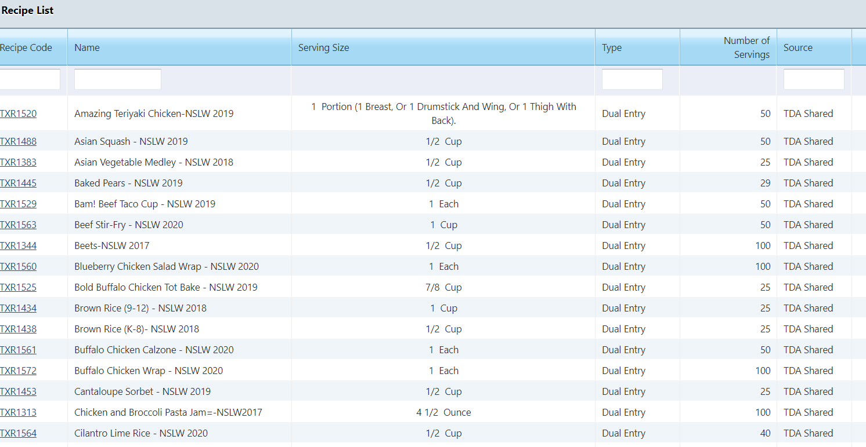
Recipe Resources

Slide 33
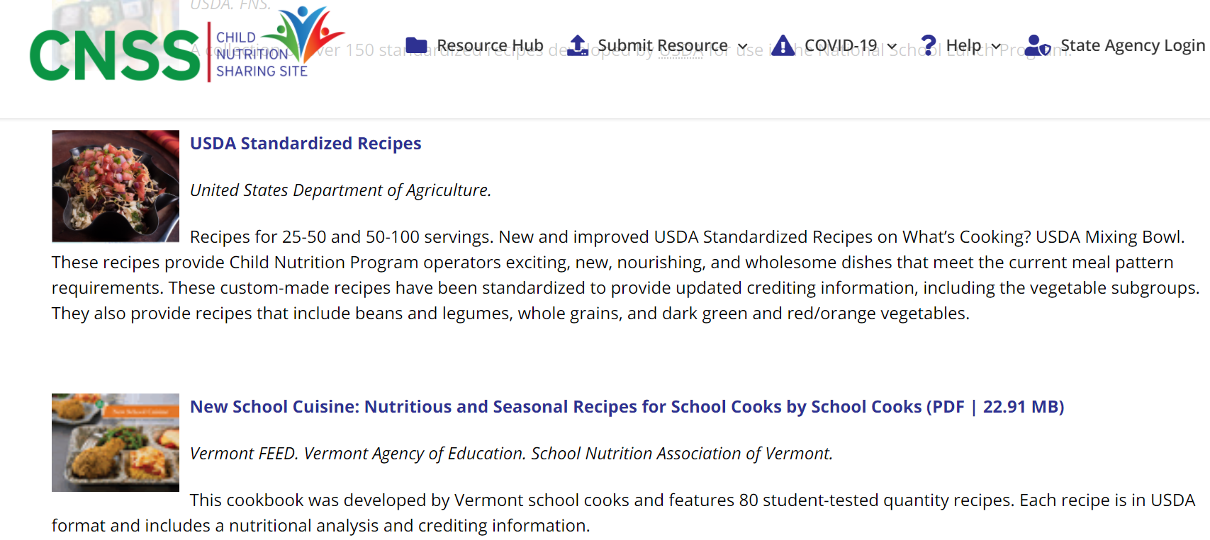
Recipe Resources

Slide 34
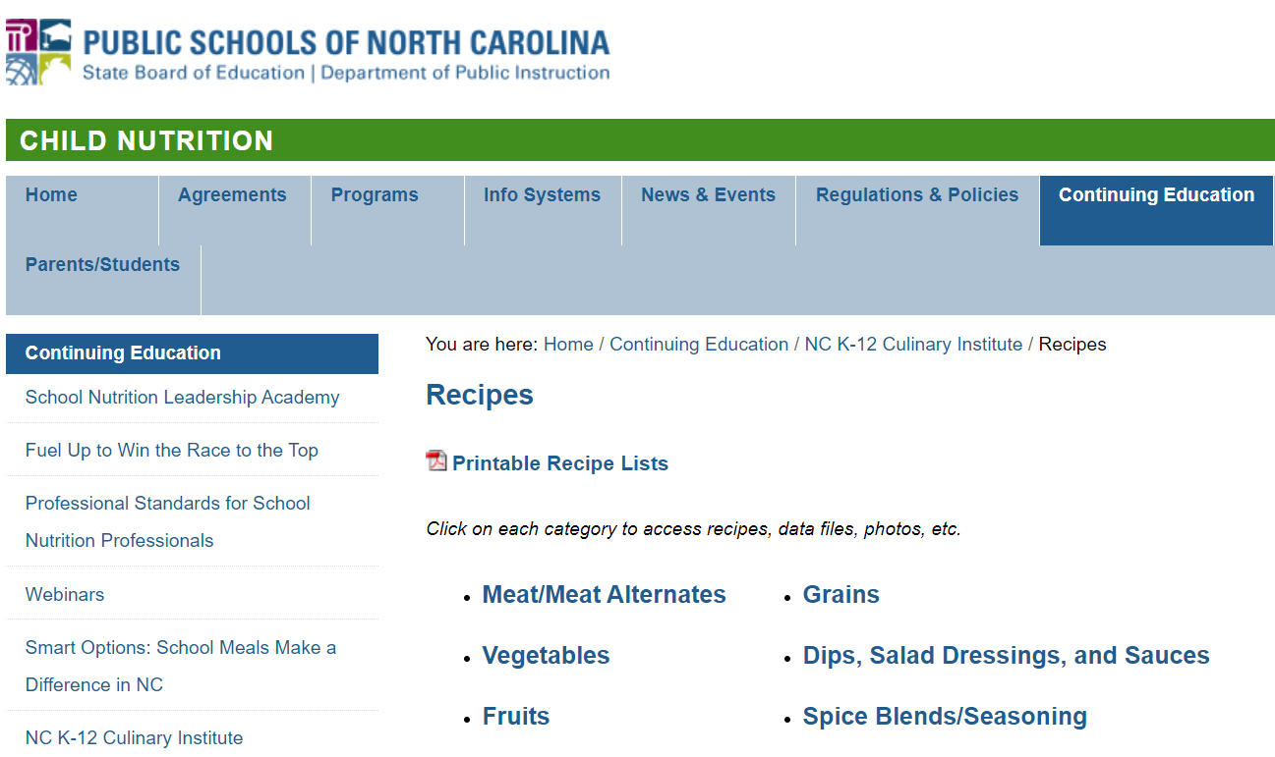
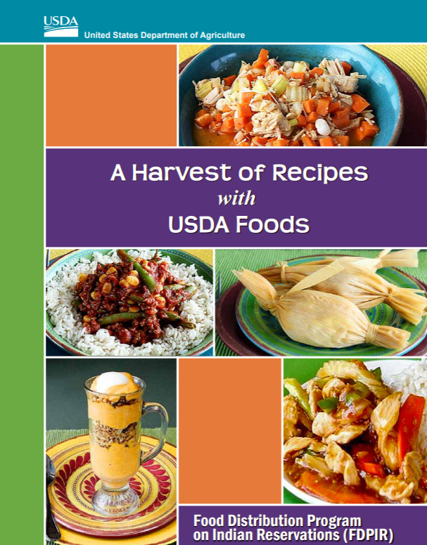
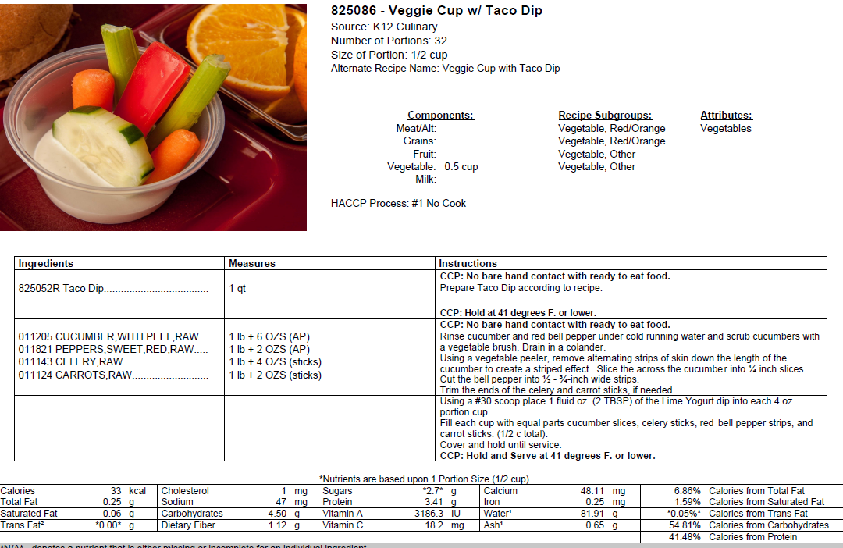
Recipe Resources
Notes:
Just as a reminder, it is a best practice to make a small test batch of a new recipe before embarking on a large batch.

Slide 35
Recipe Resources
The Institute of Child Nutrition Recipe Box: https://theicn.org/cnrb/
Texas: TDA MENU Module: Access via TX-UNPS, contact your ESC for assistance
Nutrition.gov: https://www.nutrition.gov/topics/shopping-cooking-and-meal-planning/recipe-collection
Child Nutrition Sharing Site: https://theicn.org/cnss/recipes-for-school-food-service/
North Carolina: https://childnutrition.ncpublicschools.gov/continuing-education/nc-k-12-culinary-institute/ci-recipes
Notes:
Here is the list of resources we touched upon, feel free to take a screen shot or the presentation will be available on squaremeals sometime after this session. Also, sharing recipes, ideas, and resources with fellow colleagues is also a great way to incorporate new ideas into your menu.

Slide 36
Tips for Forecasting Success
Include, but are not limited to…
Use a cycle menu
Maintain accurate food production records
Review FPRs and consolidate numbers frequently
Success depends upon previous preparation, and without such preparation there is sure to be failure.
- Confucius
Notes:
To wrap up this portion of the session, let’s review a few of the tips that have been shared.

Slide 37
Tips for Forecasting Success
Include, but are not limited to…
Be aware of operational changes
Maintain accurate usage reports
Maintain accurate inventory
Document anomalies
Success depends upon previous preparation, and without such preparation there is sure to be failure.
- Confucius
Notes:
Operational changes
Document on production records any occurrence which may shift the amounts of food served on a given day
Examples: A field trip the kitchen was unaware was occurring could effect total number of students coming for a meal, disruption in regular delivery may cause a need to substitute a menu item, Dropping a 50 serving pan of spaghetti may lead to the need to produce additional product for meal service, popular food item may need to have number of servings adjusted up for next cycle of production on a menu.
2) Maintaining accurate consolidated usage reports will prove valuable when you need to know the amount of each food item used for the course of a week, month or year. These accurate usage reports can help drive the amount of product you need to order for each delivery and will serve as an estimate of the amount of food you will use over the course of the year. When soliciting bids you will need to know what your annual usage is to estimate what needs to be ordered and to determine if your food cost is in line with your budget.
3) Maintain accurate inventory. Inventory counts should align with the frequency of orders/deliveries in your operation. If you receive your orders weekly, then it will be best to do inventory on a weekly basis so you can determine if stock on hand is adequate to meet menu needs. This also allows you to avoid over ordering. Remember to reference your PAR levels.
4) Referencing production records to assure any unusual changes to service did not occur or if it di, you have noted this and adjusted the plan accordingly.

Slide 38
Forecasting Conclusions
Forecasting is an ongoing process
Investing time upfront assures success in the end
Allows flexibility in planning for unusual situations
Informs future choices and plans
Aids in maintaining compliance with program regulations

Slide 39
Questions?

Slide 40
Updated 11/2020

