Slide 1
Utilizing USDA Foods
Jaclyn Cantu, RD
Director for USDA Foods
During the COVID-19 Pandemic
Updated 06/2020
www.SquareMeals.org
Notes:
1st Cover Option

Slide 2
What to do if requested items don’t match current needs
TDA and industry partner resources for creative packaging of bulk product.
Work with TDA and Cooperative Coordinators to find USDA food materials and products that meet needs and to release food that does not meet needs.
Surplus USDA Foods and State Account pounds available first come, first serve upon request.

Slide 3
Can an order be cancelled?
What happens to entitlement if an order is cancelled?
TDA can request to cancel or delay full truckload orders that have not been purchased by USDA.
Most of 1st round orders have been purchased by USDA.
If truckloads were cancelled, entitlement would be returned to CEs

Slide 4
Will USDA consider extending deadline for carry-over pounds for commodity processed items past November?
TDA has permanently moved the process of sweeping carry-over USDA Foods at Processors from November 30th to June 30th annually.
Due to COVID-19, TDA will not sweep SY 19-20 carry-over pounds in SY 20-21.
USDA is monitoring processor inventories closely.

Slide 5
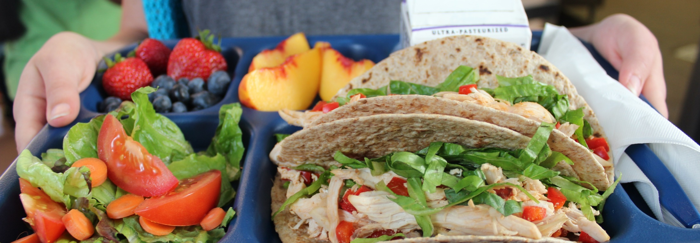
If off-site meals are not reimbursable, would districts be able to use USDA foods?
USDA released a national waiver that allows for non-congregate meals in NSLP to be claimed for reimbursement through June 2021.
USDA foods can be used in a la carte sales as long as the value of the USDA food is recouped with the sale.

Slide 6
Checking inventory levels
Weekly Commodity Bulletin
Allocation E-mails
FFAVORS
K-12 and Processor Link
Pre-Allocation functionality
Free/Short/Long term storage
Weekly e-mails for Brown Box, FtS, and Processing for TDA Warehouse deliveries
Check entitlement balances and fresh produce offerings weekly for DOD Fresh
Check balances monthly for pounds at processors

Slide 7
Minimizing Food Cost
Utilizing as many types of USDA Foods in the school menus can assist in offsetting food costs.
How many items your menus areUSDA Foods?

Slide 8
Updated 06/2020
www.SquareMeals.org

Slide 9
CONTACT US
1700 North Congress Ave.
Austin, TX 78701
www.SquareMeals.org
CommodityOperations@TexasAgriculture.gov
(877) TEX-MEAL

Slide 10
Questions?

