Slide 1
Valley Mills ISD & Laredo ISD Fall Reopening Plans & Outreach Tools for NSLP Promotion
Updated 08/2020
www.SquareMeals.org
Notes:
1st Cover Option

Slide 2
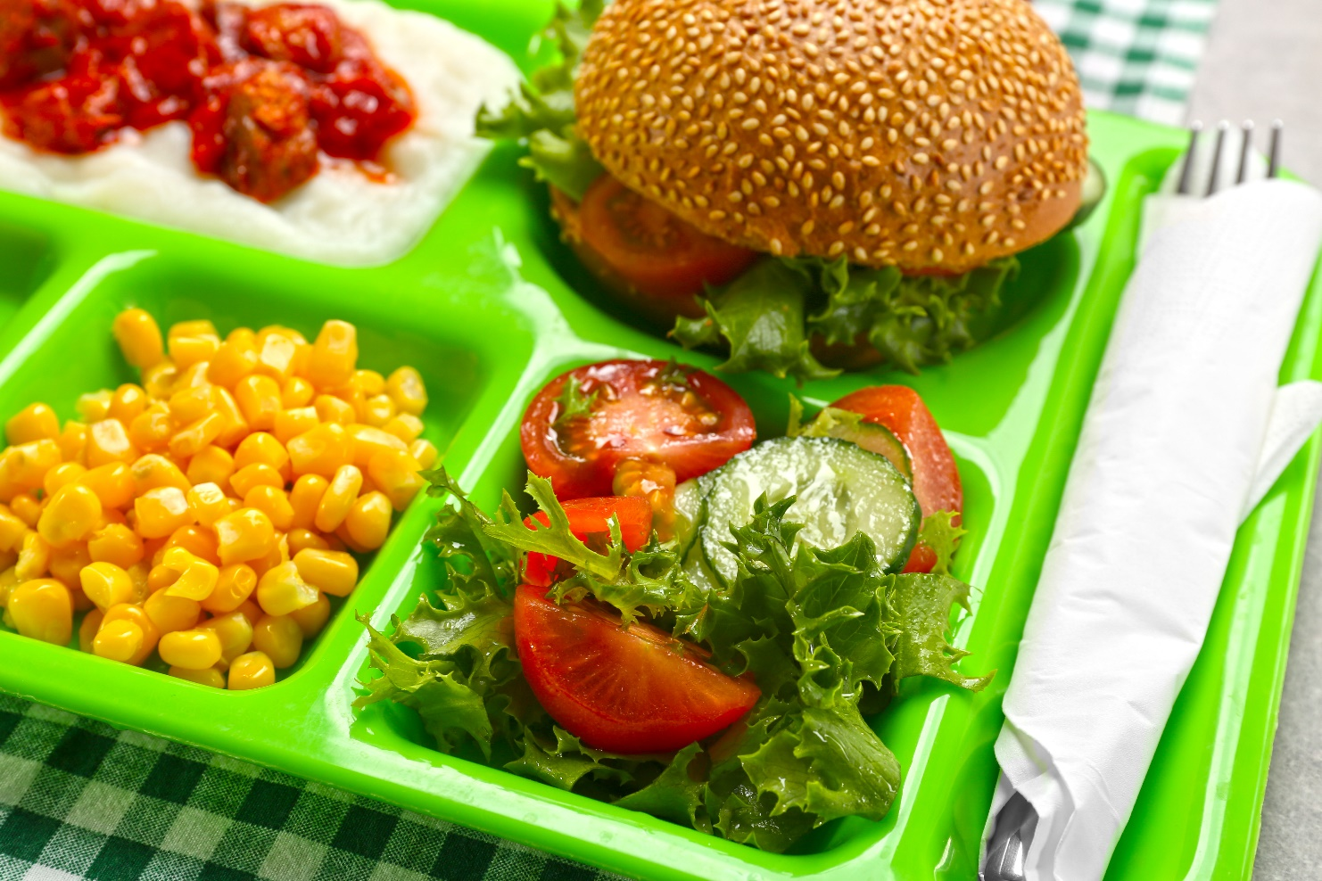
Lisa Obenhaus,
Director of Food Service, Valley Mills ISD
01
Roberto Cuellar, Jr. BA, BS, MPH
Child Nutrition Program Director,
Laredo ISD
02
Kellen Cantrell, MSNS
Marketing Specialist, Outreach, TDA
03
Presenters
Facilitated by Emilee Case,
Special Programs Coordinator,
Program Support, TDA

Slide 3
COVID Back To School Plan
Valley Mills ISD

Slide 4
Demographics
Approximately 650 students district wide
Two campuses ( Elementary, Junior High/High School together)
Free and Reduced Percentage apx 60%
Small rural community
Breakfast Participation apx 25%
Lunch Participation apx. 50%

Slide 5
School Opening
Both sites will begin on September 8th
Instruction will be in person and virtual
Meal service times have been increased in an effort to accommodate seating for all students
Non CEP/P2 schools

Slide 6
Meal Service Models
Elementary Campus
Serve Only
All menus have been decreased to one option per meal period
All components will be boxed including condiments and utensils
Milk Variety will be offered
No salad bar this year. Sub groups have been incorporated into menu
Students will arrive in cafeteria and sit in assigned seats by class
Meals will be boxed and delivered to cafeteria for both breakfast and lunch
Meals will be rang in on our POS by cashier ( Mobile POS)
No A La Carte
4 lunch periods to accommodate seating (2 grades at a time)
3 employees on campus

Slide 7
Meal Service Models
JH/HS Campus
Serve Only
All menus have been decreased to one option per meal period
Second entrees will be available to purchase
All components will be boxed including condiments and utensils
Milk Variety will be offered
Students will go through the serving line one at a time
Meals will be boxed and students will pick up a box and any additional entrees
No A La Carte
4 lunch periods to accommodate seating
3 employees on campus

Slide 8
Best Practices
All NSLP applications completed as normal
Intake form completed to include:
OVS HS Waiver
Will be Serve Only
Meal Time Waiver
Will be giving lunch and breakfast for the next day for virtual learners
Non-Congregate Feeding Waiver
Virtual students will grab a meal and eat off campus daily
No Child Present, Parent Pick Up Waiver
Parents pick up at the site that their student attends
Parents will be given a sign to place in car window so meals can be counted at the time of delivery while maintaining social distancing

Slide 9
Safety Plan
Staff Self Monitoring - Staff will answer the following:
Are you experiencing any COVIS-19 symptoms?
Have you had close contact with an individual who is lab confirmed COVIS-19?
Check your temperature (must be under 100.4)
Instructions on how to use the thermometer will be displayed
Employees must practice all cleaning and disinfecting, handwashing and respiratory hygiene
Employees will wash hands every hour or more if needed.
Employees will disinfect all work surfaces every hour or more if needed
Employees will maintain social distancing at all times and will not interact with students longer than 10 minutes at a time
All employees will wear face coverings at all times

Slide 10
Challenges/Successes
Challenges/Concerns
Potentially new processes that staff need to be trained and compliance with these procedures
Potential loss of participation which will in turn decrease food service revenue
Loss of ALC revenue which will also result in a loss of food service revenue
Continued availability of products ( foam containers etc)
Smooth implementation process
Successful usage of pre planned commodities without having excess inventory
Success
Will begin school September 8th however to date there has been positive collaboration from all staff members and administration ( Superintendent, Principals, Teachers)
Products have been available so far

Slide 11
Laredo ISD Fall Reopening Plan
Robert Cuellar Jr., MPH
Child Nutrition Program Director

Slide 12
Laredo ISD Facts
Located in Laredo, Texas
23,000 students (Pre-K thru 12 grade)
96.4% Economically Disadvantage-
94.8% F/R
CEP school district
30 schools – 20 Elementary, 4 Middle, 4 High Schools, 1 Non-Traditional High School, 1 Discipline Alternative School (all CEP)
August 24th- start date of school year

Slide 13
Pre-Covid Meal Statistics
13,000 Breakfast ADP
21,000 Lunch ADP
3,000 CACFP At Risk Supper ADP
340 After School Snacks ADP
$12,525 A la Carte Sales
17 schools participating in Fresh Fruit & Vegetable Program
Held many nutrition education events throughout the year

Slide 14
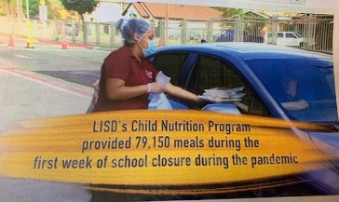
Covid Meal Statistics & Information
Beginning 1st week of school closures- Served 79,150 grab n go curbside meals (breakfast and lunch), Mon-Fri; meal service time– 9:30 am – 12 noon
From March 23rd – July 31st – Served 1,274,590 grab n go curbside meals!!
“Awesome job – Superheroes!” Serving with the heart, six feet apart
All CNP Staff followed preventive measures while preparing and distributing meals

Slide 15
During Covid
Meals Served- Down by 49%
No CACFP At Risk Supper, After School Snacks or FFVP Program
New norm– wearing face masks, face shield, sanitizing of hands and all equipment
Greatest Challenges:
- Lower Meal Participation
- Staff feeling tired
Limited I/W items-only in lunch; all breakfast typically had I/W items
Not offering choices in menu; no salad bar line

Slide 16
Pre-Covid Menus (Elem., Mid., & HS)- Lots of variety in menu items!
Menu Changes
Covid Fall Menus (Elem., Mid. & HS)- Limited Items (and no salad bar line)

Slide 17
District Survey & Fall Reopening Plan
88% parents responded students will be learning virtually; 12% attend school
Connected virtually through Google meets with District Leadership, School Board, Superintendent and with all school principals and assistant principals
Part of District’s Taskforce*
Buy-in→ on meal service models that will be implemented starting August 24th
Grab n Go Curbside Meals at most schools; 9:30-12:30 pm
SD Cafeteria as well as Breakfast and Lunches set up by the hallway (site-based decision)
Closely working with School administrators on SD, timing and compliance

Slide 18
Meal Service Models Implemented
Grab n Go Curbside side meals
Prepacked Breakfast and Lunch Meals; hot items in warmer and cold items in coolers/ice chests
Scan meal ID cards that have been issued
Parents can pick up meals for their children enrolled in our district at one school instead of going to different schools (saves time and eases parents)
Report will show the student’s enrolled school location on Nutrikids POS Report
Will also show if duplicate meals were taken
Challenges- requires more labor time, limited time for meal pick-up, and possibly parents forgetting meal ID cards (staff has duplicate cards available)
Benefit-continuing to provide meals to students; parents won’t need to worry about meals to provide at home

Slide 19
Meal Service Models Implemented
Social Distant Cafeteria
Students go through the line (6 feet apart)
CNP staff issues pre-packaged meal in Styrofoam or see-thru container
At least 15-20 minutes between lunch shifts to clean and sanitize tables
Some students could be walked over to cafeteria to pick up meal and eat in class
Contactless counting of meals by scanning student meal ID card
*have floor decals and also seating decals
*staff wearing face mask, face shield, and may have plexiglass partition as students get toward the POS (Meal ID cards would be scanned)
Greatest challenge- Students may take longer in the line to pick up meal
Benefit- Possible less waste and less expense for CNP

Slide 20
Meal Service Models Implemented
Breakfast and lunch by the Hallway or in classroom
Stations/mobile units are set up in halls or mobile units are transported down by CNP staff to each hall and classroom
Staff would offer meals by the hall and students eat in classrooms and staff would count meals (vs teacher)
Student meal ID cards will be scanned
*Challenges- Possible more expense for CNP for extra food and supplies and equipment; Possibly more trash and slightly more food waste

Slide 21
Fall Re-opening Plan
All Meals will be serve (menus planned based on popular entrée items and using commodity items as well)
Meals are served on Styrofoam trays and some meals will have bulk items that have been sealed with the use of our pre-packing machines
Will offer FFVP Program different method
Accommodate all special diets for students

Slide 22
Pre-packaging Machine

Slide 23
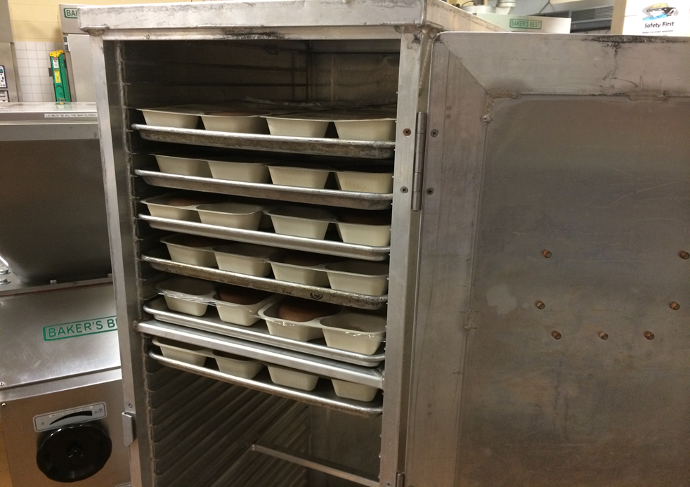
Equipment Used

Slide 24
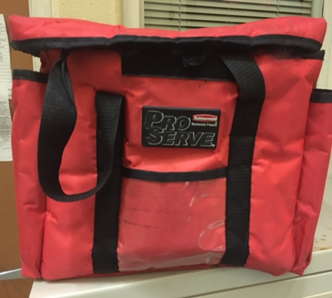
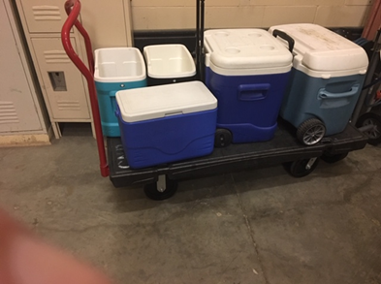
Equipment Used

Slide 27
Counting & Claiming
Use SocketScan Scanners – scan students meal ID card (school issued ID number)
If no ID card, parent must provide the school issued ID number
If new students in district, manager will type in or key in the issued school number of student
All managers at the schools will have duplicate meal ID cards in case parents lost them; in addition all managers will have a roster list to track students as well

Slide 29
POS Software- Nutrikids

Slide 30
Letters to Parents in English and Spanish

Slide 31
Importance to Have Signage

Slide 32
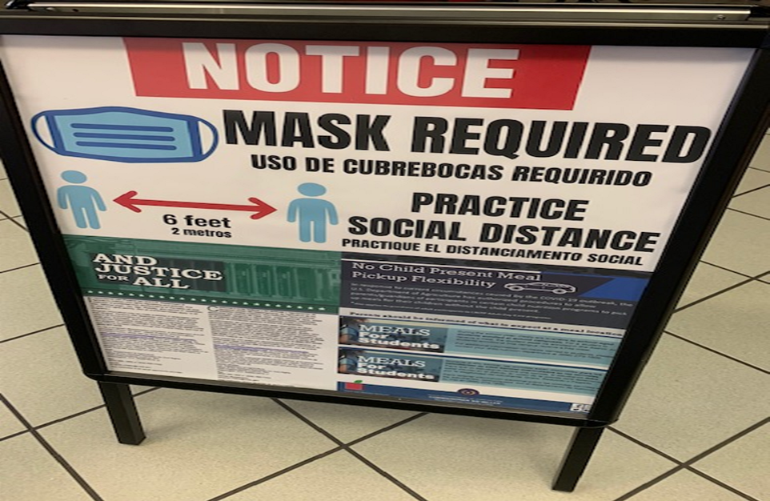
Signage for Grab n Go Curbside Meals

Slide 33
Following Preventive Measures
Employees will be wearing face masks at all times; face shields will be used by those distributing Grab n Go Meals or cashiers that are by the POS in the cafeteria will be wearing Face shield as well
Plexiglass partitions, hand sanitizing station, floor decals, seating decals will be made available and placed by the SD cafeteria; considering plastic table covers for the cafeteria; maybe also provide some schools may be purchasing disposable table cloths for children that eat in the classroom

Slide 34
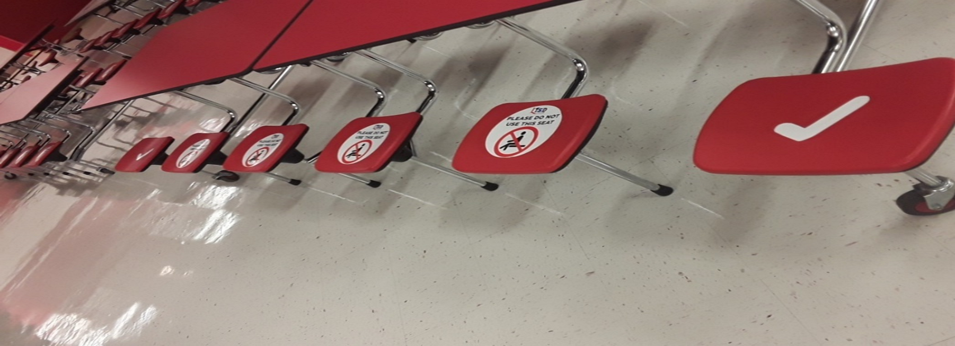
Social Distant Cafeteria Seating
Placed Decals so students know where to sit

Slide 35
Floor Decals

Slide 36
Touchless Hand Sanitation Station

Slide 37
Employee Safety is Important!

Slide 38
Employee Safety is Important!

Slide 40
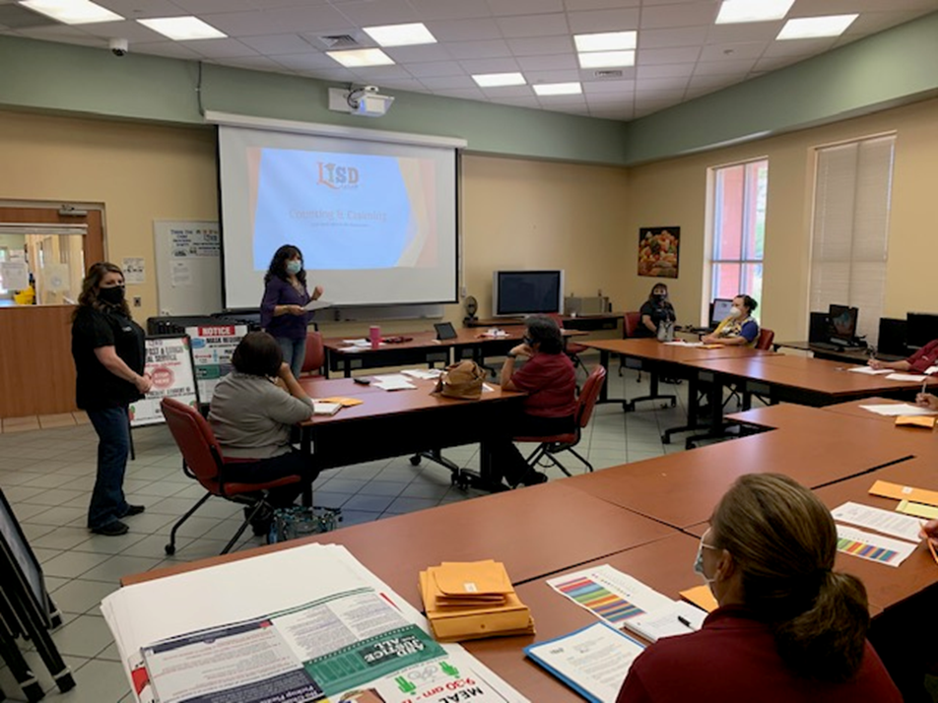
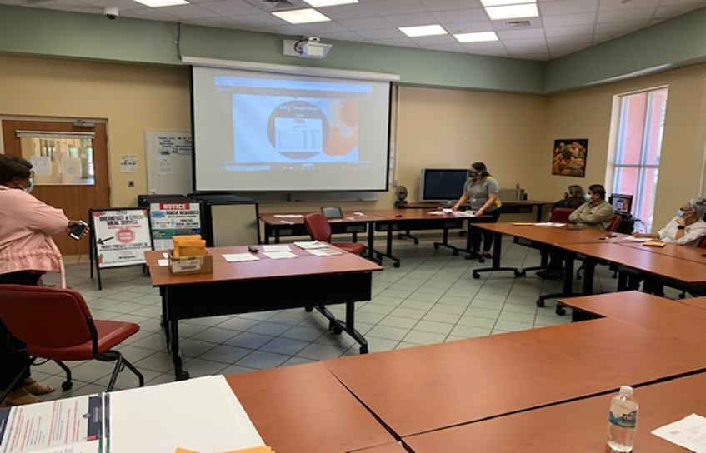
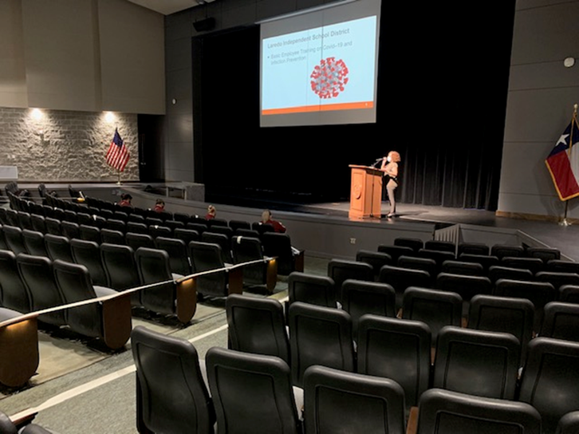
Employees are Key- Need to Train (in English & Spanish); Demonstrations
Trainings conducted in small groups (no more than 10)
Review all protocols and processes regarding meal service and preventive measures; Review on Covid-19

Slide 41
Collaboration is key: Everything is Awesome When We Work as a Team
Collaboration & Buy-in during this time is crucial. Must gain support from students, cafeteria staff, teachers, administrators, school board, superintendent, parent liaisons, and parents
Ongoing Communication

Slide 42
Big Thanks!!
TDA for ongoing support and informing all of us on important information in preparation for fall reopening plans
School Board, Superintendent, my Supervisor, all School Administration, teachers, parents and students
Special thanks to my Awesome Child Nutrition Staff!!!
For my beautiful family for their support in me working tireless hours

Slide 43
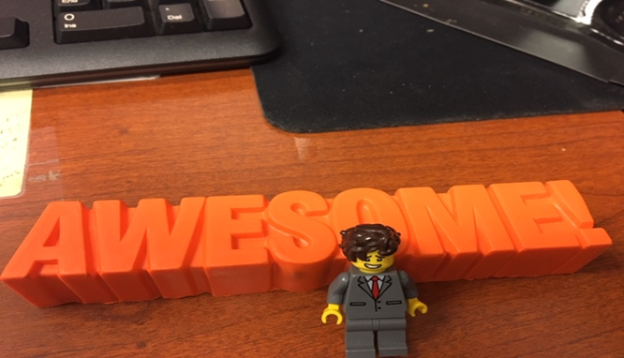
“Everything is Awesome when--
We work Together as a Team!”

Slide 45
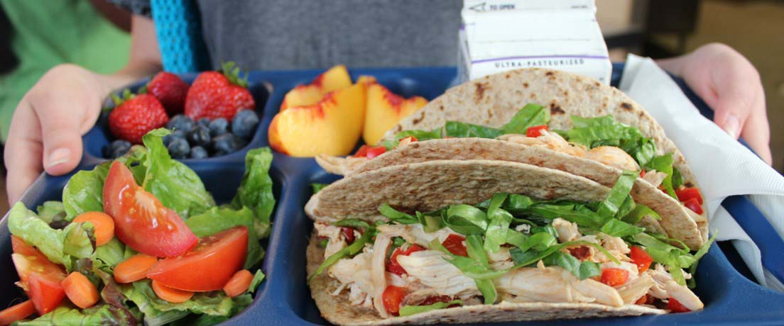
Outreach Tools To Promote NLP
Kellen Cantrell
Outreach Marketing Specialist
Texas Department of Agriculture - Food and Nutrition Division
08/2020
Notes:
Easily change photo. Please click on the small icon in the center of the holder and choose an image on your computer.
When you add the image, you may need to send it to back (Right click on the image > Send to Back).
If you would like to move the photo within the frame, click on Picture Format > Crop and then move the image to show the area of the photo desired.

Slide 46
National School Lunch Program
National School Lunch Week
Fall Planning
Resources
Resources
Resources
Notes:
Easily change photo. Please click on the small icon in the center of the holder and choose an image on your computer.
When you add the image, you may need to send it to back (Right click on the image > Send to Back).
If you would like to move the photo within the frame, click on Picture Format > Crop and then move the image to show the area of the photo desired.

Slide 47
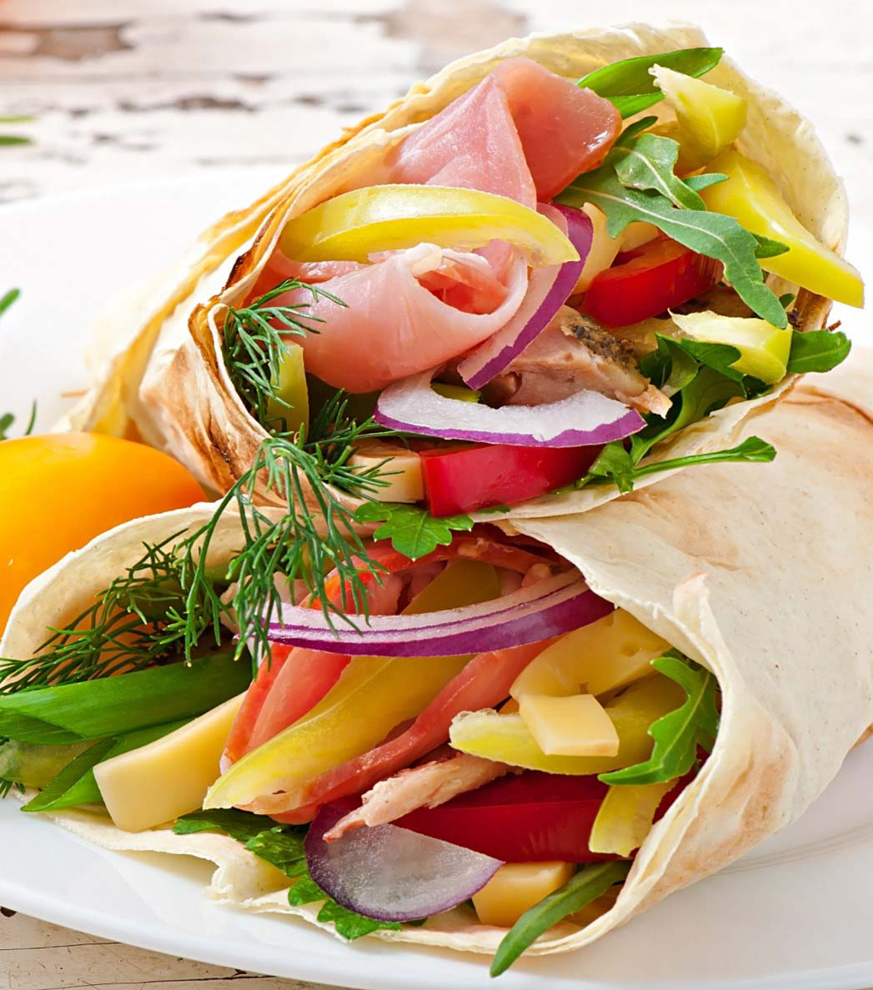
National School Lunch Program Resources
www.SquareMeals.org/NSLPResources
Policy documents – keep up with policy guidance and changes
Menu Calendar Templates – interactive resource for students and families
NSLP Calendar – provides key dates and reminders for CEs including action items and due dates
Notes:
Easily change photo. Please click on the small icon in the center of the holder and choose an image on your computer.
When you add the image, you may need to send it to back (Right click on the image > Send to Back).
If you would like to move the photo within the frame, click on Picture Format > Crop and then move the image to show the area of the photo desired.

Slide 48
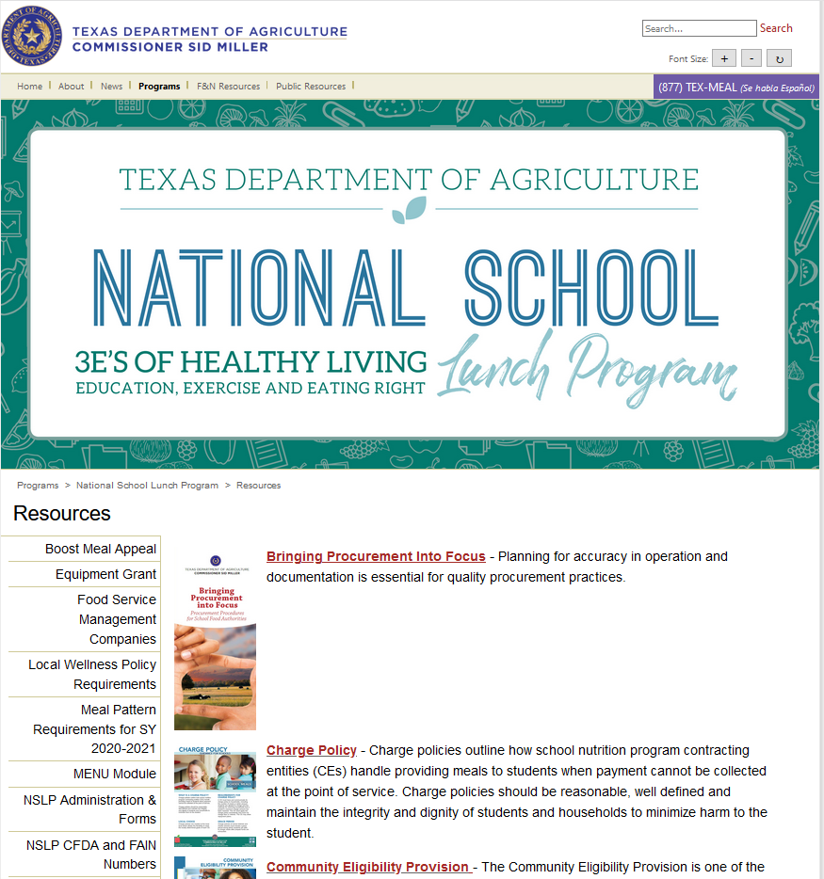

Slide 49
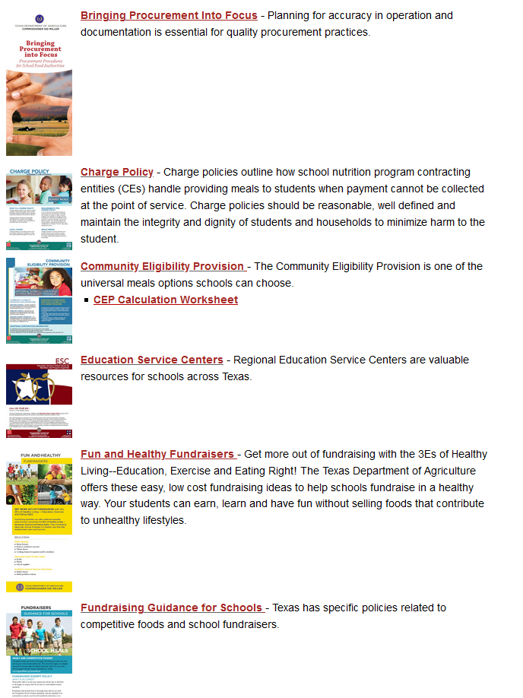

Slide 50
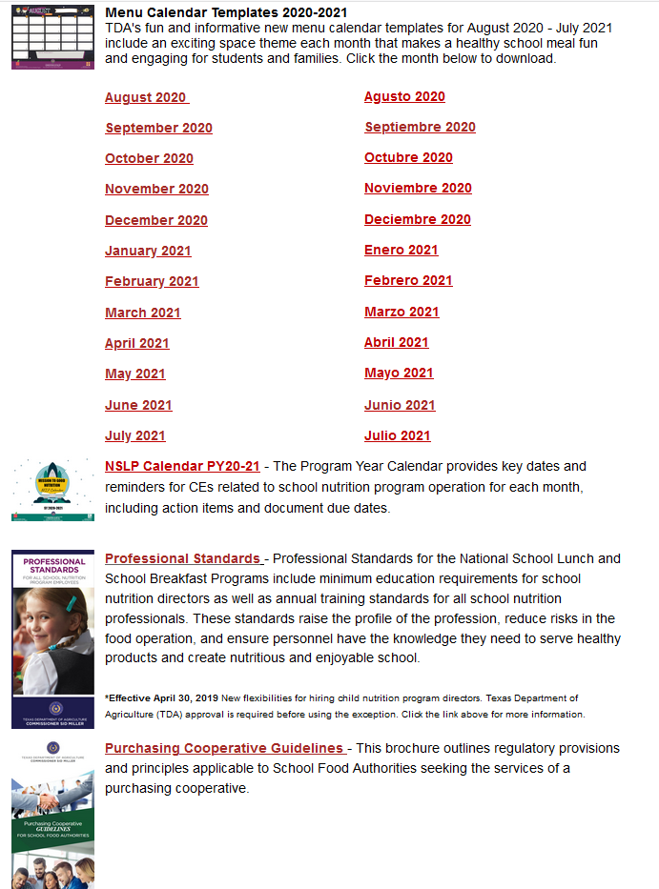

Slide 51
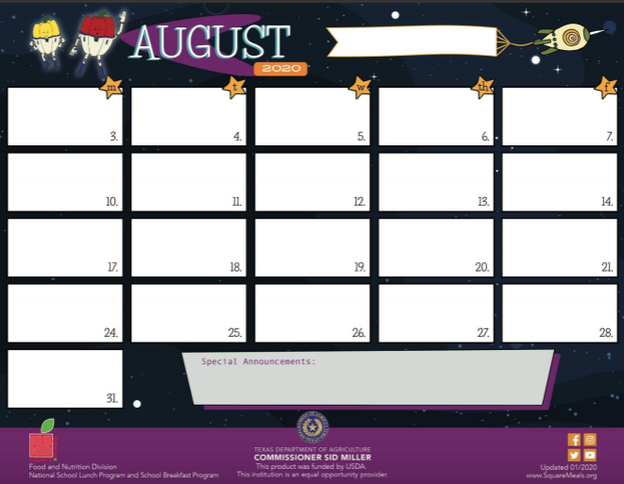
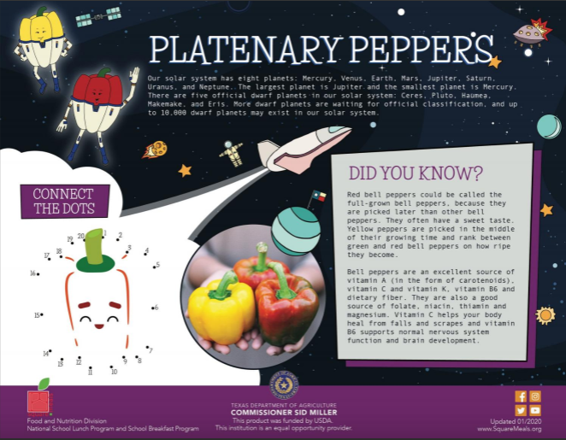

Slide 53
National School Lunch Week (NSLW) Resources
www.SquareMeals.org/NSLW
NSLW is October 12-15, 2020
The National School Lunch Week (NSLW) 2020 materials were inspired by the winning entries in the most You Art What You Eat student art contest
Materials ordered are being sent
Online materials available for download and print or digital use
Notes:
Easily change photo. Please click on the small icon in the center of the holder and choose an image on your computer.
When you add the image, you may need to send it to back (Right click on the image > Send to Back).
If you would like to move the photo within the frame, click on Picture Format > Crop and then move the image to show the area of the photo desired.

Slide 54
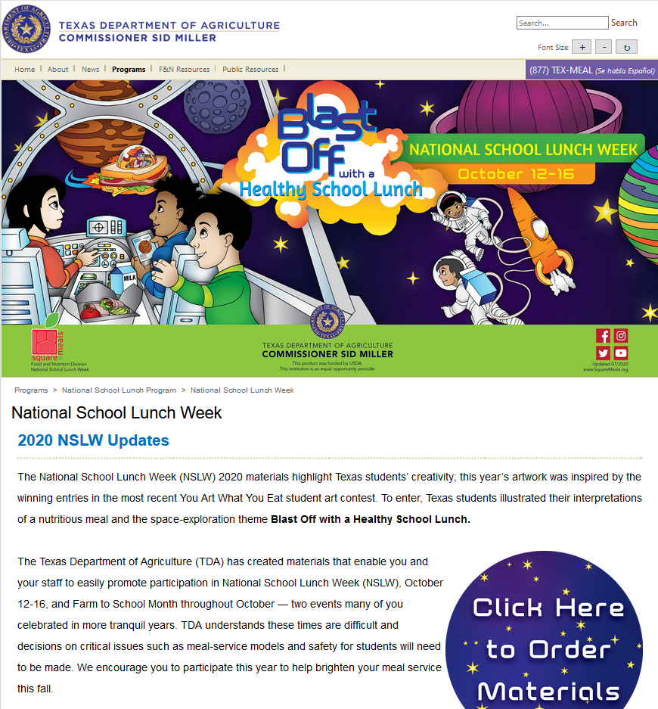

Slide 55
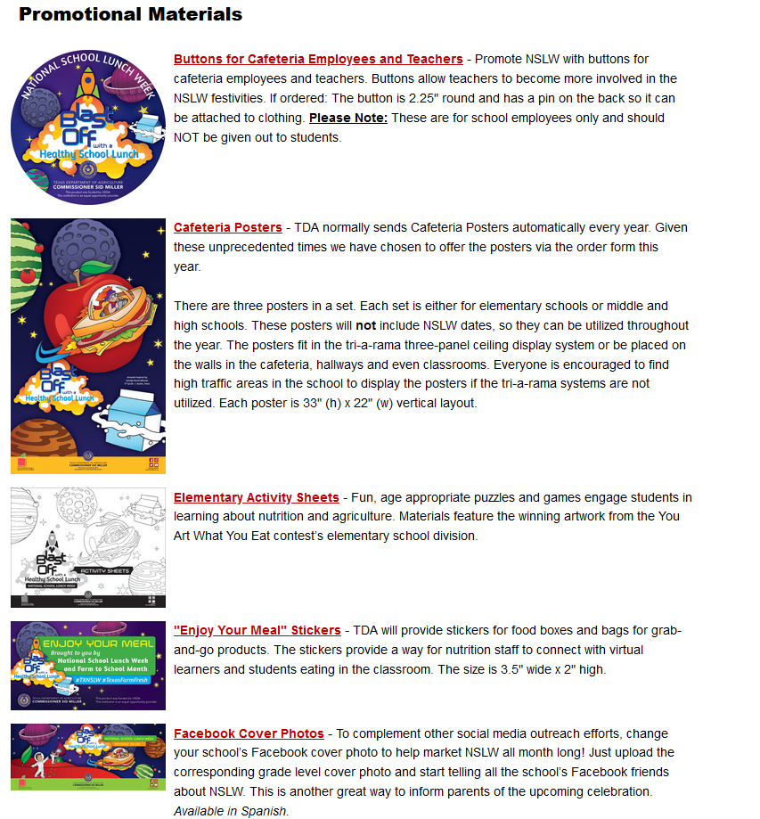

Slide 57
Fall Planning Resources
www.SquareMeals.org/FallPlanningResources
Menu Planning – Menu Template
Implementation Resources – Summer to NSLP Flyer
Printable Resources – Social Distancing Floor Decal, Enjoy Your Meal Sticker, Handwashing Reminder

Slide 58
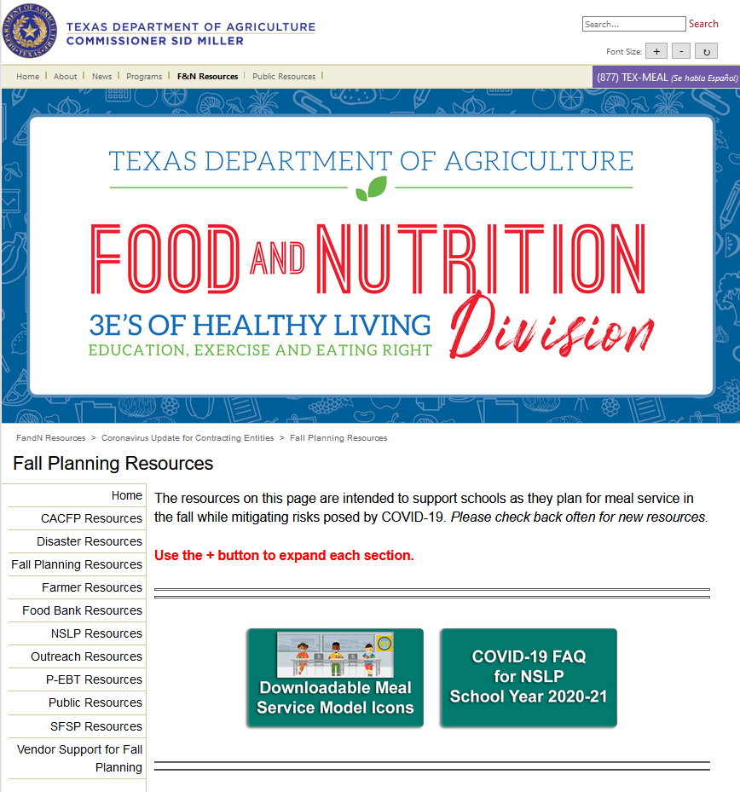

Slide 59
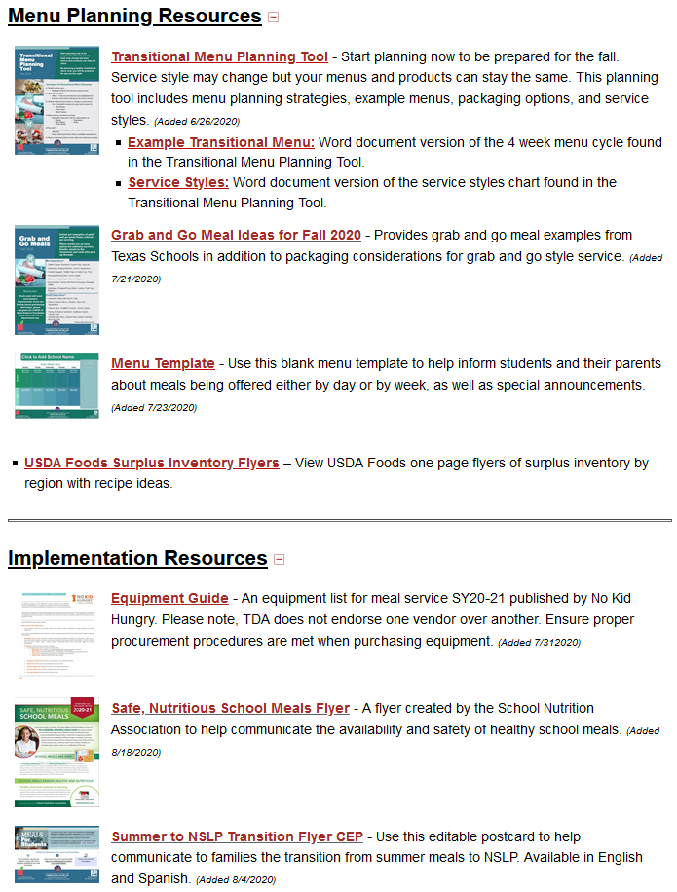

Slide 60
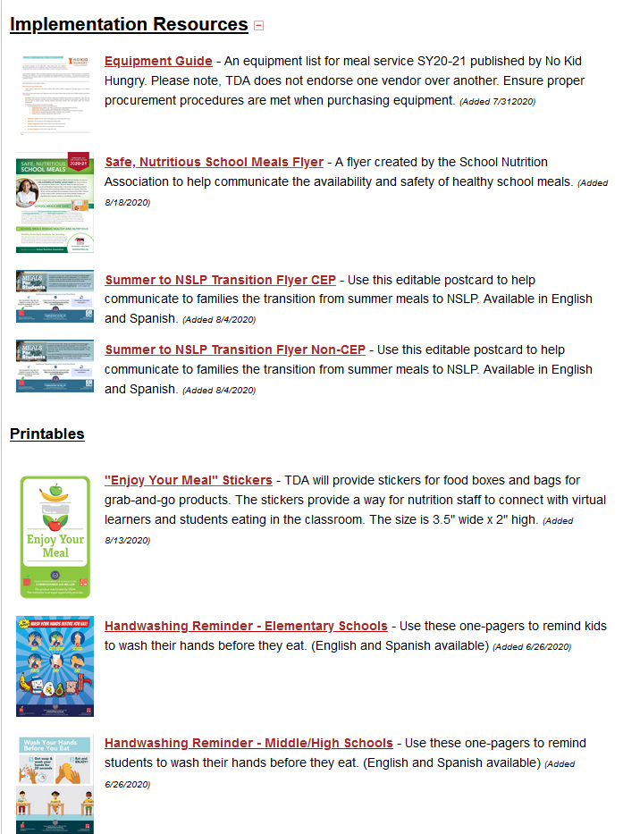

Slide 61
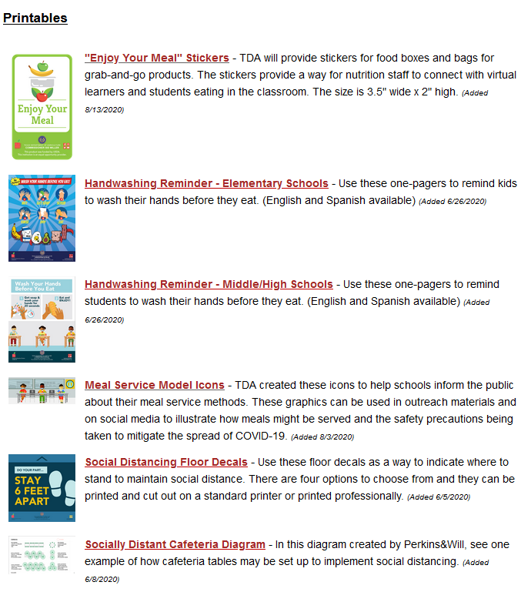

Slide 63
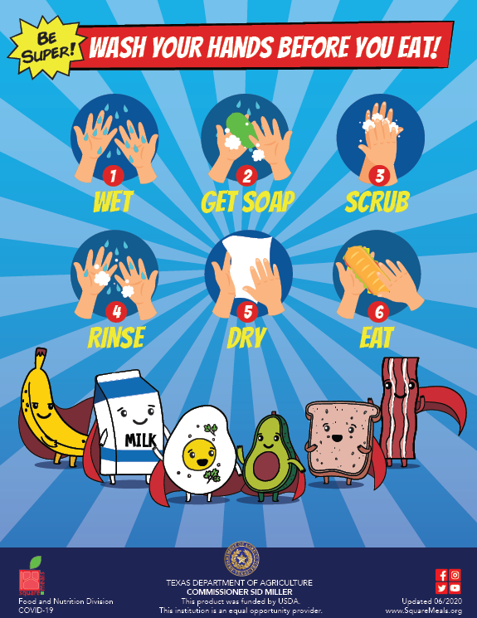

Slide 64
06/2020
Notes:
Easily change photo. Please click on the small icon in the center of the holder and choose an image on your computer.
When you add the image, you may need to send it to back (Right click on the image > Send to Back).
If you would like to move the photo within the frame, click on Picture Format > Crop and then move the image to show the area of the photo desired.

Slide 65
Questions?

Slide 66
CONTACT US
1700 N. Congress Ave. Austin, TX 78701
www.SquareMeals.org
Outreach@TexasAgriculture.gov
512-463-0754

Slide 67
Lisa Obenhaus,
Director of Food Service, Valley Mills ISD
01
Roberto Cuellar, Jr. BA, BS, MPH
Child Nutrition Program Director,
Laredo ISD
02
Kellen Cantrell, MSNS
Marketing Specialist, Outreach, TDA
03
Presenters
Facilitated by Emilee Case,
Special Programs Coordinator,
Program Support, TDA

Slide 68
Lisa Obenhaus,
Director of Food Service, Valley Mills ISD
01
Roberto Cuellar, Jr. BA, BS, MPH
Child Nutrition Program Director,
Laredo ISD
02
Kellen Cantrell, MSNS
Marketing Specialist, Outreach, TDA
03
Presenters
Facilitated by Emilee Case,
Special Programs Coordinator,
Program Support, TDA

Slide 69
Questions?
Moderated by Rachel Smith, Policy Analyst, TDA

Slide 70
Updated 06/2020
www.SquareMeals.org

