Slide 1
School Name
Menu items
Menu items
Announcement text goes here.
Copy and paste the Texas icon as many times as you need to place on the days your menu features Texas products!
Menu items
Menu items
Menu items
Menu items
Menu items
Menu items
Menu items
Menu items
Menu items
Menu items
Menu items
Menu items
Menu items
Menu items
Menu items
Menu items
Menu items
Menu items
Menu items
Menu items

Slide 2
School Name
Menu items
Menu items
Menu items
Menu items
Announcement text goes here.
Copy and paste the Texas icon as many times as you need to place on the days your menu features Texas products!
Labor Day
Menu items
Menu items
Menu items
Menu items
Menu items
Menu items
Menu items
Menu items
Menu items
Menu items
Menu items
Menu items
Menu items
Menu items
Menu items
Menu items

Slide 3
School Name
Menu items
Menu items
Menu items
Menu items
Announcement text goes here.
Copy and paste the Texas icon as many times as you need to place on the days your menu features Texas products!
Menu items
Menu items
Menu items
Menu items
Menu items
Menu items
Menu items
Menu items
Menu items
Menu items
Menu items
Menu items
Menu items
Menu items
Menu items
Menu items
Menu items
Menu items
Menu items

Slide 4
School Name
Menu items
Announcement text goes here.
Copy and paste the Texas icon as many times as you need to place on the days your menu features Texas products!
Menu items
Menu items
Menu items
Menu items
Menu items
Menu items
Menu items
Menu items
Menu items
Menu items
Menu items
Menu items
Menu items
Menu items
Menu items

Slide 5
School Name
Menu items
Menu items
Menu items
Menu items
Menu items
Announcement text goes here.
Copy and paste the Texas icon as many times as you need to place on the days your menu features Texas products!
Menu items
Menu items
Menu items
Menu items
Menu items
Menu items
Menu items
Menu items
Menu items
Menu items

Slide 6
School Name
Announcement text goes here.
Copy and paste the Texas icon as many times as you need to place on the days your menu features Texas products!
Happy New Year!
Menu items
Menu items
Menu items
Menu items
Menu items
Menu items
Menu items
Menu items
Menu items
Menu items
Menu items
Menu items
Menu items
Menu items
MLK Day
Menu items
Menu items
Menu items
Menu items
Menu items

Slide 7
School Name
Menu items
Menu items
Menu items
Menu items
Menu items
Announcement text goes here.
Copy and paste the Texas icon as many times as you need to place on the days your menu features Texas products!
Menu items
Menu items
Menu items
Menu items
Menu items
Menu items
Menu items
Menu items
Menu items
Menu items
Menu items
Menu items
Menu items
Menu items
Presidents Day

Slide 8
School Name
Menu items
Menu items
Menu items
Menu items
Menu items
Announcement text goes here.
Copy and paste the Texas icon as many times as you need to place on the days your menu features Texas products!
Menu items
Menu items
Menu items
Menu items
Menu items
Menu items
Menu items
Menu items
Menu items
Menu items
Menu items
Menu items
Menu items
Menu items
Menu items
Menu items

Slide 9
School Name
Menu items
Menu items
Menu items
Menu items
Announcement text goes here.
Copy and paste the Texas icon as many times as you need to place on the days your menu features Texas products!
Menu items
Menu items
Menu items
Menu items
Menu items
Menu items
Menu items
Menu items
Menu items
Menu items
Menu items
Menu items
Menu items
Menu items
Menu items
Menu items
Menu items
Menu items

Slide 10
School Name
Menu items
Menu items
Announcement text goes here.
Copy and paste the Texas icon as many times as you need to place on the days your menu features Texas products!
Menu items
Menu items
Menu items
Menu items
Menu items
Menu items
Menu items
Menu items
Menu items
Menu items
Menu items
Menu items
Menu items
Menu items
Menu items
Menu items
Menu items
Menu items
Memorial Day

Slide 11
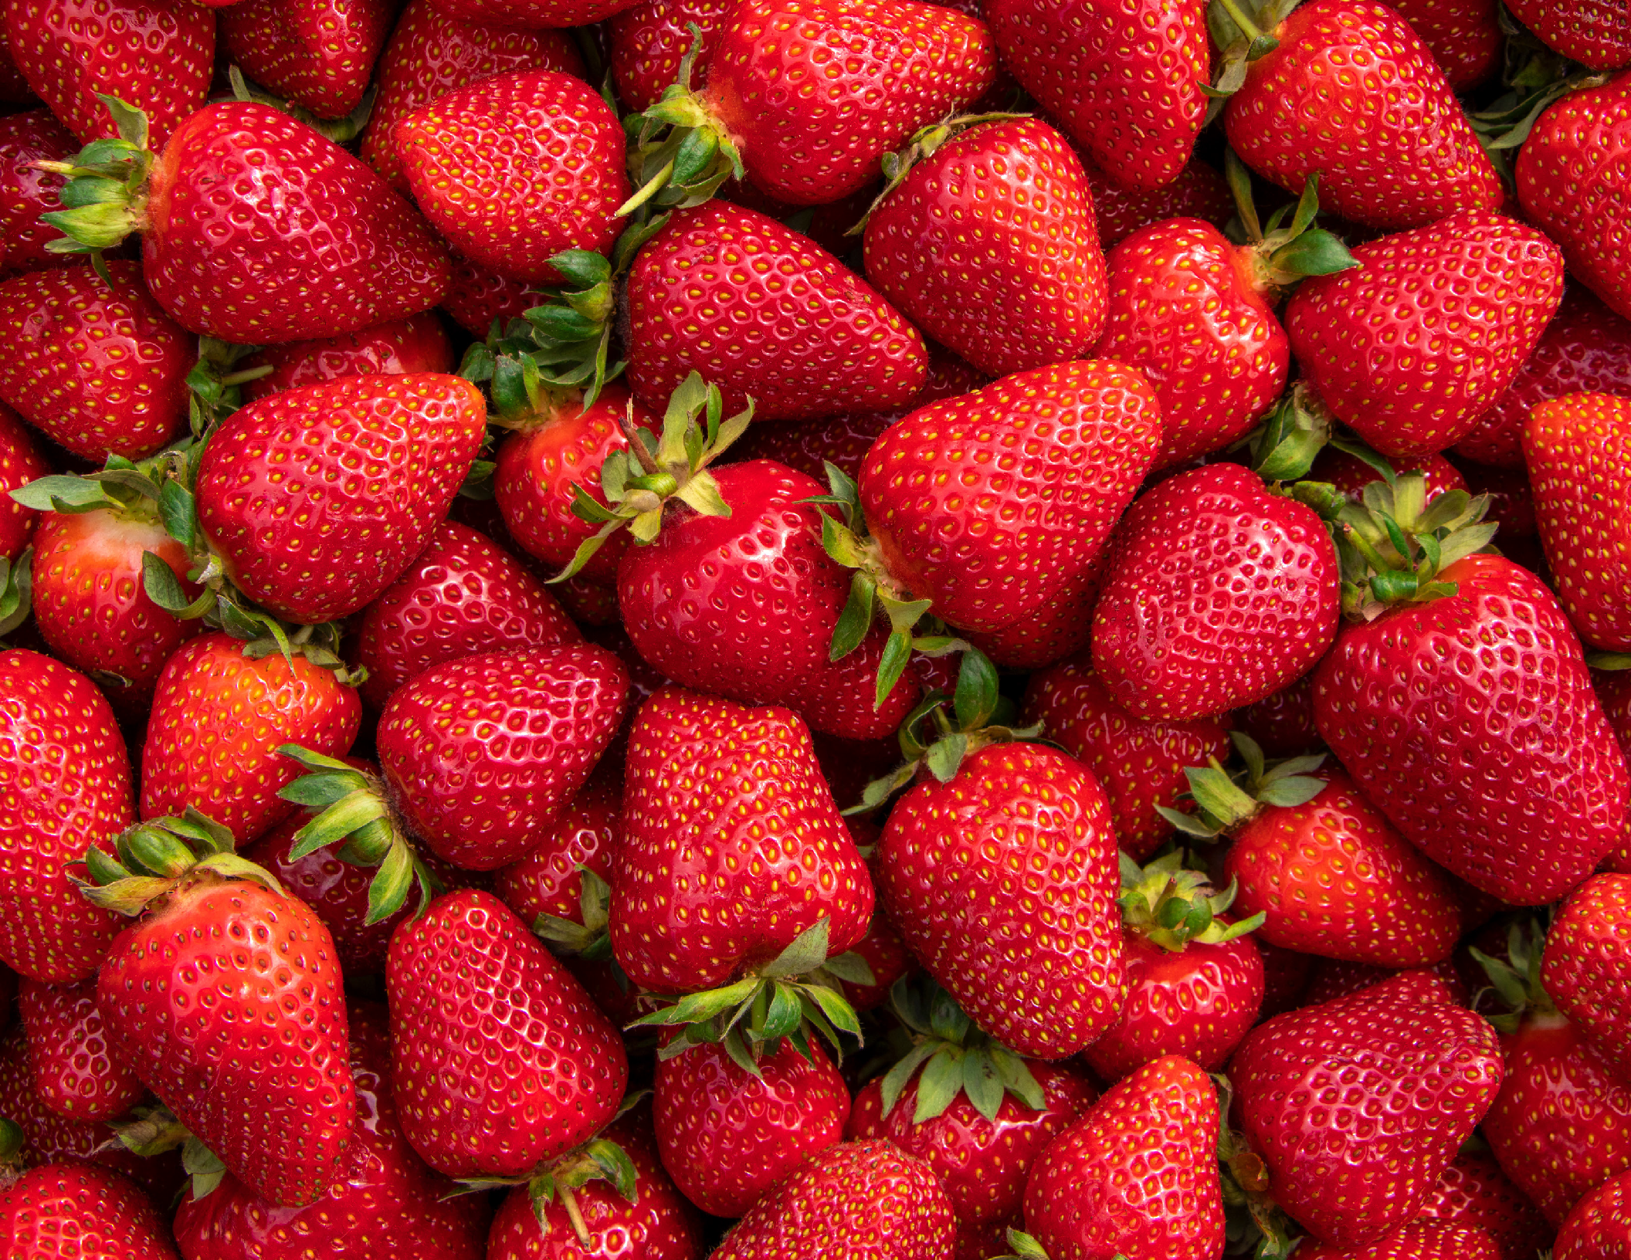
June 2025 |
School Name
Monday Tuesday
Wednesday
Thursday
Friday
2
3
4
5
6
Announcements:
Menu items
Menu items
Menu items
Menu items
Menu items
Announcement text goes here.
Copy and paste the Texas icon as many times as you need to place on the days your menu features Texas products!
9
10
11
12
13
Menu items
Menu items
Menu items
Menu items
Menu items
16
17
18
19
20
Menu items
Menu items
Menu items
Menu items
Menu items
23
24
25
26
27
Menu items
Menu items
Menu items
Menu items
Menu items
30
Strawberries
Season in Texas: April - June
Did you know?
On average, each strawberry has 200 seeds
Menu items
meals
square
Food and Nutrition Division www.SquareMeals.org
This product was funded by USDA. This institution is an equal opportunity provider.
Updated 6/6/2024 National School Lunch Program

Slide 12
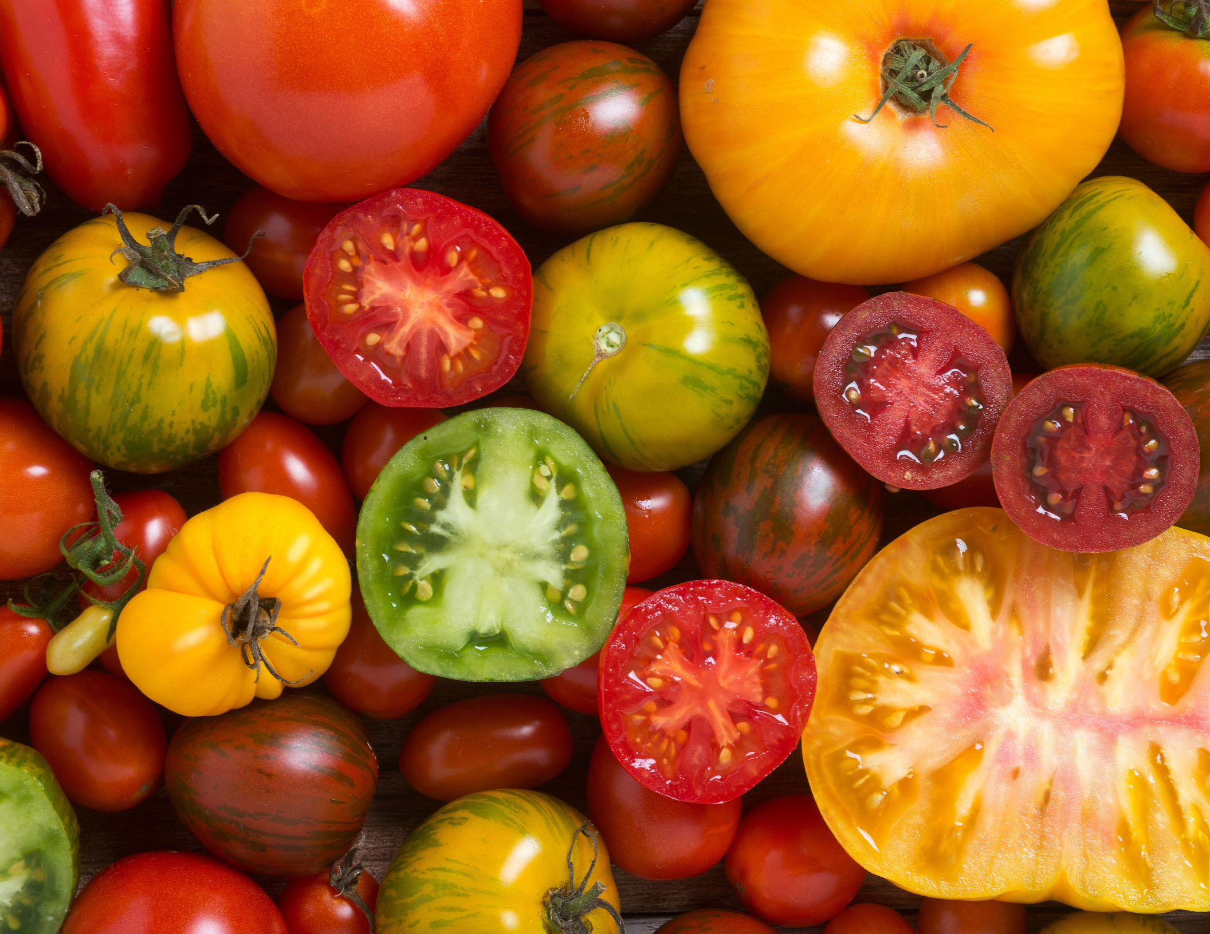
July 2025 |
School Name
Monday Tuesday
Wednesday
Thursday
Friday
1
2
3
4
Announcements:
Menu items
Menu items
Menu items
Menu items
Announcement text goes here.
Copy and paste the Texas icon as many times as you need to place on the days your menu features Texas products!
7
8
9
10
11
Menu items
Menu items
Menu items
Menu items
Menu items
14
15
16
17
18
Menu items
Menu items
Menu items
Menu items
Menu items
21
22
23
24
25
Menu items
Menu items
Menu items
Menu items
Menu items
28
29
30
31
Tomatoes
Season in Texas: April - December
Did you know?
Tomatoes are technically a berry
Menu items
Menu items
Menu items
Menu items
meals
square
Food and Nutrition Division www.SquareMeals.org
This product was funded by USDA. This institution is an equal opportunity provider.
Updated 6/6/2024 National School Lunch Program

